Slide 1
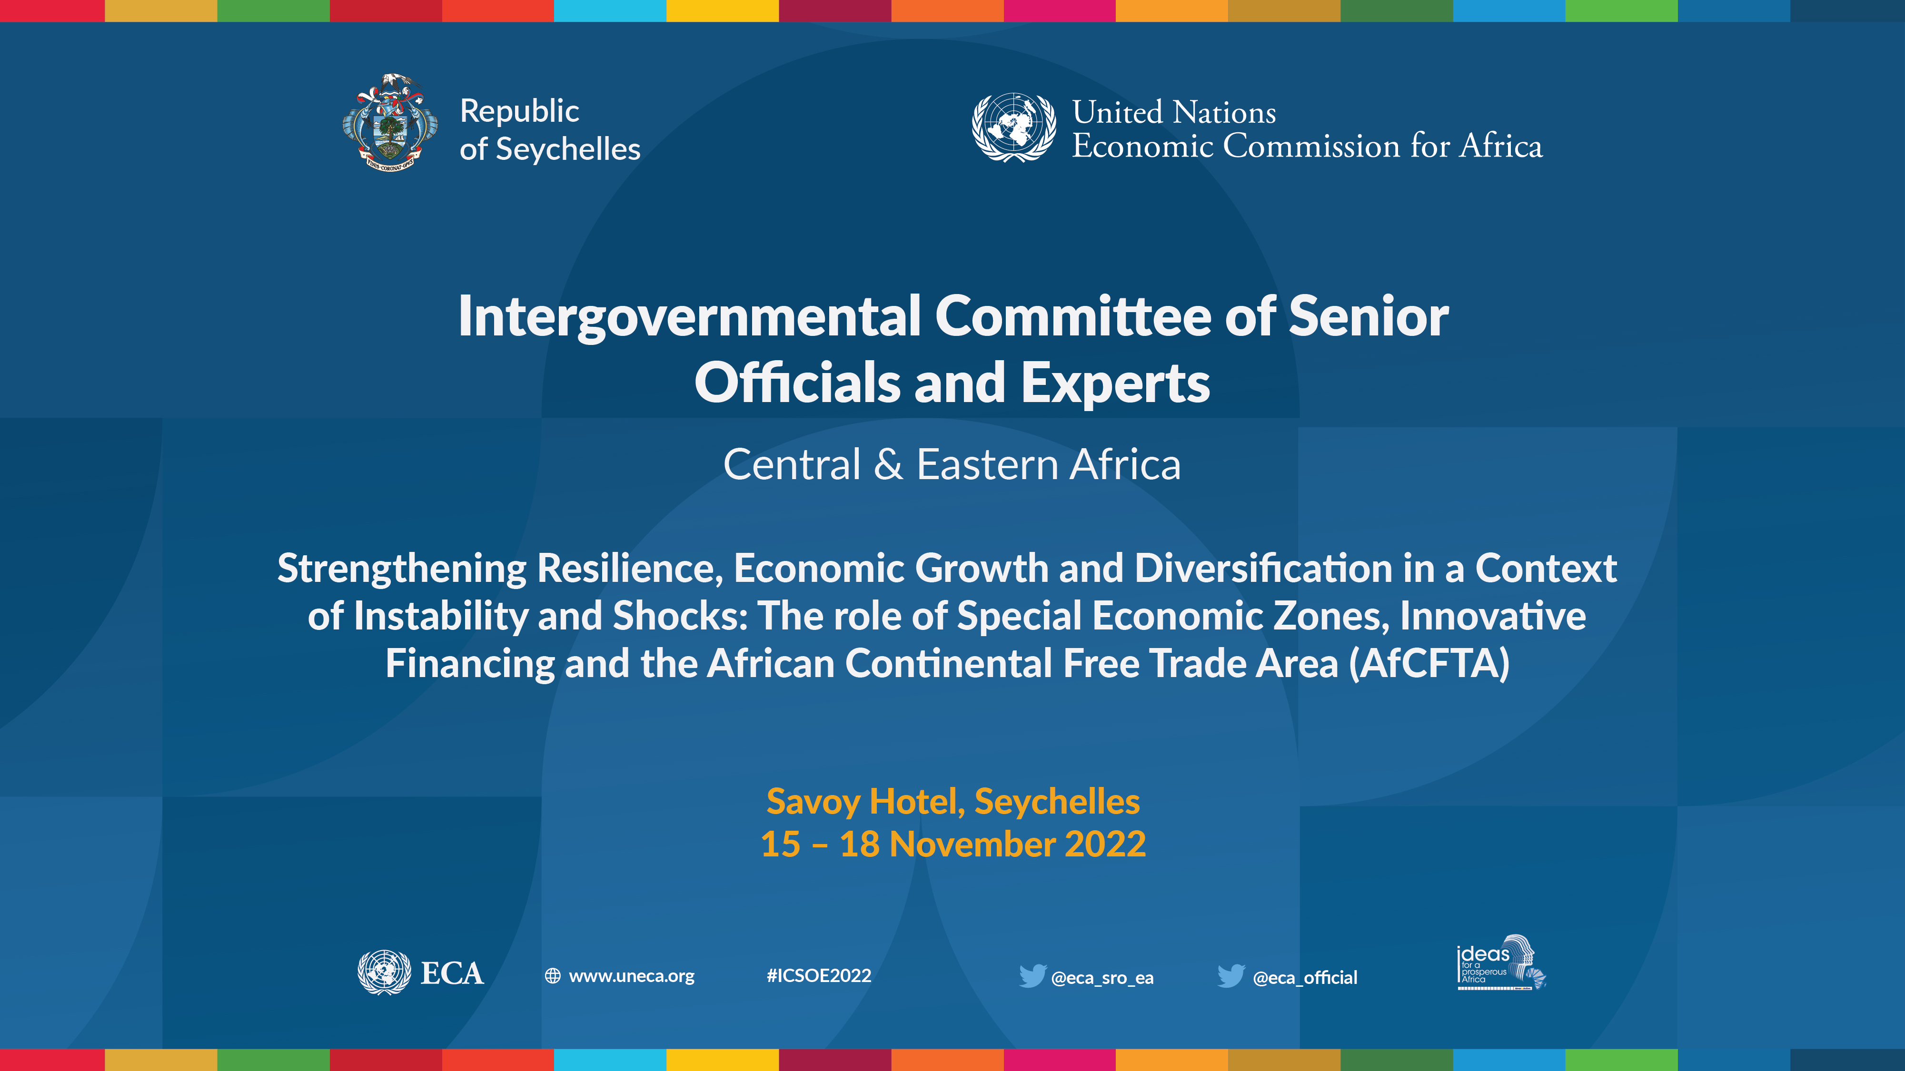
Event | Date
Presenter
Title
UNECA Sub-Regional Office for Eastern Africa

Slide 2
An Overview of the State of the Region
ICSOE | November 2022
Dr. Andrew Mold
Chief of AfCFTA and Regional Integration Cluster
Sub-Regional Office for Eastern Africa

Slide 3
OUTLINE
01
MACROECONOMIC SNAPSHOT
02
SOCIAL DEVELOPMENTS
03
CONCLUSIONS AND POLICY RECOMMENDATIONS

Slide 4

EA weathered the pandemic better than continental and global averages
Regional GDP growth rates (2017-2023)
What Kind of Recovery to Expect?:
U-shaped recovery?
W-shaped Recovery?
Or (the worst scenario?) a shaped recovery ?
$$√$$
Source: National sources, UNCTAD T&D Report (2022),IMF (2022)
Note: **Weighted Average for Eastern Africa.

Slide 5
The Need to Resume High Rates of Economic Growth…
Long-term changes* in real GDP per capita for Eastern Africa: 1970-2020
Posted a strong long-run growth performance, more than doubling their per capita incomes by 2020
Source: ECA calculations from UNCTADStat data (2022)

Slide 6
2021 was characterized by a strong recovery in most countries
GDP Growth Rates (%), 2020 and 2021
Source: National sources, & IMF (2022)
*Ethiopia and Uganda used fiscal year data

Slide 7
Quarterly growth rates reveal more about the dynamics…
Quarterly GDP growth rates
The pandemic’s effects were particularly hard felt on island states and landlocked countries in Eastern Africa.
Source: National Institute of Statistics Rwanda,, Seychelles National Bureau of Statistics

Slide 8
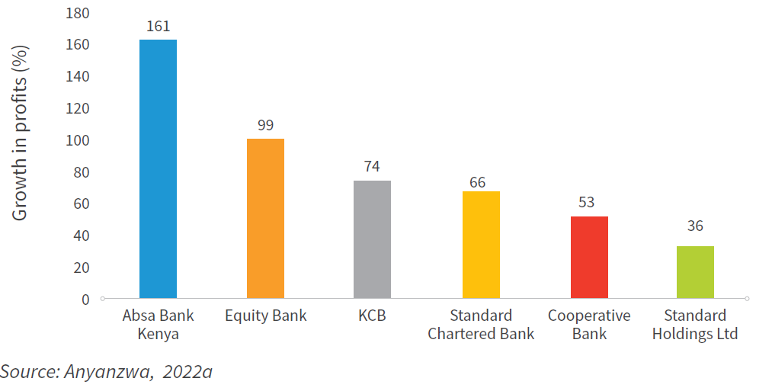
The recovery was led by a few rapidly growing sectors…e.g.
8 sectors recorded growth above 16% in 2021
One sector in particular has prospered….
2 sectors contracted
Source: KNBS Economic Survey 2022

Slide 9
Some regional economies now suffering double-digit inflation…
Annual Headline Inflation Rate (%), latest available
Period | Burundi | Ethiopia | Kenya | Rwanda | Uganda | Seychelles
21-Sep | 10.5 | 34.7 | 6.9 | -3.2 | 2.2 | 9.8
21-Oct | 9.9 | 36.6 | 6.5 | -3.3 | 1.9 | 10.0
21-Nov | 8.7 | 37.2 | 5.8 | -3.4 | 2.6 | 9.4
21-Dec | 10.0 | 34.0 | 5.7 | -2.0 | 2.9 | 7.9
22-Jan | 12.3 | 34.5 | 5.4 | 1.3 | 2.7 | 3.9
22-Feb | 13.4 | 33.6 | 5.1 | 4.2 | 3.2 | 3.0
22-Mar | 12.8 | 37.2 | 5.6 | 5.6 | 3.7 | 2.2
22-Apr | 16.1 | 34.0 | 6.5 | 10.5 | 4.9 | 2.2
22-May | 18.6 | 37.2 | 7.1 | 14.8 | 6.3 | 2.1
22-Jun | 17.5 | 34.0 | 7.9 | 16.1 | 6.8 | 2.1
22-Jul | 19.1 | 33.5 | 8.3 | 19.6 | 7.9 | 2.3
22-Aug | 19.6 | 32.5 | 8.5 | 20.4 | 9.0 | 2.8
23-Sep | 20.9 | 30.7 | 9.2 | 23.9 | 10.0 | 3.0
Source: National Sources

Slide 10
Inflationary Pressures being driven by one sector?
In Rwanda, food constitutes 48 and 27 percent of weighting in rural and urban CPI, respectively
Source: UNECA using IMF Commodity Price Indexes (2022), rebased to Jan 2020
Source: NISR (September 2022)

Slide 11
Fiscal deficits and debt levels continue to mount
Debt and Fiscal Balance (IMF Estimates October 2022*)
Source: UNECA using IMF (2022b) and national sources. *Figures for Djibouti from April 2022

Slide 12
Composition of Debt Matters for its Sustainability…
Interest Payments on Debt as % of Government Revenue, 2011-2020
Source: World Bank Development Indicators 2022

Slide 13
The Resilience of East African Trade…
Source: ECA analysis of UNCTADStat Data (2022)

Slide 14
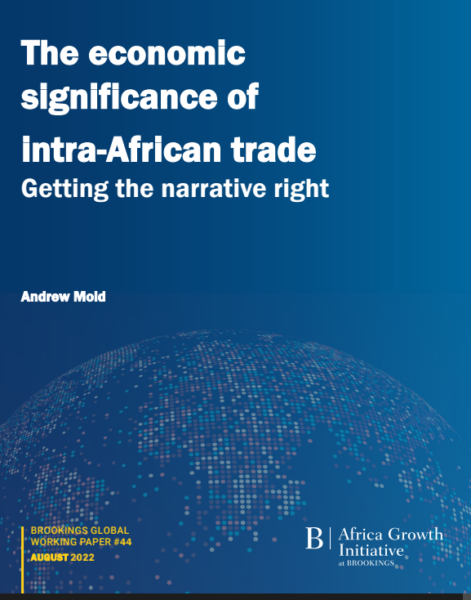
Which region has the highest intra-African trade?
Source: ECA analysis of UNCTADStat Data (2022)

Slide 15
Proof of the vibrancy of EAC trade? Kenyan-Tanzanian Trade…
Source: ECA analysis of KCB (2022)

Slide 16
FDI flows appeared to have significant momentum
FDI Inflows Percent Change, 2020-2021
FDI to East Africa grew by 29% to $10.0 billion in 2021.
Despite the outbreak of conflict in Tigray, FDI flows to Ethiopia reached $4.3 billion in 2021. Renewable energy sector and privatization are the main drivers of this figure.
Source: UNCTAD World Investment Report 2022

Slide 17
Maintaining ODA has become a challenge…
ODA to Eastern African Countries and % Change
Decline in UK Aid to Selected East African Countries, 2020-2022
Year | 2019 | 2020 | % Change
Somalia | 1,251 | 2,013 | 61%
Comoros | 28 | 34 | 24%
Madagascar | 287 | 339 | 18%
Ethiopia | 2,210 | 2,347 | 6%
Kenya | 1,481 | 1,419 | -4%
Eritrea | 25 | 13 | -46%
Eastern Africa | 11,440 | 12,580 | 10%
% Share Africa Total | 38% | 37% | -1%
Africa, Total | 30,412 | 33,773 | 11%
ODA received by the region is not much in view of the scale of the economic crisis precipitated by the global pandemic.
Those countries which are more dependent on assistance from UK have struggled to maintain ODA
Source: International Development Committee (2022)

Slide 18
Strong sentiment about depending more on domestic resources?
Most Africans/Eastern Africans(63%) want their countries to be self-reliant and control their own democratic and economic affairs.
More than three-fourths(77%) Tanzanian want their country to finance its national development from their own resources rather than rely on external loans. Highest in the region.
Source: Afrobarometer(2021
Note: Eastern Africa covers average of 4 countries
Africa covers average of 34 countries

Slide 19
OUTLINE
01
MACROECONOMIC SNAPSHOT
02
SOCIAL DEVELOPMENTS
03
CONCLUSIONS AND POLICY RECOMMENDATIONS

Slide 20
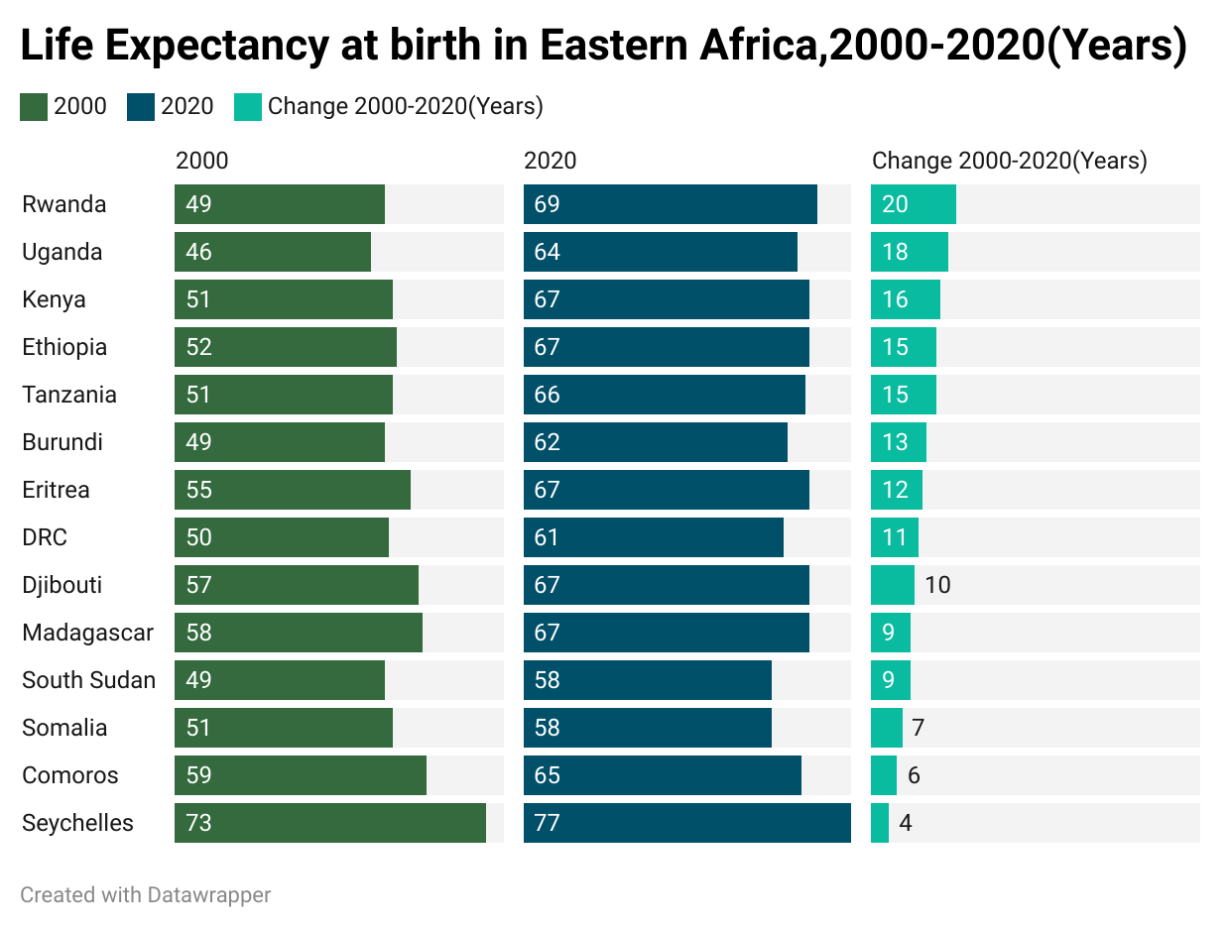

An impressive improvement in living conditions over last two decades

Slide 21
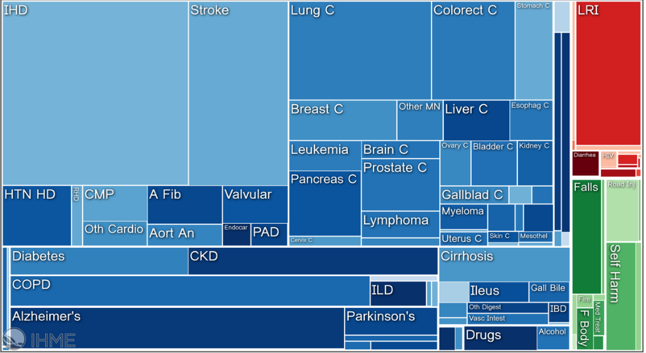
How people die in High Income Countries…(1)
Non- Communicable diseases
Communicable diseases
Injuries
Source: GBD Compare | Viz Hub (2022)

Slide 22
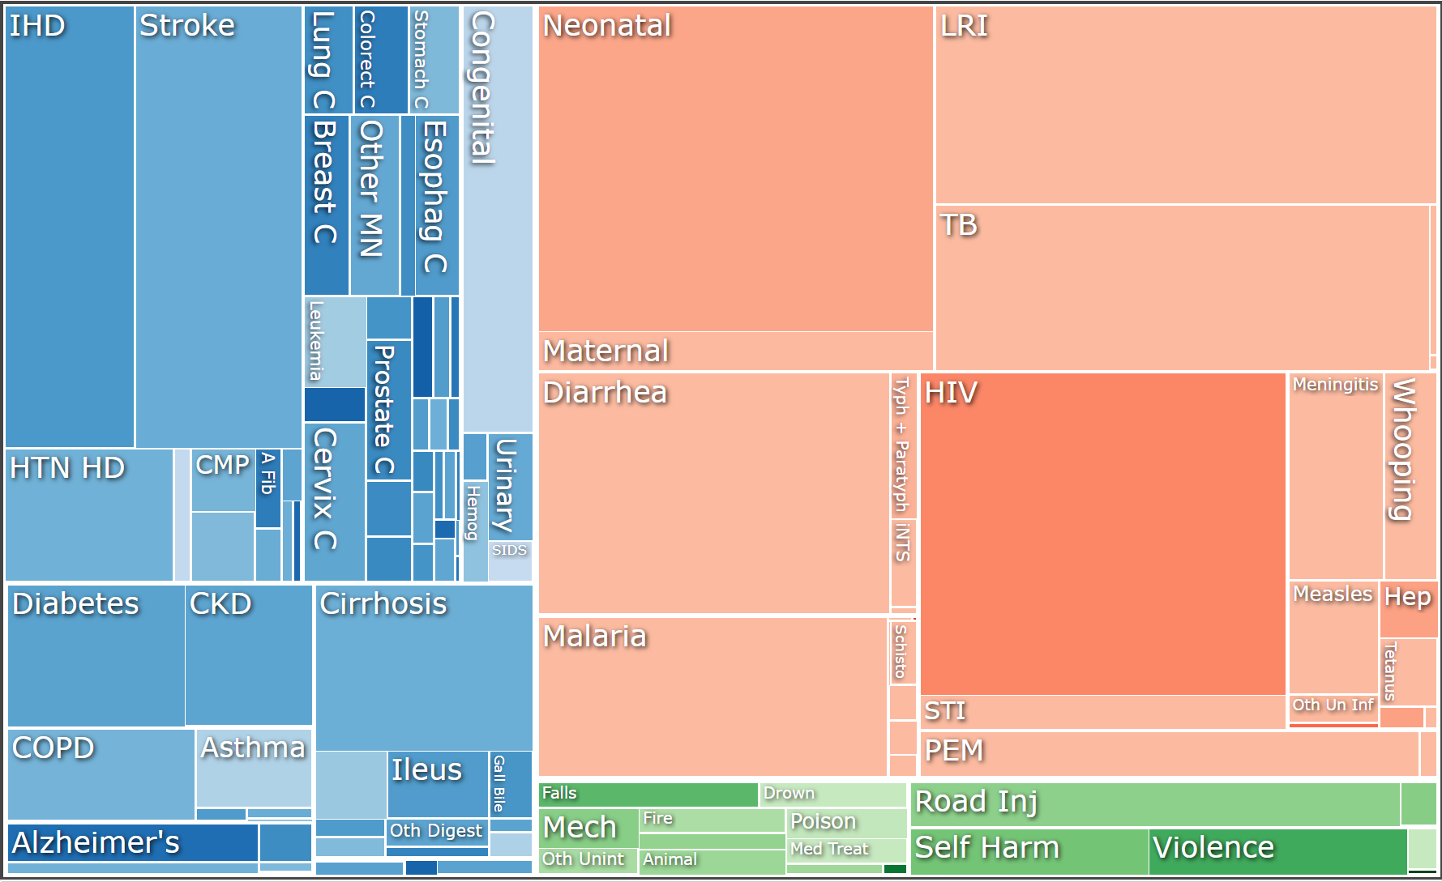
How people die in Eastern Africa Countries….
Non- Communicable diseases
Communicable diseases
Injuries
Source: GBD Compare | Viz Hub (2022)

Slide 23
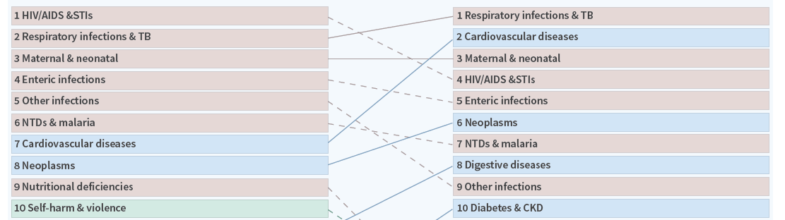
Changing Causes of Death Eastern Africa 2000-2019
2000
Source: GBD Compare | Viz Hub (2022

Slide 24
Changing Causes of Death Eastern Africa 2000-2019
2000
2019
Source: GBD Compare | Viz Hub (2022

Slide 25
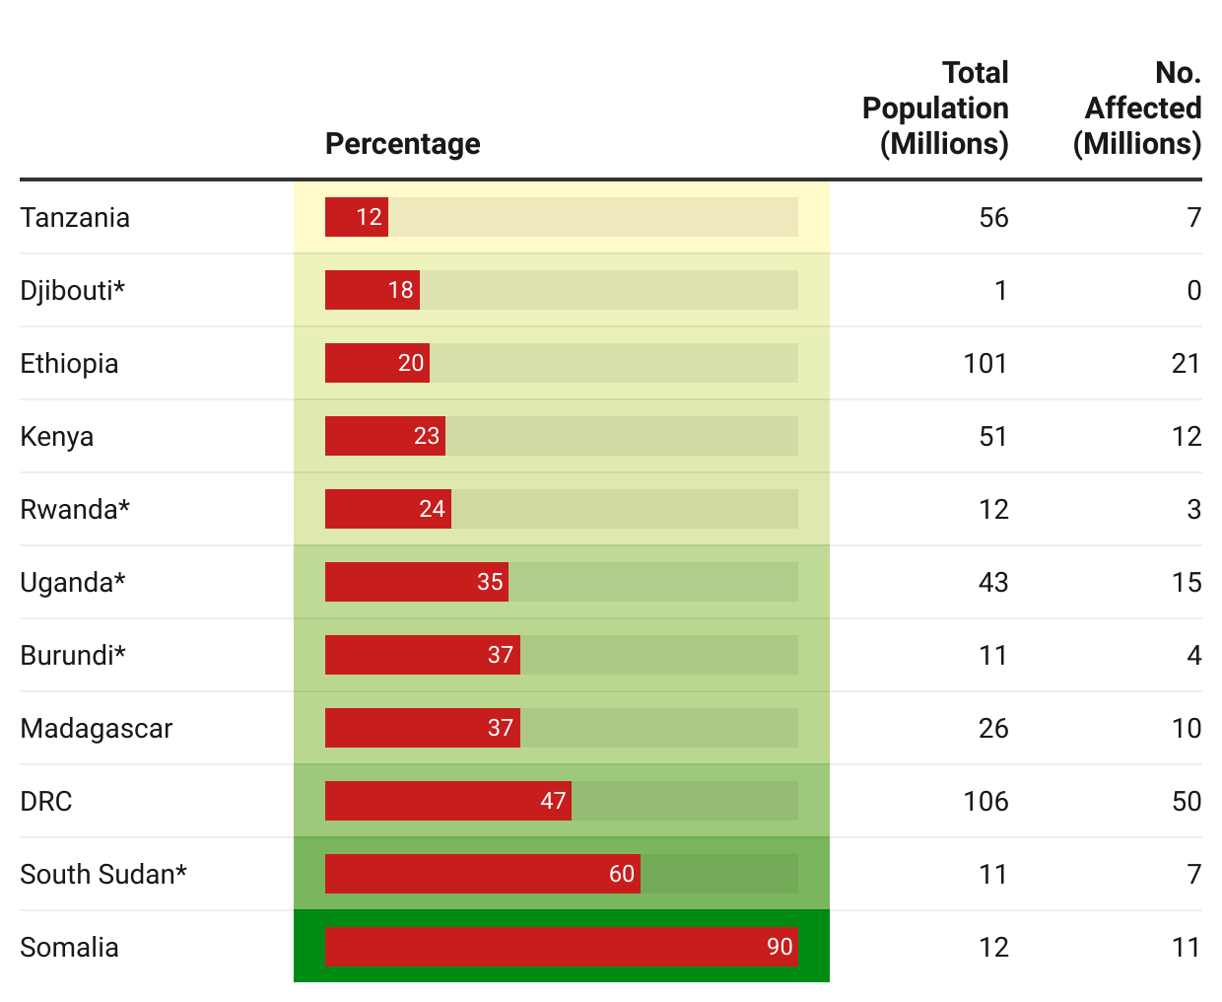
Food insecurity crisis mounting in the region
Prevalence of insufficient food consumption(as of November 2022)
Top Ten countries with highest number of people in food crisis in world, 2021(Millions)
Note:*Predicted figure
Source:WFP Hunger Map,2022
Source: FSIN (2022), UNECA calculations.

Slide 26
Climate hazards has led to acute food insecurity in the region
Number of Climate Disasters in Eastern Africa, 2020 – 2021
Source: CRED (2022)

Slide 27
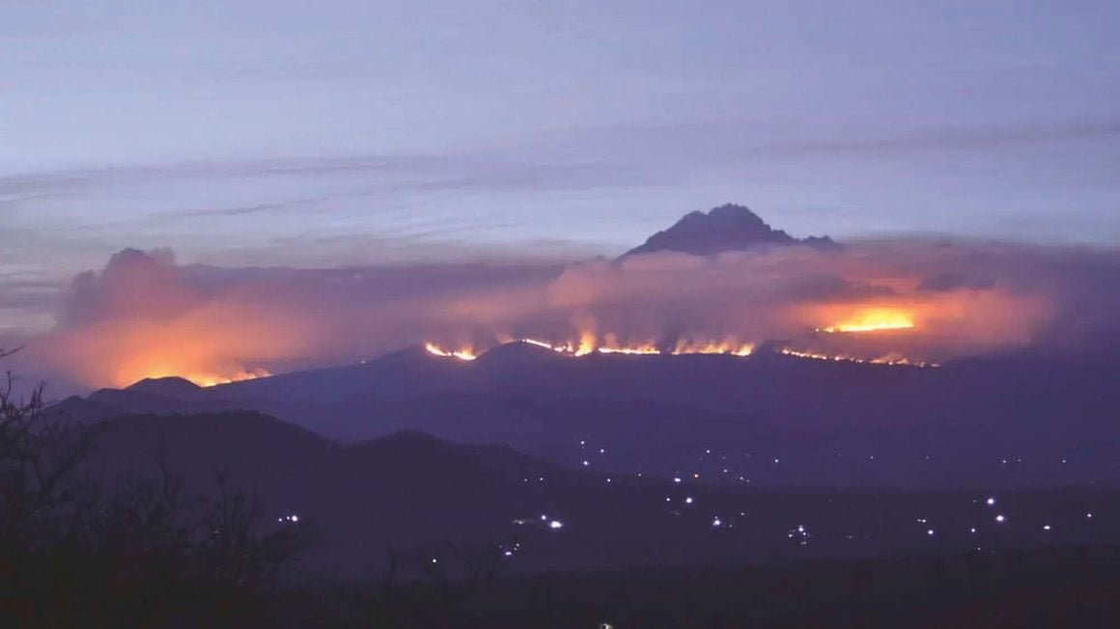
Photo | Thomas Becker | Picture Alliance Via Getty Images/East African Newspaper

Slide 28
East Africa is host to a significant number of IDPs
Top Ten Internally Displaced People(in Millions), 2020
DRC, Somalia, Ethiopia and South Sudan are in the top 10 IDP countries in 2020.
As of 31 December 2021, there were approximately 12.4 million IDPs in the region* – mainly in Burundi, Ethiopia, Somalia and South Sudan.
The drivers of displacements are complex, including conflict, persecution as well as climatic and natural disaster factors, e.g., in Burundi (climate) and Ethiopia (ongoing conflict).
Source: UNHCR,2022
*Note: Region refers to East and Horn of Africa, and the Great Lakes (EHAGL) region

Slide 29
OUTLINE
01
MACROECONOMIC SNAPSHOT
02
SOCIAL DEVELOPMENTS
03
CONCLUSIONS AND POLICY RECOMMENDATIONS

Slide 30
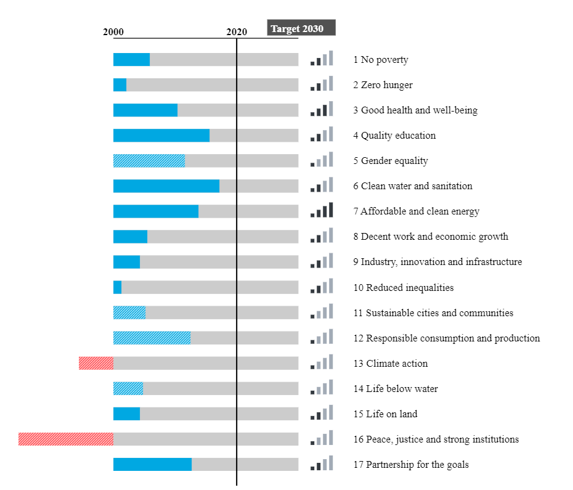
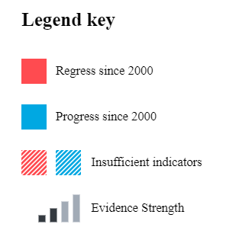


Need to Accelerate Progress on SDGs Regionally…
Source: ECAStats 2022

Slide 31



Policy Recommendations?
Build Resilience Against Climate Shocks
Fix Finance
Return to Priorities of National Development Plans

Slide 32
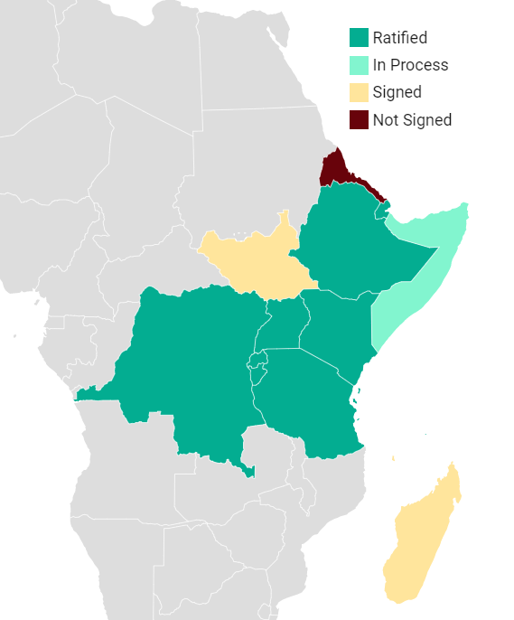
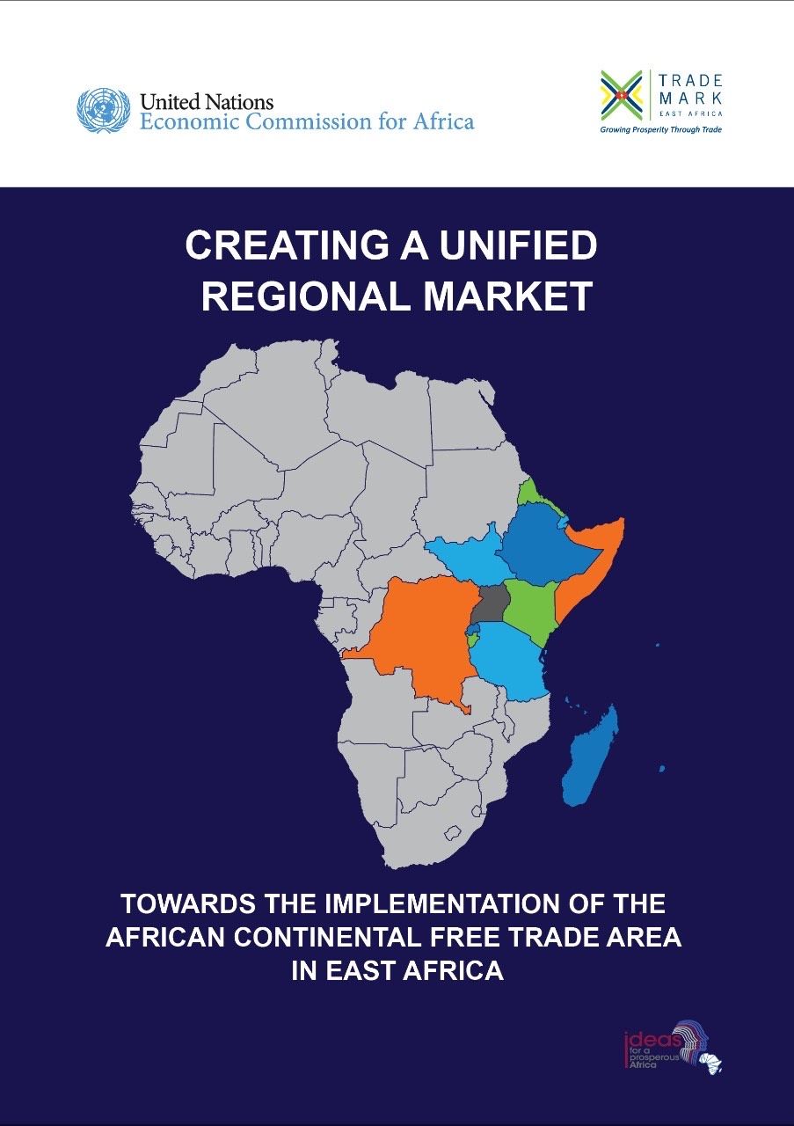
Implementing the AfCFTA $−$ towards sustained development
Status of AfCFTA Ratification as of 9 October 2022
The implementation of the AfCFTA is a long-term goal which promises to put the continent on a new path towards sustained development.
Source: TRALAC

Slide 33
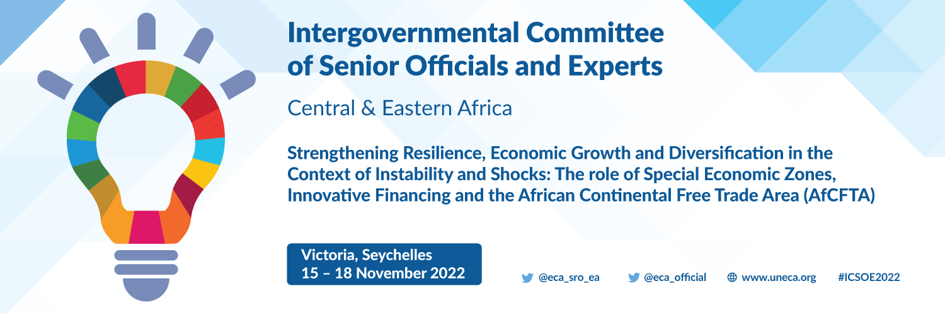
For more information:
www.uneca.org/ea-icsoe26

