Slide 1
Event | Date
Presenter
Title
UNECA Sub-Regional Office for Eastern Africa

Slide 2
Innovative financing for Eastern Africa: Fintech, Cryptocurrencies and Islamic finance
ICSOE2022, 15 November 2022
Prof. Issouf Soumaré
Université Laval, Quebec, Canada
www.issoufsoumare.com

Slide 3
Innovative financing for Eastern Africa: Fintech, Cryptocurrencies and Islamic finance
Part 1: Fintech and Cryptocurrencies in Eastern Africa
Prof. Issouf Soumaré
Université Laval, Quebec, Canada
www.issoufsoumare.com

Slide 4
PREAMBLE
Development in ICT sector, particularly with the rapid penetration of the internet over the past decades has substantially impacted human beings and all economic activities.
The finance sector with Fintech is one of the sectors that have been substantially impacted by the development of technology and the internet.
Fintech have ultimate impact on individuals, households, and firms in terms of reduced transactional costs and easy access to financial services
The development of Fintech in Eastern Africa will definitively increase financial inclusion and will support the sub-region development.

Slide 5
OUTLINE
01
DEFINITION AND GENERALITIES OF FINTECH
02
CURRENT STATE OF FINTECH IN EASTERN AFRICA
03
FINTECH AND SME DEVELOPMENT IN EASTERN AFRICA & AfCFTA
04
CRYPTOCURRENCIES IN EASTERN AFRICA
05
CONSTRAINTS TO FINTECH DEVELOPMENT IN EASTERN AFRICA
06
CONCLUSION AND RECOMMENDATIONS

Slide 6
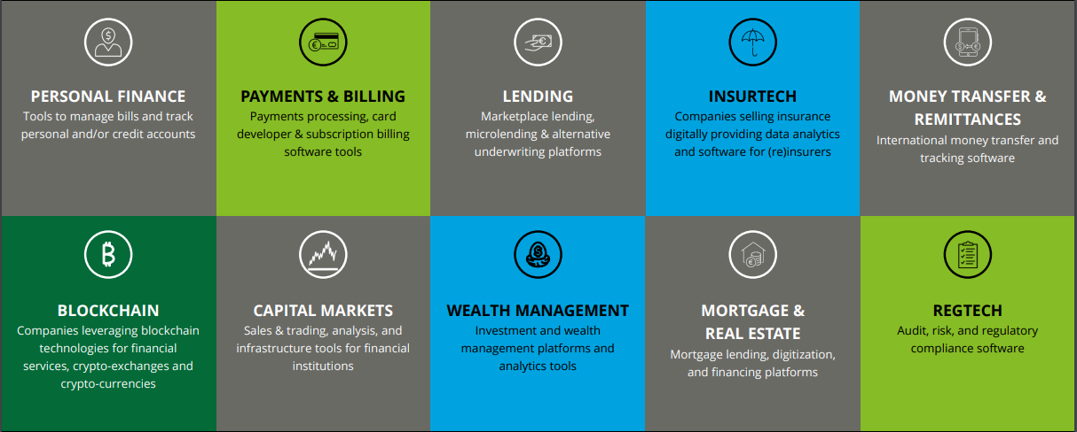
01 DEFINITION AND GENERALITIES
The main types of Fintech cover sectors summarized in the table below:

Slide 7
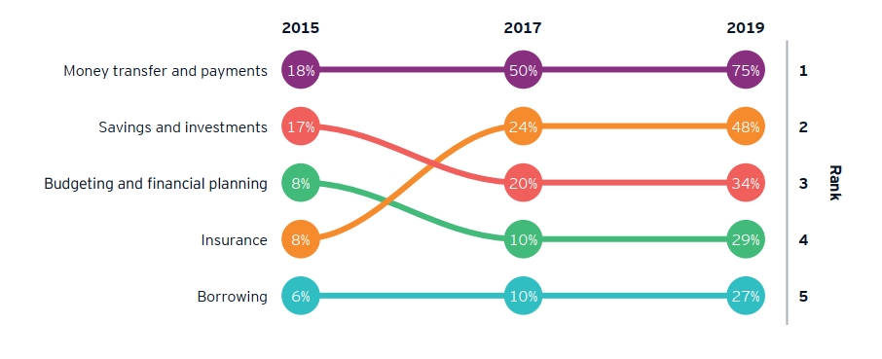
01 DEFINITION AND GENERALITIES
Money transfer and payments remain the main Fintech type worldwide (Evolution of the use of Fintech services between 2015 and 2019)
Source: E&Y (2019)

Slide 8
02 CURRENT STATE OF FINTECH IN EASTERN AFRICA
Mobile payment is the main type of transactions used in the region (Type of payment transactions in selected Eastern African countries, 2013-2016)
 |  | Cheques | Cards | Mobile
Kenya | Number of transactions - in millions/ share (%) | 19.4 (1%) | 216.2 (12%) | 1,526.1 (87%)
 | Transactions value – US$ millions (share in %) | 26,348.5 (36%) | 13,965.2 (1%) | 33,555.8 (45%)
 | Average size of transactions (US$) | 1,358.2 | 64.6 | 22
 | 3 Year growth rate (2013-2016) | 4.80% | -3.10% | 20.80%
Tanzania | Number of transactions - in millions/ share (%) | 1.6(0.1%) | 72.7 (4%) | 1,677 (96%)
 | Transactions value – US$ millions (share in %) | 2,910 (8%) | 5,249 (15%) | 27,012 (77%)
 | Average size of transactions (US$) | 1,819.2 | 72.2 | 16.1
 | 3 Year growth rate (2013-2016) | -15% | 13.10% | 27%
Rwanda | Number of transactions - in millions/ share (%) | 0.3 (0.1%) | 9.8 (5%) | 205.7 (95%)
 | Transactions value – US$ millions (share in %) | 874 (32%) | 578.9 (21%) | 1,268.9 (47%)
 | Average size of transactions (US$) | 2,913.3 | 59.1 | 6.2
 | 3 Year growth rate (2013-2016) | 0.30% | 18.30% | 46.60%
Source: FSD Africa (2016), Central Bank of Kenya, Bank of Tanzania, National Bank of Rwanda

Slide 9
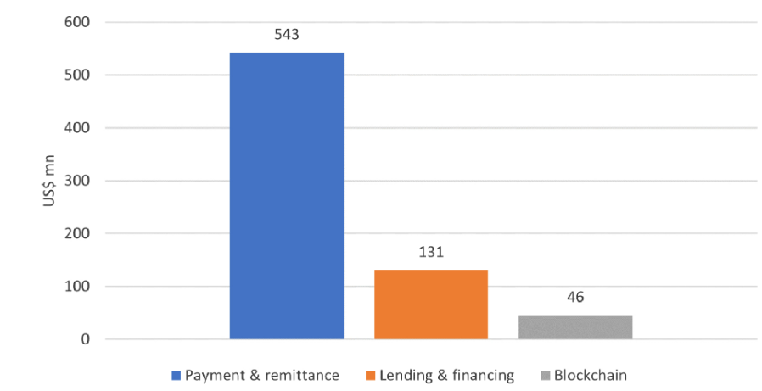
02 CURRENT STATE OF FINTECH IN EASTERN AFRICA
African Fintech investment is currently dominated by mobile payments and remittances Fintech (Investment in African Fintech, 2015 - H1’2021)
Kenya is the leading Eastern African country in terms of Fintech Start-up (Number of Fintech start-ups in Africa, 2021)
Source: Raji (2021) and Mureithi (2021).
Source: Statista Research Department

Slide 10
02 CURRENT STATE OF FINTECH IN EASTERN AFRICA
Enablers of Fintech in the region
1. Demographic trend
(high share of millennials in the population: >30%)
2. Rapid internet penetration
(growing share of population with access to the internet: from 2% in 2010 to 19% in 2020)
4. Gaps in financial services
(limited access of the population to the traditional banking sector: account ownership < 50%)
3. Rapid mobile penetration
(Growing share of mobile subscriptions: from 28% in 2010 to 61% in 2020)

Slide 11
03 FINTECH AND SME DEVELOPMENT IN EASTERN AFRICA & AfCFTA
Fintech could positively impact SME business growth and development:
Adoption and implementation of financial technology easier and less costly
Making payments easier and faster
Integration and automation of financial management functions (record-keeping, inventory…)
Increase access to alternative and long-term financing (P2P lending, factoring, crowdfunding)
Fintech can contribute to the success of AfCFTA through the following channels:
Payment systems: Solving cross-border payments within the continent could “exponentially increase intra-Africa trade,” according to the UNDP and the AfCFTA Secretariat.
E-commerce: Fintech development can improve e-commerce and boost regional trade.
Cross-border investment in Fintech: The investment protocol of AfCFTA allows cross-border investments. The development of Fintech which attracts cross-border investments is another facet of the role Fintech can play in the successful implementation of AfCFTA.

Slide 12
04 CRYPTOCURRENCIES: DEFINITION
A cryptocurrency is a digital currency issued peer-to-peer, without the need for a central bank, and used through a decentralized computer network.
It uses cryptography, peer-to-peer networks, and distributed ledger technology such as blockchain to create, verify, and secure transactions.
There are several issues posed by cryptocurrencies: very risky assets

Slide 13
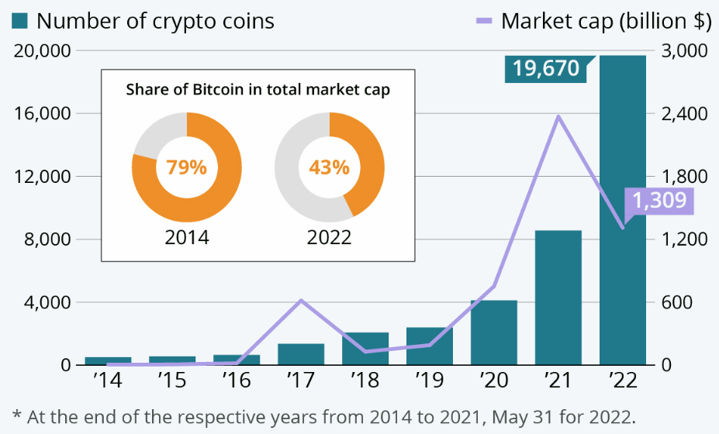
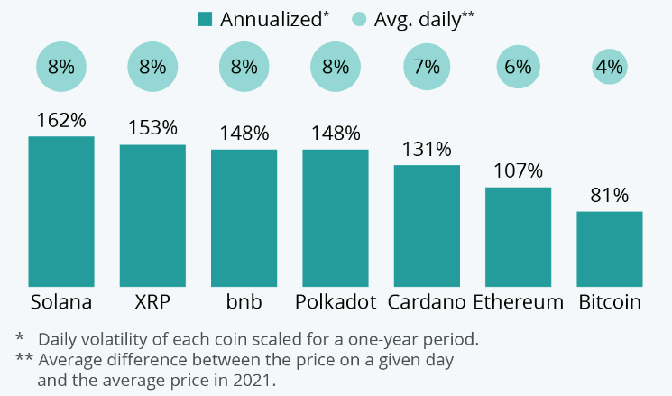
04 CRYPTOCURRENCIES: TREND AND VOLATILITY
In spite of various advantages, there are several issues posed by cryptocurrencies – They are risky assets (top volatility cryptocurrencies in 2021)
Source: Statista
The number of cryptos rises from only a few hundred virtual currencies from 2014 to 19,670 at end of May 2022.
Market cap moved from US$600 billion in 2014 to US$3 trillion in Nov. 2021 before dropping to US$1.3 trillion in May 2022.

Slide 14
04 CRYPTOCURRENCIES: CBDC
The increasing use and adoption of cryptocurrencies by the population and businesses have pushed several central banks to launch or prepare to launch their digital currency, namely CBDC (Central Bank Digital Currency).
CBDC is a digital alternative to cash that is also decentralized, and offers more flexibility.
Nigeria is among the first countries in the world to issue CBDC, namely eNaira in October 2021. Many other countries, including USA, EU, Russia and Australia, are exploring to issuing their CBDC.

Slide 15
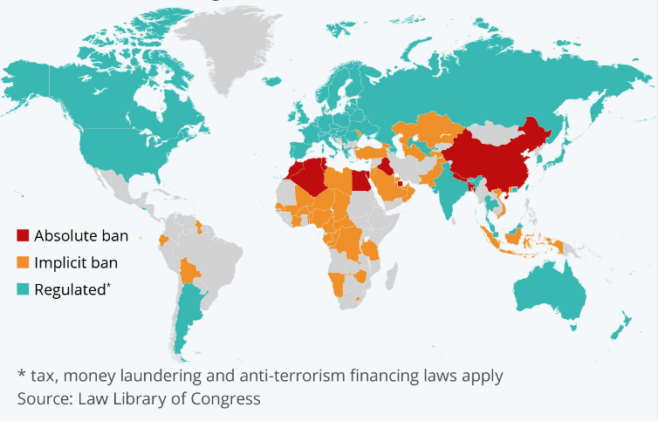
04 CRYPTOCURRENCIES: REGULATION
The map below highlights that cryptocurrencies in Eastern Africa are implicitly banned although residents increasingly use them (Where the world regulates cryptocurrencies as of November 2021)
Use case:
In Kenya, an organization called Grassroots Economics (GE), had issued a local cryptocurrency called Sarafu to support poor communities in Nairobi.
Source: Statista

Slide 16
04 CRYPTOCURRENCIES: POTENTIAL BENEFITS
Potential benefits in Eastern Africa:
Potential to streamline cross-border payments
Can have a positive impact on AfCFTA implementation in the region
Can reduce financial transaction costs
Increase access to financial services and financial inclusion
Accelerate the development of e-commerce with enlargement of local businesses’ market as local enterprise can easily connect to online payment platforms with reduced transaction costs.
Ease of international capital flows as with cryptocurrencies, there is no constraint or barrier for international capital flows.
Encourage digital financial transactions: payments, transfers, savings, credit, insurance, and investments.

Slide 17
04 CRYPTOCURRENCIES: POTENTIAL DEMERITS
Demerits in Eastern Africa:
Highly risky assets as currently most cryptocurrencies in circulation are speculative assets.
Lack of investor protection. As cryptocurrencies are not regulated and the platforms that trade these currencies are not locally regulated, there is no protection for local investors.
Personal data protection is a key issue with Fintech in general. Without any regulation, cryptocurrency trading platforms could not develop rules to protect the data of people who use these platforms.
Safety and stability of the financial system, as well as operational, financial integrity, and cybersecurity risks.
Anti-money laundering and terrorism financing (AML/CFT) issues. As there is no AML/CFT regulation in these countries for cryptocurrency trading platforms, these can be used by criminals and terrorists to transfer and manage money to finance criminals and terrorism activities.
Macro-financial issues, particularly the fact that the international reserve of the countries could not be easily managed as most of the international transfers or transactions are not easily traceable by central banks.

Slide 18
05 CONSTRAINTS TO FINTECH DEVELOPMENT IN EASTERN AFRICA
Fintechs face several constraints for their development in Eastern Africa:
Lack of the full spectrum of skills and competencies across the region: For instance, there is shortage of chief technology officers, software engineers, data scientists
Limited economic infrastructures in the region which lead to limited internet and electricity coverage, poor network connectivity, particularly in rural areas
High cost of internet and mobile
Limited digital literacy in the pubic
Legal and regulatory requirements for Fintech are significant (Data governance including personal data protection, KYC, Cybersecurity requirements, Electronic money and electronic fund transfer regulation, Anti-money laundering and countering of financial terrorism regulation, Digital banking regulation, Digitally–enabled ID regulation, E-money regulation…). So far, these key regulations are not fully implemented in all the countries of the region.

Slide 19
05 CONSTRAINTS TO FINTECH DEVELOPMENT IN EASTERN AFRICA
Currently, only Kenya in the region, has implemented a full set of legal and regulatory requirements for Fintech
Country | Anti-money laundering | Equity crowdfunding | Digital ID | Electronic money | Cyber security | Electronic Payment/Transfer | Data protection
Burundi | Regulated | No legislation identified | Regulated | Regulated | Regulated | Regulated | No legislation identified
Congo, DR | Regulated | No legislation identified | Regulated | Regulated | No legislation identified | Regulated | Regulated
Comoros | Regulated | No legislation identified | Regulated | Regulated | No legislation identified | No legislation identified | Regulated
Djibouti | Regulated | No legislation identified | Regulated | No legislation identified | Regulated | No legislation identified | No legislation identified
Ethiopia | Regulated | No legislation identified | Regulated | Regulated | Regulated | Regulated | Regulated
Kenya | Regulated | Regulated | Regulated | Regulated | Regulated | Regulated | Regulated
Madagascar | Regulated | No legislation identified | No legislation identified | Regulated | Regulated | Regulated | Regulated
Rwanda | Regulated | No legislation identified | Regulated | Regulated | Regulated | Regulated | Regulated
Somalia | Regulated | No legislation identified | No legislation identified | No legislation identified | No legislation identified | No legislation identified | No legislation identified
South Sudan | Regulated | No legislation identified | No legislation identified | No legislation identified | Regulated | No legislation identified | No legislation identified
Tanzania | Regulated | No legislation identified | Regulated | Regulated | Regulated | Regulated | Regulated
Uganda | Regulated | No legislation identified | Regulated | Regulated | Regulated | Regulated | Regulated
Source: World Bank and authors’ compilation

Slide 20
06 CONCLUSION AND RECOMMENDATIONS
The development of the Fintech industry has significantly impacted individuals and firms in Eastern African countries, with a significant increase in financial inclusion.
Indeed, the limited access of people, particularly in remote rural areas and among low-income populations, to the banking sector, and the penetration of smartphones and the internet in the region are among the enablers of Fintech development in the region.
Mobile payments Fintech is the main type of Fintech in the region. However, other Fintechs such as P2P lending, invoice lending, e-commerce finance… are more and more increasing.
However, certain number of constraints limit the development of Fintech in the region, e.g. poor infrastructure, lack of legal and regulatory framework…

Slide 21
06 FINTECH - CONCLUSION AND RECOMMENDATIONS
Regulation:
AfCFTA: Coordinate and harmonize the implementation of a legal and regulatory framework.
Define a set of rules and laws that cover the full spectrum of Fintech. Include in the legal and regulatory framework provisions and incentives to promote interoperability among Fintech solutions in the region.
Adapt quickly the legal and regulatory framework to the evolution of the sector as it is a fast developing and transforming sector.
Infrastructure:
Design policies to increase internet and mobile penetration through cost reduction.
Increase IT infrastructure (high-speed internet, energy…) investment.
Skills and competencies: Increase practical experience content in the training programs of technology schools and universities of the region.
Establish Fintech hubs, accelerators, sandboxes, and incubators that young entrepreneurs can access to develop their start-ups.
Establish a mentoring program to support young Fintech entrepreneurs to develop their soft skills, increase their exposure, and their ability to raise funds/capital to develop their start-ups.
Support Fintech development that increases SME financial inclusion.

Slide 22
06 CRYPTOCURRENCY - CONCLUSION AND RECOMMENDATIONS
Each country in the region should define a legal and regulatory framework to manage the challenges and risks posed by the usage of cryptocurrencies and crypto-assets.
Each country in the region should initiate research and study for the issuance of its digital currency (CBDC).
Implement pan-regional harmonized personal data protection laws by reaching a consensus on the regulatory goals.
Develop a pan-regional blockchain strategy to take advantage of this powerful cutting-edge technology.
Support high-level research and education on blockchain technology and its governance.
Explore the feasibility of creating and operating a pan-regional blockchain infrastructure that offers a testbed for innovators, researchers, businesses, and the public sector to run blockchain-based applications.

Slide 23
Innovative financing for Eastern Africa: FinTech, Cryptocurrencies and Islamic finance
Part 2: Islamic finance in Eastern Africa
Prof. Issouf Soumaré
Université Laval, Quebec, Canada
www.issoufsoumare.com

Slide 24
PREAMBLE
Over the past decades, Islamic finance had a significant expansion across the world with total assets growth of almost 25% a year to reach US$2.7 trillion in 2020.
Recognizing the growing importance of Islamic banking and the growing demand for financial services that meet ethical standards, an increasing number of major international banks have opened Islamic banking “windows” tailored to the needs of Islamic investors from a global Muslim population of over 1 billion, including 11 million Muslims in Europe and 6 million in the USA.
The growing number of financial institutions offering Islamic financial services and products combined with the increasing size of the total asset of the sector represents a great financing opportunity for Eastern African economies which struggle to mobilize significant financing for their development.

Slide 25
OUTLINE
01
DEFINITION AND GENERALITIES
02
CURRENT STATE OF ISLAMIC FINANCE IN EASTERN AFRICA
03
ISLAMIC FINANCE & ECONOMIC FINANCING IN EASTERN AFRICA
04
CONSTRAINTS TO ISLAMIC FINANCE DEVELOPMENT IN EASTERN AFRICA
05
CONCLUSION AND RECOMMENDATIONS

Slide 26
01 DEFINITION AND GENERALITIES
Islamic finance is a set of sharia-based (under Islamic laws) financing techniques.
Islamic finance leverages the fact that the practice of ribã (usury or interest) is forbidden by Islam.
The key principle of Islamic finance is that the owner of a project and investors or lenders should share the profits and losses of the investment based on pre-agreed sharing rules.
Main principles of Islamic finance:
Wealth must be generated from legitimate trade and asset-based investment.
Investment should also have a social and ethical benefit (per Islamic laws) to the wider society beyond pure return.
Risk should be shared.
All harmful activities (haram) should be avoided.

Slide 27
01 DEFINITION AND GENERALITIES – Trend in Islamic finance
As of today, Islamic finance is composed of 3 main sectors: i) Islamic banking sector; ii) Islamic capital market and iii) Islamic insurance sector (Takaful) with total global asset around US$2.7 trillion in 2020, largely driven by Islamic banking which represented 68.2% of the industry as presented in 2020 Sectoral analysis of IFSI (2020) below.
Source: IFSB, Islamic financial service industry report (2021):
In 2020, Islamic finance capital market was the sub-sector with the highest annual growth of 26.9%.

Slide 28
02 CURRENT STATE OF ISLAMIC FINANCE IN EASTERN AFRICA
Islamic finance is at its first development stage in Eastern Africa:
In Somalia, the first Islamic financial institution was founded in 1998. The first Islamic bank in Somalia is Amal Bank.
Islamic banking emerged in Kenya with Barclays launching Islamic banking products in December 2005. The sector later expanded with the introduction of 2 Islamic banks, First Community Bank in 2007 and Gulf African Bank (GAB) in 2008.
In 2008, Tanzania authorized Kenya Commercial Bank (KCB), for the establishment in the country of an “Amana Islamic” branch, specializing in Islamic banking. It is the very first bank offering Islamic financial services in the country.
In Ethiopia, an interest-free banking system like Islamic finance was first allowed in 2011 under the existing conventional banking system.
In Uganda, the Financial Institutions Act 2004 was amended in 2016 to allow companies and banks to offer Islamic finance banking services.
In Djibouti, it is through the creation of the Saba Islamic Bank in 2006 (renamed Saba African Bank in 2018), that Islamic finance was introduced into the Djiboutian financial environment.

Slide 29
02 CURRENT STATE OF ISLAMIC FINANCE IN EASTERN AFRICA
Since 2012, the number of IFI in Eastern Africa has increased from 12 to 84 in 2022 (Number of Islamic finance institutions in selected Eastern African countries, 2022).
 | Full-fledged Islamic Banks | Islamic bank windows | Microfinance | Takaful | Total
Burundi | 0 | 2 | 0 | 0 | 2
Djibouti | 3 | 3 | 1 | 1 | 8
Ethiopia | 5 | 14 |  | 4 | 23
Kenya | 6 | 9 | 2 | 2 | 19
Rwanda |  |  | 1 |  | 1
Seychelles | 1 | 0 | 0 | 0 | 1
Somalia | 13 | 1 | 0 | 5 | 19
Tanzania | 1 | 6 | 0 | 0 | 7
Uganda | 1 | 0 | 2 | 1 | 4
Total | 30 | 35 | 6 | 13 | 84
Source: Author’s compilation from various sources
Ethiopia, Kenya and Somalia show the highest number of Islamic finance institutions.

Slide 30
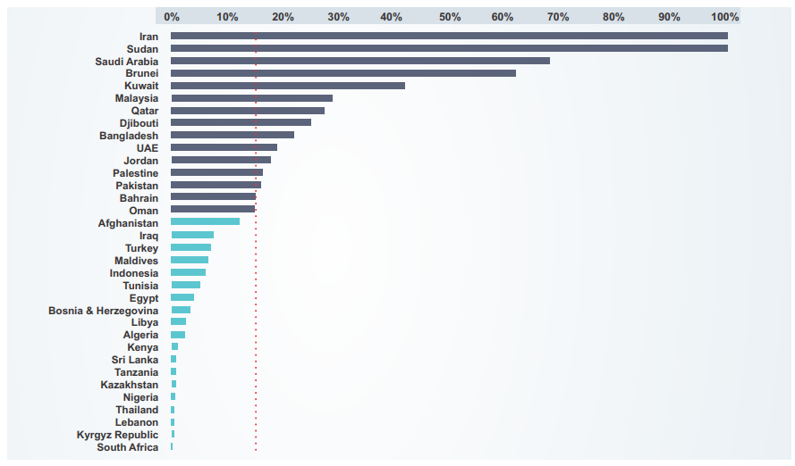
02 CURRENT STATE OF ISLAMIC FINANCE IN EASTERN AFRICA
In Eastern Africa, Djibouti is leading in terms of Islamic banking development
(Islamic banking share in total banking assets by main country, 3Q 2020).
Source: IFSB, Islamic financial service industry report (2021)

Slide 31
02 CURRENT STATE OF ISLAMIC FINANCE IN EASTERN AFRICA
With 24.1% of its population being Muslims, Eastern Africa represents an opportunity for Islamic finance growth (Estimates of the Muslim population in Eastern African countries in 2022).
Country | Muslim Population | Total population 2022 | Share of Muslim population (%) | Share of worldwide Muslim population (%)
Burundi | 1 288 958 | 12 889 576 | 10.0% | 0.1%
Comoros | 822 549 | 836 774 | 98.3% | 0.0%
Djibouti | 1 087 224 | 1 120 849 | 97.0% | 0.1%
DRC | 9 901 021 | 99 010 212 | 10.0% | 0.5%
Eritrea | 1 613 606 | 3 684 032 | 43.8% | 0.1%
Ethiopia | 41 825 794 | 123 379 924 | 33.9% | 2.0%
Kenya | 6 051 079 | 54 027 487 | 11.2% | 0.3%
Madagascar | 2 961 171 | 29 611 714 | 10.0% | 0.1%
Rwanda | 661 282 | 13 776 698 | 4.8% | 0.0%
Seychelles | 1 178 | 107 118 | 1.1% | 0.0%
Somalia | 17 562 316 | 17 597 511 | 99.8% | 0.9%
South Sudan | 2 182 633 | 10 913 164 | 20.0% | 0.1%
Uganda | 6 614 942 | 47 249 585 | 14.0% | 0.3%
Tanzania | 23 055 207 | 65 497 748 | 35.2% | 1.1%
Total East Africa | 115 628 959 | 479 702 392 | 24.1% | 5.7%
Source: World Population Review and author’s calculations

Slide 32
02 CURRENT STATE OF ISLAMIC FINANCE IN EASTERN AFRICA
Potential benefits of Islamic finance in the region:
Improvement of financial inclusion in the region.
Islamic finance emphasizes partnership-style financing, which could be useful in improving access to finance for the poor and small businesses.
Mobilization of additional outside financing by attracting financing from Arab countries or private investors in the Middle East.
Islamic finance can improve sustainable development through its justice and fairness principles.
Islamic finance can significantly contribute to economic development, given its direct link to physical assets and the real economy.
It can help to strengthen financial stability in the region. Speculative transactions are sources of instability and by nature misallocation of capital.
Transparency: Islamic banking is about conducting business fairly and transparently.

Slide 33
03 ISLAMIC FINANCE & ECONOMIC FINANCING IN EASTERN AFRICA
Several studies using data from various countries have concluded that Islamic finance is more inclined to provide financing to SMEs than conventional banks
Kenya – Yussuf (2017); Somalia - Abdinur & Ondes (2022); Turkey - Aysan et al. (2016), Benbekhti et al. (2021)
Islamic finance can support industrialization in the region through:
Fostering inclusive capital markets
Encouraging alternative sources of long-term finance
Attracting investment flows through FDI and developing overseas partnerships
Islamic finance can support successful implementation of AfCFTA in the region:
Financing of economic infrastructures
Financing of local enterprises to boost their production to target a larger market
Encouraging alternative sources of long-term finance
Trade financing through Islamic trade finance products

Slide 34
04 CONSTRAINTS TO ISLAMIC FINANCE DEVELOPMENT IN EASTERN AFRICA
Issues of Islamic finance institutions:
Increase in transaction costs and difficulties involved in supervising and monitoring.
Increased cost of doing business with the extra compliance required for the IFI.
Issue of standardization and consistent legal/regulatory framework.
Risk exposure cannot use some hedging strategies to minimize risk as these are prohibited.
Some Islamic products may not be compatible with international financial regulations.
Gaps in skills and competencies:
Lack of sharia law knowledge
Lack of understanding of the profit & loss sharing mechanism
Lack of understanding of Islamic finance products

Slide 35
04 CONSTRAINTS TO ISLAMIC FINANCE DEVELOPMENT IN EASTERN AFRICA
Limited legal and regulatory framework
Countries | Current state of Islamic finance’s legal and regulatory framework in Eastern African countries
Kenya | No legal and regulatory framework is fully dedicated to Islamic finance. However, Finance Act section 45 has been amended to allow Islamic finance institutions to operate
Djibouti | In 2011, a regulatory and institutional framework specific to Islamic finance was adopted
Tanzania | No legal and regulatory framework for Islamic finance
Burundi | No legal and regulatory framework for Islamic finance
Uganda | Financial Institutions Act 2004 was amended in 2016 to allow offering of Islamic finance banking services
Rwanda | No legal and regulatory framework for Islamic finance
Eritrea | No legal and regulatory framework for Islamic finance
Madagascar | No legal and regulatory framework for Islamic finance
Seychelles | Legal and regulatory framework to allow Islamic finance institutions to operate adopted in 2014
Comoros | No legal and regulatory framework for Islamic finance. However, the country hired DM consulting firm to assist in developing a legal and regulatory framework for Islamic finance
DRC | No legal and regulatory framework for Islamic finance
South Sudan | The country inherited Sudan's fully Islamic financial system and is pushing to convert it into a conventional banking system
Ethiopia | No legal and regulatory framework for Islamic finance. All guidelines issued to regulate “conventional” banks are applied to Islamic banks
Somalia | The country is fully ruled by Islamic laws which means that existing financial system laws are Sharia-compliant
Source: Author’s compilation from various sources

Slide 36
05 CONCLUSION AND RECOMMENDATIONS
Islamic finance is a financial system that provides Sharia-compliant financial products and services.
The system is based on interest-free financing with a profit & loss sharing mechanism.
It has experienced significant growth over the past decades.
However, its development in Eastern Africa is limited despite the growth potentialities of the region and the benefits of the sector as alternative financing source.
The following recommendations are intended to help policymakers and decision makers in the region to address these challenges:
Design specific and dedicated legal and regulatory framework for countries that do not have such a framework;
Join international Islamic financial organizations to leverage their assistance for the standardization of Islamic finance products, documentation, and business practices;
Include Islamic finance in the curriculum of universities and schools;
Create Islamic finance training centers for financial professionals.

Slide 37
THANK YOU!
www.uneca.org/ea-icsoe26

Slide 38
For more information:
www.uneca.org/ea-icsoe26

