Slide 1
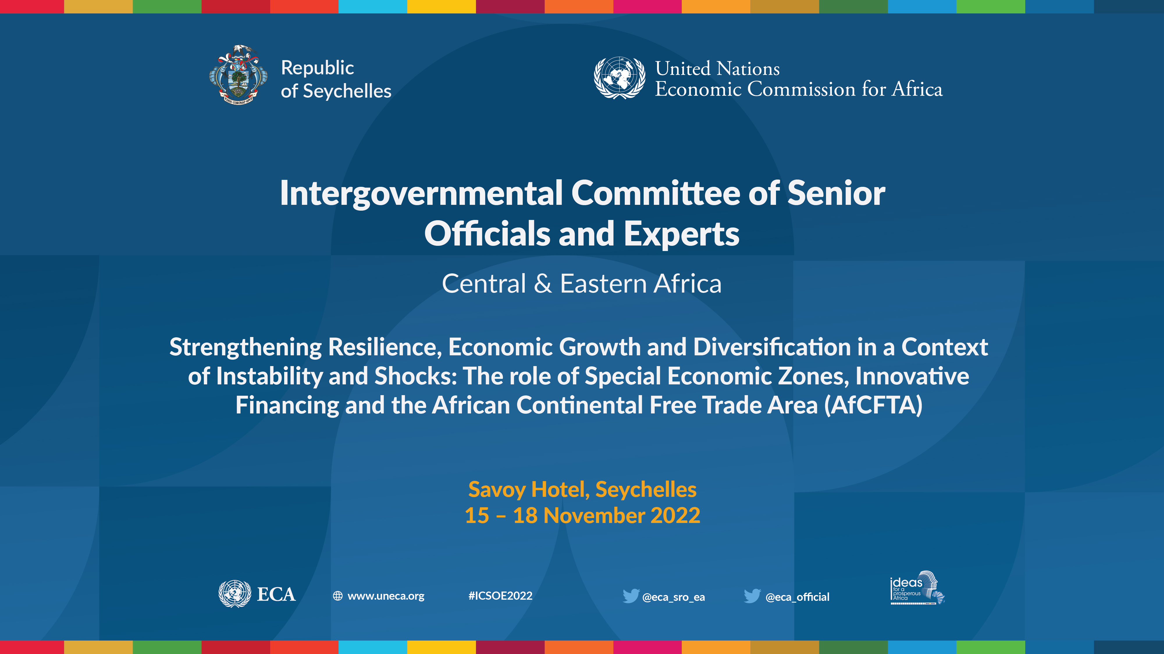
Event | Date
Presenter
Title
UNECA Sub-Regional Office for Eastern Africa

Slide 2
The Role of Statistics in Better Harnessing Urban Tourism Opportunities
Steps Towards Assessing Economic, Social And Environmental Impacts
ICSOE | November 2022
Prof. Pius Odunga
UNECA Sub-Regional Office for Eastern Africa

Slide 3

OUTLINE
Introduction
01
Sustainability of Urban Tourism
02
03
Economic Dimensions of Urban Tourism
04
Environmental Dimensions of Urban Tourism
Social Dimensions of Urban Tourism
05
Conclusion
06

Slide 4



Assessing the impacts of tourism in terms of…
Economic Impact of Tourism
  Direct (Tourism Satellite Accounts)
  Indirect
  Induced
  Total
Environmental Impact of Tourism
Social Impact of Tourism
Notes:
Economic contribution measures the size and overall significance of the tourism industry within an economy (in terms of employment creation, value addition, and the generation of output, income, tax revenue, foreign exchange earnings etc),
Economic impact refers to the changes in the economic contribution resulting from specific events or activities (positive or negative) that comprise ‘shocks’ to the tourism system.

Slide 5
OUTLINE
Introduction
01
Sustainability of Urban Tourism
02
03
Economic Dimensions of Urban Tourism
04
Environmental Dimensions of Urban Tourism
Social Dimensions of Urban Tourism
05
Conclusion
06

Slide 6
Tourism….
is a social, cultural and economic phenomenon
impacts the economy, natural and built environment, the local population in the places visited and the visitors themselves.
therefore depends on the environment, social and economic structures.
It is of vital interest for the sector to sustain the basis of its prosperity – the tourism destinations – in all its dimensions.
Sustainability takes full account of its current and future economic, social and environmental impacts, addressing the needs of visitors, the industry, the environment and host communities.
has significant potential to drive socioeconomic development and environmental conservation
Notes:
is a social, cultural and economic phenomenon which contributes to economic growth, social development and mutual understanding around the world.
It has an impact on the economy, the natural and built environment, the local population in the places visited and the visitors themselves.
Tourism therefore depends on the environment, the social and economic structures, including employment, and on governance.
It is of vital interest for the sector to sustain the basis of its prosperity – the tourism destinations – in all its dimensions.
Sustainable tourism is tourism that takes full account of its current and future economic, social and environmental impacts, addressing the needs of visitors, the industry, the environment and host communities.
Sustainable tourism should thus make optimal use of environmental resources, respect host communities and ensure viable, long-term economic operations, providing benefits that are distributed fairly among all stakeholders.
Tourism has significant potential to drive socioeconomic development and environmental conservation and is mentioned in 3 of the 17 SDGs, relating to sustainable economic growth and decent employment, sustainable production and consumption, and the conservation and sustainable use of oceans.
The United Nations Measuring Sustainable Tourism (MST) project is developing an international statistical framework for measuring tourism’s role in sustainable development.
The expected Statistical Framework for Measuring Sustainable Tourism (MST Framework) aims to extend the current statistical frameworks beyond their economic focus, to incorporate environmental, and social dimensions and at relevant spatial levels: global, national and sub-national.

Slide 7

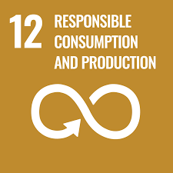

Tourism and SDGs….
How can sustainable tourism be measured?
UN Measuring Sustainable Tourism (MST) - international statistical framework being developed.
Aim - to extend the current statistical frameworks beyond economic focus, to incorporate environmental, and social dimensions and at relevant spatial levels: global, national and sub-national.

Slide 8
Tourism Framework for Sustainable Development
Measuring the Sustainability of Tourism
Linking data and Decision
Why? Who?
Context
What? Standard definitions, classification & terms
How? Data & methods
Statistical Framework for MST
MST and sustainable tourism policies
Economic
Tourism industry value added
Tourism establishments
Tourism employment
Visitor numbers
Visitor expenditure
Investment & infrastructure
Environment
Water
Energy
Waste
GHG emissions
Land
Ecosystems
Biodiversity
Protected areas/parks
Natural resources
Social
Community
Health outcomes
Education
Income & wealth
Decent work
Governance
Human rights
Accessibility
Culture & heritage
security
MST in practice: statistics, accounts & indicators
Spatial scales: Global, National, Regional, Local

Slide 9
OUTLINE
Introduction
01
Sustainability of Urban Tourism
02
03
Economic Dimensions of Urban Tourism
04
Environmental Dimensions of Urban Tourism
Social Dimensions of Urban Tourism
05
Conclusion
06

Slide 10

Direct Contribution of Tourism (Measured by Tourism Satellite Accounts, TSA)
(a) Estimates
  tourism demand (TSA Table 1-4)
  tourism supply (TSA Table 5-6)
  value added by tourism activities in the economy (TSA Table 6)
(b) Establish level of employment generated by tourism activities (TSA Table 7)
(c) Approximate gross fixed capital formation in the sector (TSA Table 8)
(d) Assess tourism collective consumption mainly by the government (TSA Table 9)
(e) State tourism non-monetary indicators (TSA Table 10)
Notes:
The economic dimension of tourism, therefore, covers the production and consumption associated with tourism activity in terms of associated goods and services.
This will commonly be reflected in measures such as visitor consumption and the output of tourism industries.
The economic dimension also includes description of the characteristics of tourism industries and the production processes of tourism industries.
It thus captures investments in produced capital (hotels, transport infrastructure, etc.); employment in tourism and human capital (including skills and experience); and information on the size, industry class and ownership of tourism establishments.

Slide 11
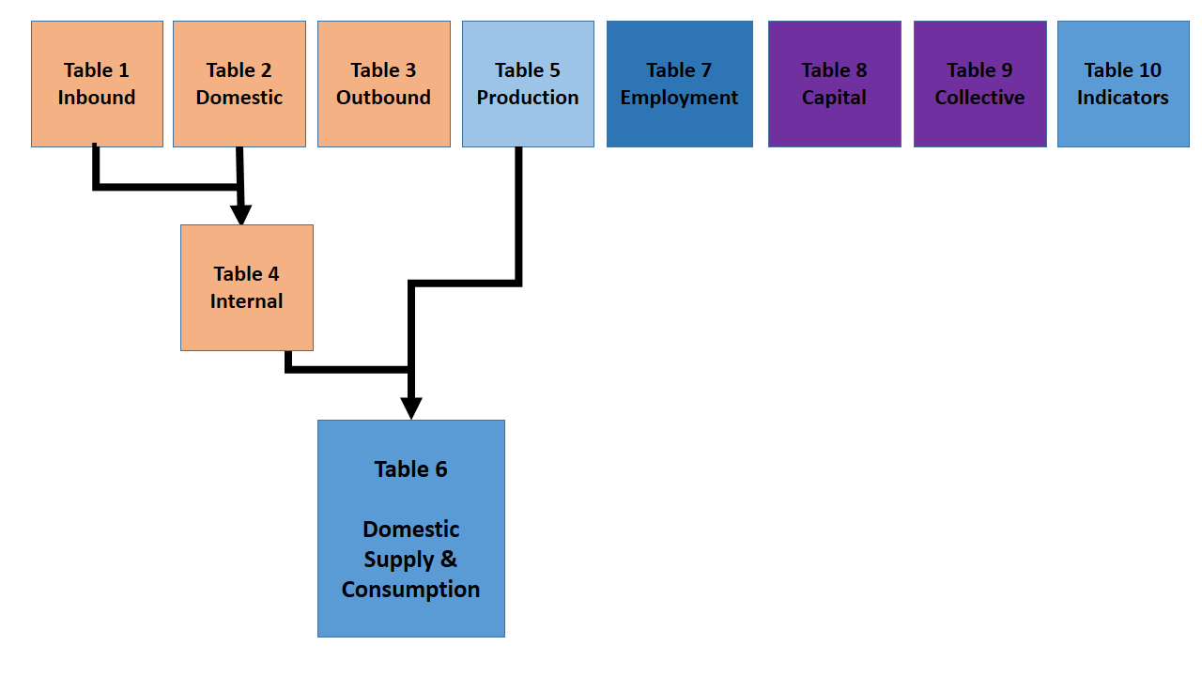
Interaction of the TSA variables
Interaction of the TSA variables and their link with those of the National Accounts

Slide 12
Cont.
Inbound Tourism- visitors into urban centers from other parts of the country and the rest of the world (Excursionists and Tourists)
Domestic Tourism – movement of residents within urban boundaries
Outbound Tourism- residents leaving urban centers to other parts of the country and the rest of the world
Internal Tourism- tourism activity within boundaries of urban centers (Inbound and Domestic tourism)
Tourism Production- goods and services produced within urban boundaries for internal tourism consumption
Production and consumption of tourism commodities within urban boundaries
Employment- jobs created by tourism establishments within urban centers
Gross Fixed Capital Formation- general investment within tourism sector of urban centers
Tourism collective consumption- government and other public consumption on tourism within urban centers
Non-monetary indicators, for instance, bed/room numbers and occupancy rates within specific urban centres

Slide 13
Indirect and Induced Contribution of Tourism
Approaches to estimating indirect, induced and total impacts (derived multipliers):
Associated Computer Software Packages:
Input-Output Table
Social Accounting Matric(SAM)
General Equilibrium Models(GE)
Capacity Utilization Model (CUM)
Regional Economic Models (REMI)
Impact Analysis for Planning (IMPLAN) model and
Computable General Equilibrium (CGE) Models.

Slide 14
Study Framework
Profit Savings & Taxes
Imported Services
Imported Goods
Commuters
Rounds of Induced Effects
$
commodities
Local Purchases
Total Impacts
Direct Effect
Imports
Local Purchases
Rounds Of Induced Effects
Labour
Commuters
Imported Goods
Imported Services
Profit, Savings & Taxes
Household Savings & Taxes
Notes:
All impacts have a starting point in the economy, defined as the Direct Effect.
The Direct Effect sets off iterations of Indirect (inter-industry production used to create the Direct Effect) and Induced (labour) spending.
Each arrow represents a backward linkage in the impact.
Large blue arrows represent rounds of local purchases that contribute to the economy of the country.
Black dotted arrows show leakages of dollars to import goods, services and labour.
This accounts for transactions that do not stimulate further spending in the economy of the country.
The circular purple arrows describe the continual rounds of Indirect and Induced impacts.
Each round of impacts generates fewer local effects and increasing numbers of imports, until all the money invested in the original window’s purchase leaks from the country.
Profits, savings, and taxes generate no further economic activity for the country.
This is because profits, taxes and savings represent money set aside for later usage.
The final result of all the rounds of purchase generated locally by the initial Direct Effect is the Total Impact.

Slide 15

Data Sources and Analysis
EORA multi-region input-output table (MRIO) database:
http://www.worldmrio.com/
Software Packages for Analysis
IMPLAN (IMpact analysis for PLANning) software
Used to evaluate the tourism total economic impact in Rwanda.
Economic analysis framework is comprehensive and adaptive

Slide 16
OUTLINE
Introduction
01
Sustainability of Urban Tourism
02
03
Economic Dimensions of Urban Tourism
04
Environmental Dimensions of Urban Tourism
Social Dimensions of Urban Tourism
05
Conclusion
06

Slide 17

Environmental Dimensions of Tourism
concerns the stocks and changes in stock of environmental assets - natural capital for the support of the tourism sector.
Natural capital includes land, beaches, coastal and marine areas, national parks, rivers, etc.
incorporates measurement of the flows of natural inputs to tourism production processes – water and energy etc.
And flows of residuals from tourism production and consumption – GHGs, solid waste, wastewater etc.
Notes:
Environmental impacts of tourism activity e.g. energy use, GHG emissions, climate change, solid waste, waste water, disruption of ecosystems and biodiversity
Dependence of tourism activity on the environment e.g. land, water and energy requirement, health and food quality, ecosystems (beaches, reefs, forests etc.)
Responses of tourism businesses and visitors in relation to the environment e.g. environmental protection expenditure, environmental taxes

Slide 18
System of Environmental-Economic Accounting (SEEA)
Notes:
The System of Environmental-Economic Accounting (SEEA) can be separated into four broad types of accounting:
(i) Accounting for environmental flows in physical terms; into, within and from the economy.
This includes accounting for flows of water, energy, air emissions, solid waste and emissions to water; and can be extended to account for individual elements and substances such as carbon and nitrogen.
(ii) Accounting for natural resources in terms of stocks and changes in stocks (e.g. discoveries of resources, depletion).
This includes accounting for stocks of mineral and energy resources, timber, fish, water and soil.
(iii) Accounting for environmental transactions that are included in the SNA but not specifically identified as “environmental”.
This includes accounting for environmental protection and resource management expenditure, environmental taxes and subsidies and the supply and use of environmental goods and services.
(iv) Accounting for land and ecosystems. In this type of accounting the focus is on understanding the changing composition of the area of a country in terms of land use and land cover and the quality of the land in terms of the condition of its ecosystems. Accounting for ecosystem also involves the measurement of ecosystem services and evaluating the capacity of ecosystem to continue to generate market and non-market ecosystem services.

Slide 19
Combining SEEA and TSA
Notes:
(i) One of the distinct advantages of organizing and integrating data using an accounting framework is that the information can be directly linked to economic modeling that uses input-output tables summarizing the structure and inter-linkages of the economy.
This is possible due to the use of consistent definitions of income and production and the use of common industry classifications.
(ii) There are many examples of the use of environmental flow information in connection with standard input-output tables and an introduction to the principles and summary of the relevant literature is provided in SEEA Applications and Extensions (UN et al 2017).
Advancing the measurement of integrated TSA and SEEA accounts will further support these efforts in understanding the broader connections between tourism activity and the environment and ensuring that environmental data can be taken into account in the economic modeling of tourism.

Slide 20
OUTLINE
Introduction
01
Sustainability of Urban Tourism
02
03
Economic Dimensions of Urban Tourism
04
Environmental Dimensions of Urban Tourism
Social Dimensions of Urban Tourism
05
Conclusion
06

Slide 21

The social dimension – a range of social aspects related to tourism activity
local, traditional and indigenous cultural aspects.
Also, outcomes of tourism production processes…
performance in relation to gender equality, income equality and other aspects of equality;
and the development of social capital reflected in the strength of community networks and institutional arrangements.
NB:Tourism social dimensions (Inclusion, capital, equity, individual/community wellbeing)
Notes:
There are four parts of this dimension to be rationalized:
The different conceptual approaches to the social dimension including concepts of social capital, social inclusion and exclusion, social equity and welfare, social cohesion and well-being.
The different perspectives on the social dimension of tourism primarily the visitor, the host community and tourism businesses.
The aspects that are most commonly associated with the social dimension such as health, education, culture, decent work, etc.
The different population groups including children and youth, the elderly, people with disabilities, etc.
Social impact of tourism activity e.g. local tradition and customs, on employment
Dependence of tourism activity on ‘social’ infrastructure including a sustainable qualified workforce, transport infrastructure and public facilities

Slide 22
OUTLINE
Introduction
01
Sustainability of Urban Tourism
02
03
Economic Dimensions of Urban Tourism
04
Environmental Dimensions of Urban Tourism
Social Dimensions of Urban Tourism
05
Conclusion
06

Slide 23




Conclusion
Urban centres are characterized by high population densities, high disposable income, high income disparities etc
Urban centres have high concentration of socio-cultural attractions
Urban tourism has all the three dimensions of sustainable tourism i.e. economic, environmental and social components
Sub-sectoral TSA for urban tourism can help in policy formulation and decision-making processes

Slide 24

For more information:
www.uneca.org/ea-icsoe26

