Slide 1
Event | Date
Presenter
Title
UNECA Sub-Regional Office for Eastern Africa

Slide 2
Boosting Regional Tourism in Eastern Africa: Exploring the Potential of Urban Tourism
ICSOE | November 2022
Jim Ayorekire
UNECA Consultant
UNECA Sub-Regional Office for Eastern Africa

Slide 3
OUTLINE
Tourism performance: global, continental and regional
01
Urbanization and its impacts on tourism
02
03
Urban tourism data gaps
Global urban tourism trends
04
Measuring urban tourism competitiveness
05
Level and nature of urban tourism in Eastern Africa
06
Recommendations for urban tourism growth in Eastern Africa
07

Slide 4
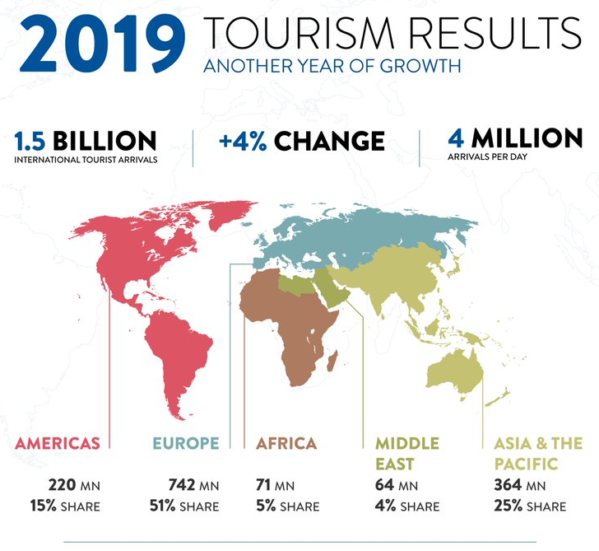
Pre-COVID 19 Global Tourism Performance
Tourism - one of the fastest growing industries globally generating remarkable economic, social and environmental benefits
Africa’s Performance remains low
71 Million international tourists
5% share of global international arrivals
3% of global tourism receipts
Source: UNWTO Barometer
Notes:
Prior to the crisis, growth in East Africa was very strong – the highest of all sub-regions on the continent
This year, it is still expected to expand slightly, driven by growth – against all odds – in Ethiopia, Rwanda, South Sudan and Tanzania

Slide 5
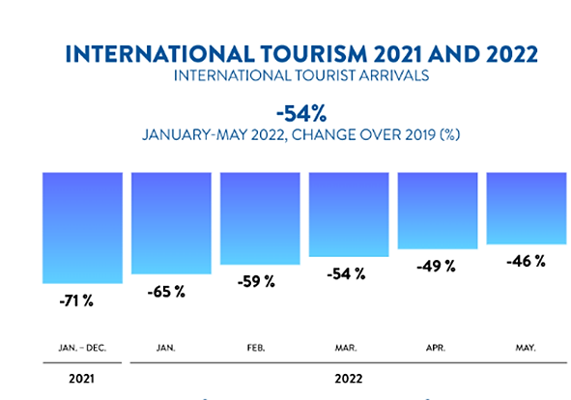
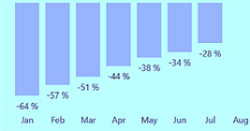
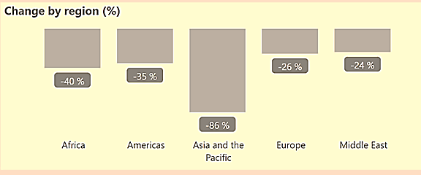
Post-COVID 19 Global Tourism Performance
Recovery towards pre 2019 performance
1 billion fewer international tourist arrivals in 2021
Loss of US$ 1.0 trillion in total export revenues from international tourism in 2021
International tourist arrivals increasing in January-July 2022 but remained 28% below 2019
Africa international tourist arrivals still at 40% below 2019
Sub Saharan Africa arrivals at 46% below 2019
Source: UNWTO Tourism Dash Board (2022)
Notes:
Prior to the crisis, growth in East Africa was very strong – the highest of all sub-regions on the continent
This year, it is still expected to expand slightly, driven by growth – against all odds – in Ethiopia, Rwanda, South Sudan and Tanzania

Slide 6
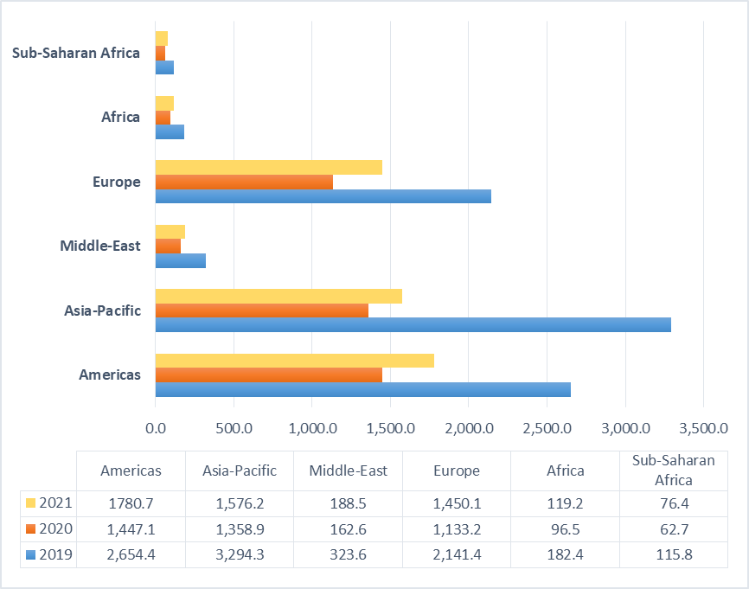
Africa Tourism Performance
Total contribution of Tourism and Travel to GDP (USD Billion)
Tourism performance and contribution remains low in Africa
Pre and Post Covid19 - contribution of tourism to GDP has remained low in Africa
Sub-Saharan contribution to GDP is even lower than Africa's average
Situation can be attributed to a number of factors including limited tourism product offer that affects destination competitiveness
Urban tourism considered a viable driver to diversify the tourism products, increase tourist arrivals and enhance economic development across the rapidly urbanising landscape in Africa including Eastern African
Source: World Travel and Tourism Council (2022)
Notes:
Prior to the crisis, growth in East Africa was very strong – the highest of all sub-regions on the continent
This year, it is still expected to expand slightly, driven by growth – against all odds – in Ethiopia, Rwanda, South Sudan and Tanzania

Slide 7
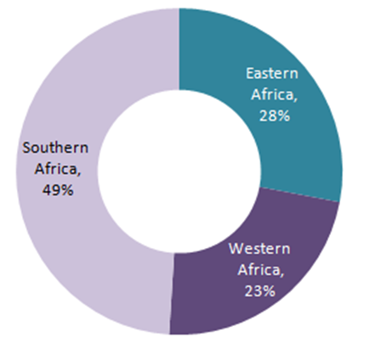
Africa Regional Tourism Performance
Travel arrivals by region in sub-Saharan Africa
Regional tourism performance
Africans increasingly traveling across their countries and in the continent
In 2019, domestic tourism accounted for 55% of Africa’s tourism and travel spending, compared with 74% in the Asia-Pacific and 83% in North America
Regional tourism still low - only 4 out of 10 international tourists originate within Africa
COVID-19 crisis exposed Africa’s dependence on foreign international travelers
Source:
Notes:
Prior to the crisis, growth in East Africa was very strong – the highest of all sub-regions on the continent
This year, it is still expected to expand slightly, driven by growth – against all odds – in Ethiopia, Rwanda, South Sudan and Tanzania

Slide 8
OUTLINE
Tourism performance: global, continental and regional
01
Urbanization and its impacts on tourism
02
03
Urban tourism data gaps
Global urban tourism trends
04
Measuring urban tourism competitiveness
05
Level and nature of urban tourism in Eastern Africa
06
Recommendations for urban tourism growth in Eastern Africa
07

Slide 9
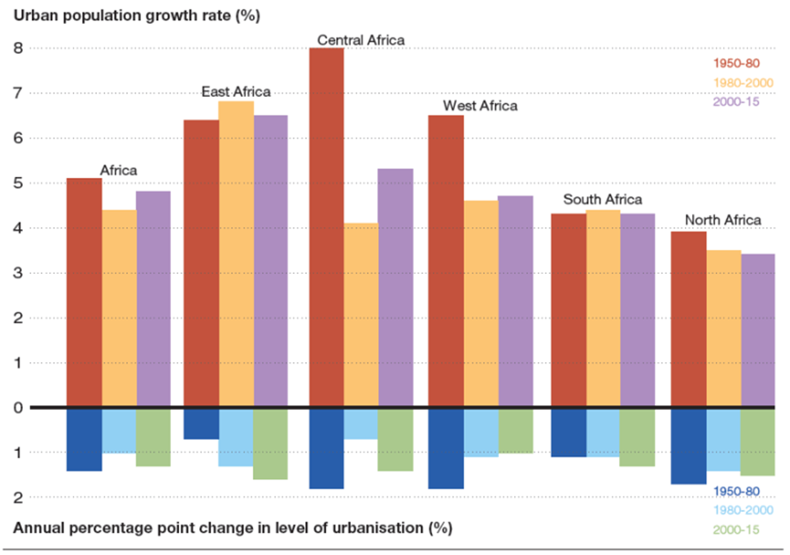
Increasing urbanization will impact tourism
Urban population growth and growth in the level of urbanization in Africa by period, 1950–2015
Urbanisation Vs tourism development
55% of the world’s population living in urban areas that have become global economic hubs, driving growth and innovation
Global share of African urban residents is projected to grow from 11.3 % in 2010 to 20.2% by 2050
City tourism is the fastest-growing segment of the international leisure travel market as tourists as search for attractive destinations in nearby and overseas cities
Growth of city tourism is driven by urbanization processes leading to increasing number of people living in cities who feel more connected to cities and urban lifestyle
City trips worldwide increased by 82% and reached a market share of 22% of all holidays
Source: Source: Kanos & Heitzig (2020).
Notes:
Prior to the crisis, growth in East Africa was very strong – the highest of all sub-regions on the continent
This year, it is still expected to expand slightly, driven by growth – against all odds – in Ethiopia, Rwanda, South Sudan and Tanzania

Slide 10
OUTLINE
Tourism performance: global, continental and regional
01
Urbanization and its impacts on tourism
02
03
Urban tourism data gaps
Global urban tourism trends
04
Measuring urban tourism competitiveness
05
Level and nature of urban tourism in Eastern Africa
06
Recommendations for urban tourism growth in Eastern Africa
07

Slide 11
Limited data on Urban Tourism Development in Eastern Africa - Data gaps
Nature trend and performance of urban tourism at the global level
Levels of urban tourism development in Eastern Africa cities and how they compare to other cities in Africa and the world
Potential of Eastern Africa cities to attract tourists and reasons why the urban centers remain comparatively under-visited in the sub-region
Main stakeholders in intra-regional and intra-continental tourism in Africa vis-à-vis sustainable urban tourism development in Eastern Africa
Best practices from the most-visited cities in the world and how these can inform the sustainable urban tourism development in the Eastern Africa.

Slide 12
OUTLINE
Tourism performance: global, continental and regional
01
Urbanization and its impacts on tourism
02
03
Urban tourism data gaps
Global urban tourism trends
04
Measuring urban tourism competitiveness
05
Level and nature of urban tourism in Eastern Africa
06
Recommendations for urban tourism growth in Eastern Africa
07

Slide 13
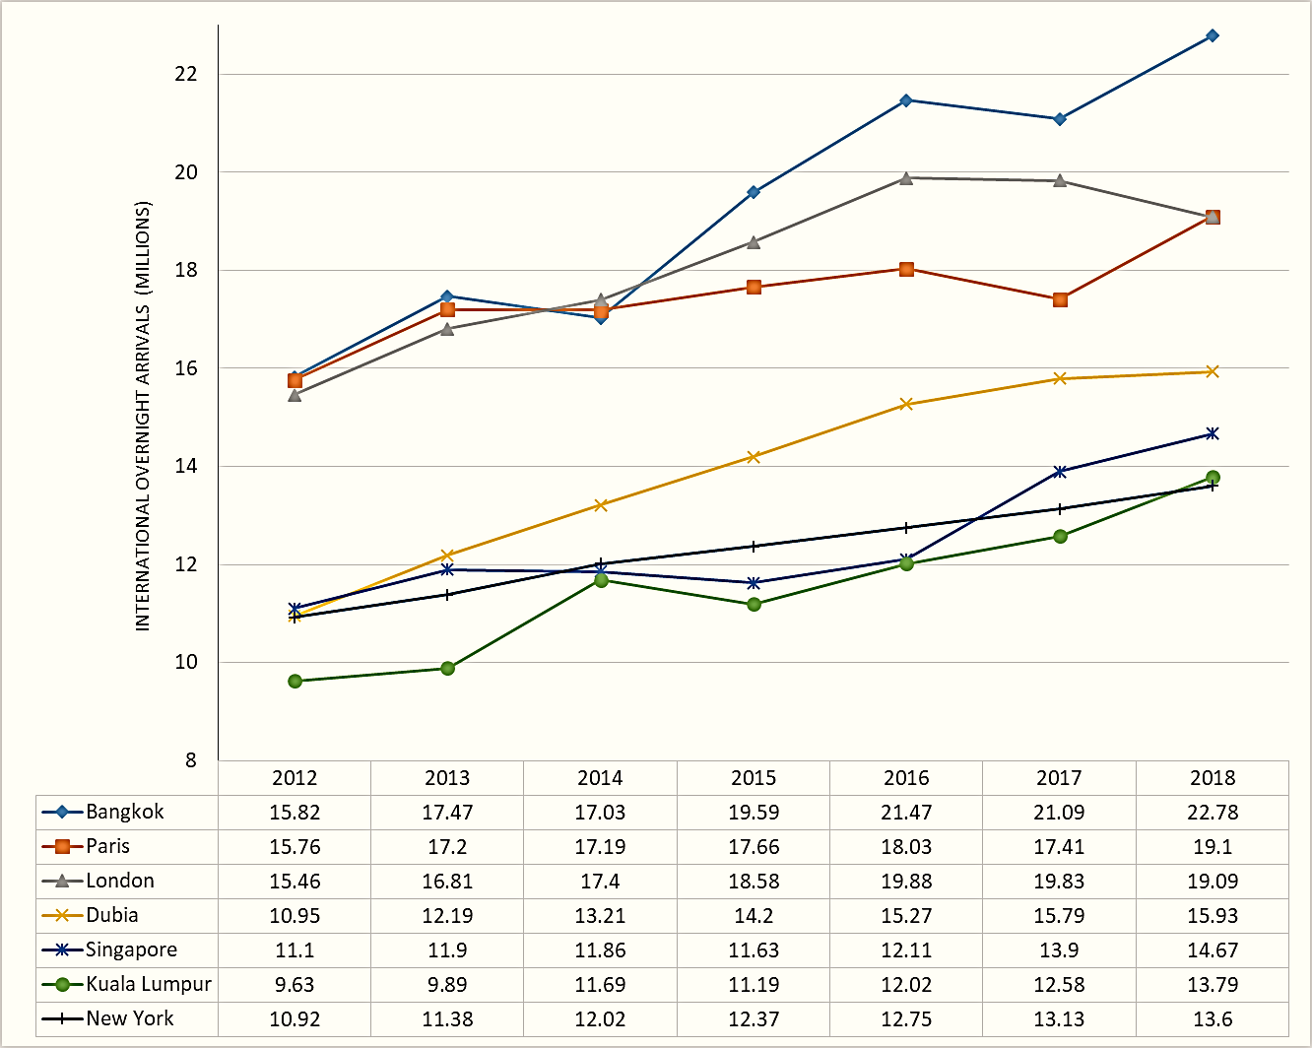
Trend of Global Urban Tourism and contribution to Tourism Development
International overnight tourist arrivals in the leading urban tourism cities 2012-2018 (in millions)
Tourism within urban areas leads to
Diversification of tourism product offer
Enhanced attractiveness and competitiveness of overall destination (country) beyond the city
Diverse employment opportunities
Urban infrastructure development of sustainable cities
Boosting the urban economy
However
If not well managed may lead to over tourism and associated challenges
Source: Mastercard’s Global Destination Cities Index (2019)
Notes:
Prior to the crisis, growth in East Africa was very strong – the highest of all sub-regions on the continent
This year, it is still expected to expand slightly, driven by growth – against all odds – in Ethiopia, Rwanda, South Sudan and Tanzania

Slide 14
Performance of top 10 urban tourism destinations
Top 10 urban tourism destinations performance
Leading destinations
Bangkok – highest overnight international visitors – 22.8 M
New York – highest length of nights spent – 8
Dubai – highest visitor spending – USD 30.8 billion
Dubai - highest average daily spending – USD 553
Singapore – highest percentage of national overnight arrivals
City (country) | Overnight international Visitor arrivals (Million) | Average Length of Visit (Nights spent) | Overnight international Visitor spending (US$ Billion) | Average Daily Spend (US$) | Percentage of national overnight arrivals
Bangkok (Thailand) | 22.8 | 4.8 | 20.0 | 184 | 36.7
Paris (France) | 19.1 | 2.5 | 14.1 | 296 | 36.5
London (UK) | 19.0 | 5.8 | 16.5 | 148 | 50.4
Dubai (UAE) | 15.9 | 3.5 | 30.8 | 553 | 79.2
Singapore (Singapore) | 14.7 | 4.2 | 16.6 | 272 | 100
Kuala Lumpur (Malaysia) | 13.8 | 5.7 | 11.1 | 142 | 46
New York (USA) | 13.6 | 7.9 | 16.4 | 152 | 19.6
Istanbul (Turkey) | 13.4 | 5.8 | 8.3 | 106 | 44.6
Tokyo (Japan) | 12.9 | 5.4 | 13.8 | 196 | 19.3
Antalya (Turkey) | 12.4 | 14 | 7.7 | 44 | 41.3
Source: Mastercard’s Global Destination Cities Index (2019)
Notes:
Prior to the crisis, growth in East Africa was very strong – the highest of all sub-regions on the continent
This year, it is still expected to expand slightly, driven by growth – against all odds – in Ethiopia, Rwanda, South Sudan and Tanzania

Slide 15
OUTLINE
Tourism performance: global, continental and regional
01
Urbanization and its impacts on tourism
02
03
Urban tourism data gaps
Global urban tourism trends
04
Measuring urban tourism competitiveness
05
Level and nature of urban tourism in Eastern Africa
06
Recommendations for urban tourism growth in Eastern Africa
07

Slide 16
Measuring Tourism Competitiveness in Urban areas
Source: Developed based on Euro Monitor International index (2021)

Slide 17
Performance of selected Urban Tourism destinations….…contd

Slide 18
OUTLINE
Tourism performance: global, continental and regional
01
Urbanization and its impacts on tourism
02
03
Urban tourism data gaps
Global urban tourism trends
04
Measuring urban tourism competitiveness
05
Level and nature of urban tourism in Eastern Africa
06
Recommendations for urban tourism growth in Eastern Africa
07

Slide 19
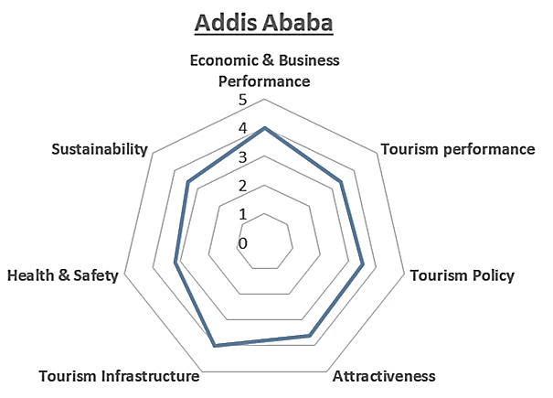
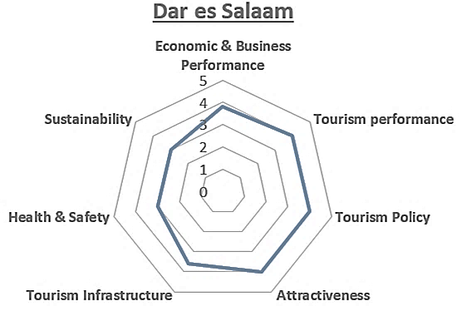
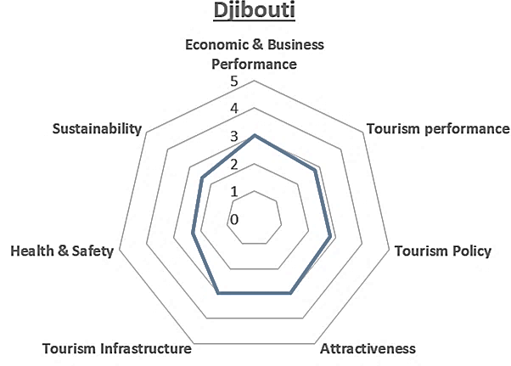
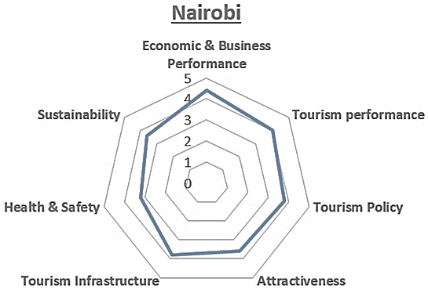
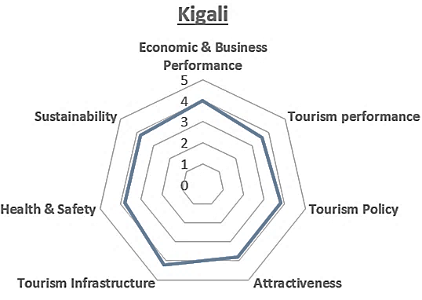
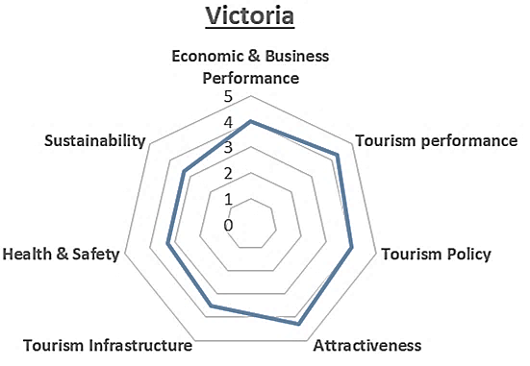
What is the level and nature of urban tourism within Eastern Africa cities?
Source: Panel of Experts (2022)
Notes:
Prior to the crisis, growth in East Africa was very strong – the highest of all sub-regions on the continent
This year, it is still expected to expand slightly, driven by growth – against all odds – in Ethiopia, Rwanda, South Sudan and Tanzania
Scheme 4.5-5 excellent performance, 3.5-4.4 good performance, 2.5-3.4 moderate performance, 1.5-2.4 weak performance, 1.0-1.4 very weak perfomance

Slide 20
Drivers and opportunities of urban tourism growth in Eastern Africa
Increasing Urbanisation
Expanding middle-class
More focus on tourism product diversification
Growing MICE segment
Increasing ICT penetration
More easing of travel restrictions
Youthful population
Increasing transport connectivity
Enhanced safety & security
Notes:
Prior to the crisis, growth in East Africa was very strong – the highest of all sub-regions on the continent
This year, it is still expected to expand slightly, driven by growth – against all odds – in Ethiopia, Rwanda, South Sudan and Tanzania

Slide 21
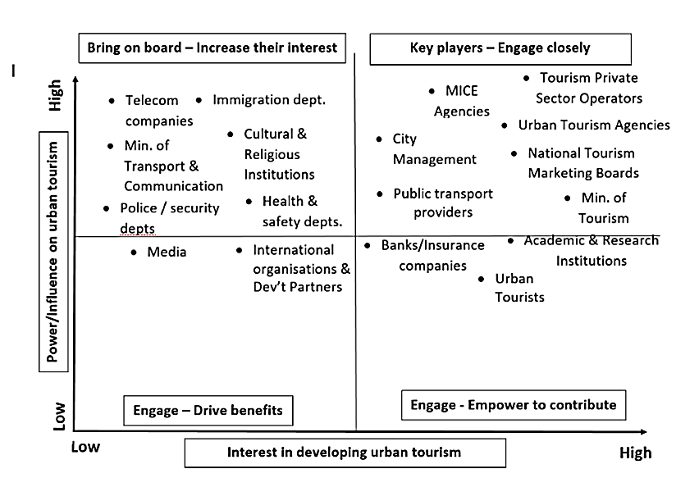
Stakeholder involvement is key for Urban Tourism in Eastern Africa to grow
Key observations
High power/high interest - engage closely – city authorities to guide and private sector to drive urban tourism
High power/low interest - bring on board – immigration, security depts. Telecom companies, cultural institutions
Medium power/low interest - engage to drive benefits – media & development partners
Low power/high interest – empower to contribute – academia, urban tourists, financial institutions

Slide 22
Urban Tourism growth in Eastern Africa is limited by number of challenges
Unfavorable economic environment – tourism growth in the cities is still not prioritized by cities’ authorities and business environment still constrained – especially for SMEs
Low tourism performance – limited investment and strategic planning resulted into few attractions, few visitors, short length of stay, less visitor expenditure
Inadequate planning and policy support – tourism not integrated and mainstreamed into wider city development framework – weak support structure and lack of guidelines
Low attractiveness - untapped attractions, inadequate branding and marketing, few built-up attractions
Inadequate support infrastructure - poor transport network, limited signage and interpretation services, overwhelmed waste management facilities
Minimal health and safety provisions – constrained water, sanitation and hygiene services, and inadequate safety provisions
Limited urban tourism sustainability performance research and monitoring - no networks to learn best practices from each other and no framework to monitor if cities are drifting into over tourism
Notes:
Prior to the crisis, growth in East Africa was very strong – the highest of all sub-regions on the continent
This year, it is still expected to expand slightly, driven by growth – against all odds – in Ethiopia, Rwanda, South Sudan and Tanzania

Slide 23
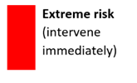
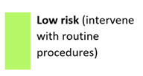
Unplanned Urban tourism growth can pose risks to Eastern Africa countries – Risk Matrix
 |  | Likelihood
 |  | Rare | Unlikely | Possible | Likely | Very Likely
Impact | Very High |  | SMEs out competed by large scale enterprises | Failure of accommodation facilities to keep pace with increasing visitor numbers Increased disease incidence from reduced environmental quality | Failure to develop urban tourism planning and policy frameworks Lack of technical capacity for cities to plan and manage urban tourism Lack of skilled perssonel to establish and manage competitive urban tourism enterprises Low capacity to innovate or adopt new smart city/smart tourism technologies Increased disease incidences | Overwhelmed transport system – high traffic congestion Lack of data and research to support evidence-based planning Poor planning leading to poor product offer and reduced visitor experience
 | High |  | Weak/nascent private sector not capable of investing in urban tourism Lack of political will | Destruction of cultural/heritage resources High visitor seasonality Youth & women excluded from urban tourism value chain | Failure of cities to establish urban tourism units/departments Failure of cities to allocate funds to support urban tourism development SMEs out competed Increased air pollution especially from transport systems – poor air quality Increased crime rate & social evils | Increasd waste generation that overwhlems waste management systems Overwhelmed capacity of support service systems – WiFi, health Unfavorable business environment
 | Moderate |  | Cultural clash between visitors & residents |  | Disruption of urban ecological systems
 | Low | Less use of urban tourism spaces by residents | Reduced residents’ quality of life and livability | Increased prices of goods & services due to high visitor numbers | Increased negative attitude of residents due to high visitor numbers
 | Very Low |  | Residents exiting key urban tourism cities | Reduced psychological health of residents resulting from visitor stress
Source: Panel of Experts & case study review (2021)
Notes:
Prior to the crisis, growth in East Africa was very strong – the highest of all sub-regions on the continent
This year, it is still expected to expand slightly, driven by growth – against all odds – in Ethiopia, Rwanda, South Sudan and Tanzania

Slide 24
Key success factors for Urban Tourism in Eastern Africa countries - Lessons Eastern Africa can learn from leading urban tourism destinations
Uniqueness and authenticity – each city is unique hence has to strategically positions itself to offer an authentic experience
Comprehensive policy and integrated planning framework – efficient and coordinated strategies enable city become competitive destinations
Conducive business and investment environment – a robust micro and macro business environment is vital for tourism enterprises to thrive in urban areas
Well-structured products and organised city tour packages – cities identify key flag ship products around which packages are developed to offer exceptional experiences
Marketing and promotion – create awareness and increase market share
Notes:
Prior to the crisis, growth in East Africa was very strong – the highest of all sub-regions on the continent
This year, it is still expected to expand slightly, driven by growth – against all odds – in Ethiopia, Rwanda, South Sudan and Tanzania

Slide 25
OUTLINE
Tourism performance: global, continental and regional
01
Urbanization and its impacts on tourism
02
03
Urban tourism data gaps
Global urban tourism trends
04
Measuring urban tourism competitiveness
05
Level and nature of urban tourism in Eastern Africa
06
Recommendations for urban tourism growth in Eastern Africa
07

Slide 26
Recommendations for urban tourism growth in Eastern Africa
Enhance Policy and planning - prioritize and mainstream urban tourism in the national polices and urban development plans - increase awareness amongst policy makers and development planners and advocate for prioritization of urban tourism
Undertake institutional and regulatory reforms - establish institutions/units or re-designate existing ones to coordinate and oversee urban tourism planning, development and promotion. Strengthen capacities of cities that already have fully fledged institutions
Provide tourist infrastructure and services – ensure provision of decent and efficient public transport services, quality accommodation & recreational facilities, restaurants, entertainment and shopping facilities, appropriate signage and interpretation services and efficient financial services
Brand, promote and market cities - undertake comprehensive tourism experience and product mapping to understand the unique and rich historical, cultural, economic and geo-political opportunities to guide branding, promotion and marketing
Notes:
Prior to the crisis, growth in East Africa was very strong – the highest of all sub-regions on the continent
This year, it is still expected to expand slightly, driven by growth – against all odds – in Ethiopia, Rwanda, South Sudan and Tanzania

Slide 27
Recommendations…contd
Design urban tourism development incentives – develop affordable tour packages that offer diverse experiences, discounted prices and ease access to motivate visitors to stay longer and spend more
Build collaboration and partnerships – explore public-private partnership (among others) to mobilise financial and human assets to develop attractions, facilities and services.
Enhance research and development – undertake research to inform urban tourism planning and development, carry out monitoring and evaluation of its impact. This will provide evidence-based planning and decision making that is vital for sustainable urban tourism development and management.
Notes:
Prior to the crisis, growth in East Africa was very strong – the highest of all sub-regions on the continent
This year, it is still expected to expand slightly, driven by growth – against all odds – in Ethiopia, Rwanda, South Sudan and Tanzania

Slide 28
For more information:
www.uneca.org/ea-icsoe26

