Slide 1
EMPOWERING
Under the theme:
“Connected African Girls, Creating Brighter Futures”

Slide 2
Girls in ITC - “Connected African Girls, Creating Brighter Futures”
I- MAKING TECH ACCESSIBLE
Localities
Type of Digital channels and tools
Increase digital literacy and digital inclusion
Showing possibilities
Encourage experimentation
Tech for Good

Slide 3
Girls in ITC - “Connected African Girls, Creating Brighter Futures”
Credit Photo: WETECH

Slide 4
Girls in ITC - “Connected African Girls, Creating Brighter Futures”
II- HAVING A SUPPORT SYSTEM
Advocacy and policy
Finding support in your circles
Mentorship
Communities
Photo Credit: i Programmer

Slide 5
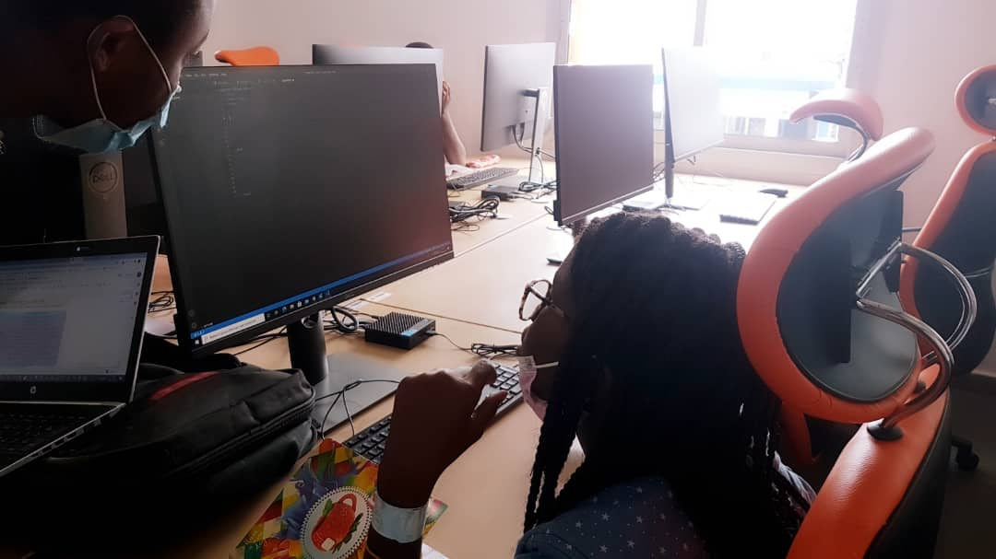
Girls in ITC - “Connected African Girls, Creating Brighter Futures”
Credit Photo: WETECH

Slide 6
Girls in ITC - “Connected African Girls, Creating Brighter Futures”
III – USING COMMUNITIES & NETWORKING
Build your network
Volunteerism
Experiences
Opportunities
Personal development
Create safe environment for women

Slide 7
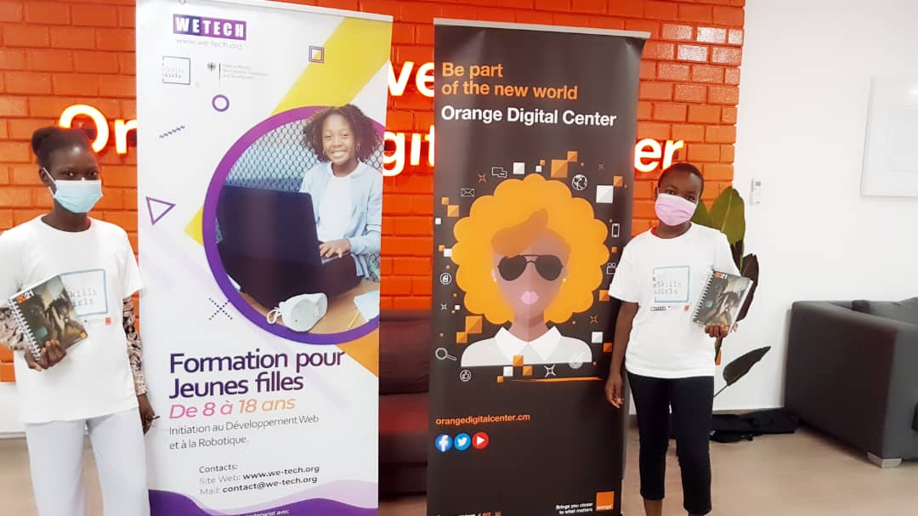
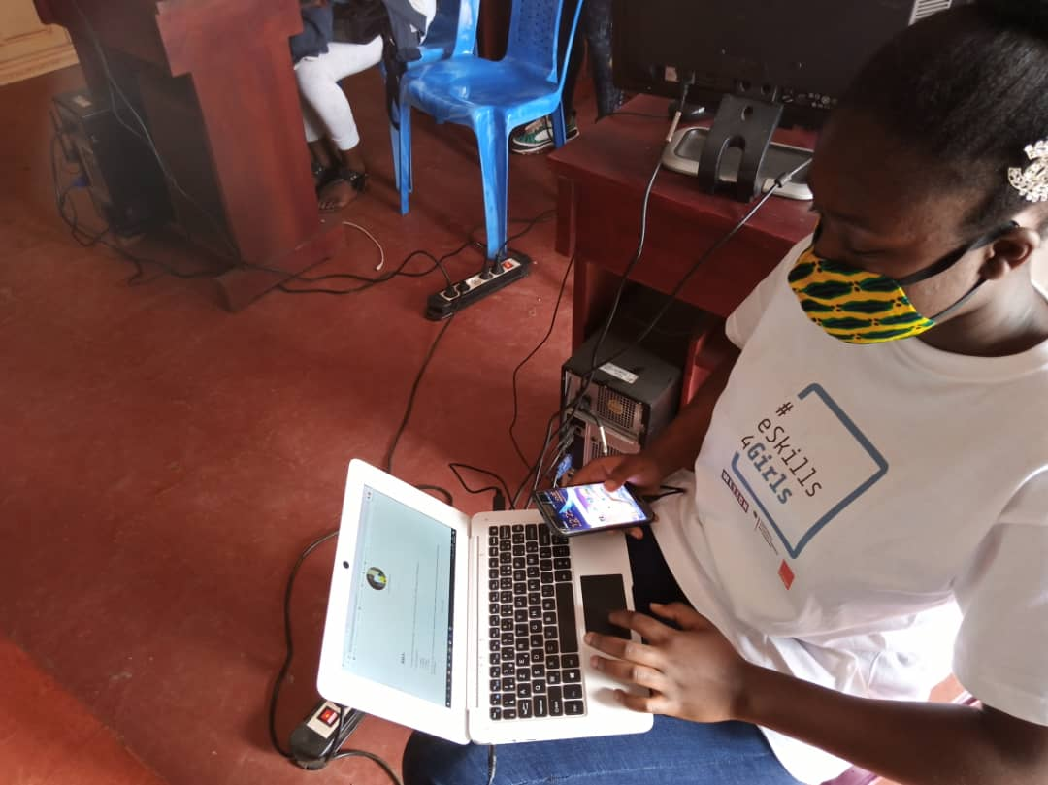
Girls in ITC - “Connected African Girls, Creating Brighter Futures”
Credit Photos: WETECH

Slide 8
Girls in ITC - “Connected African Girls, Creating Brighter Futures”
IV- SHARING YOUR STORY
Inspire
Share experience
Make your voice heard
Visibility and representation

Slide 9
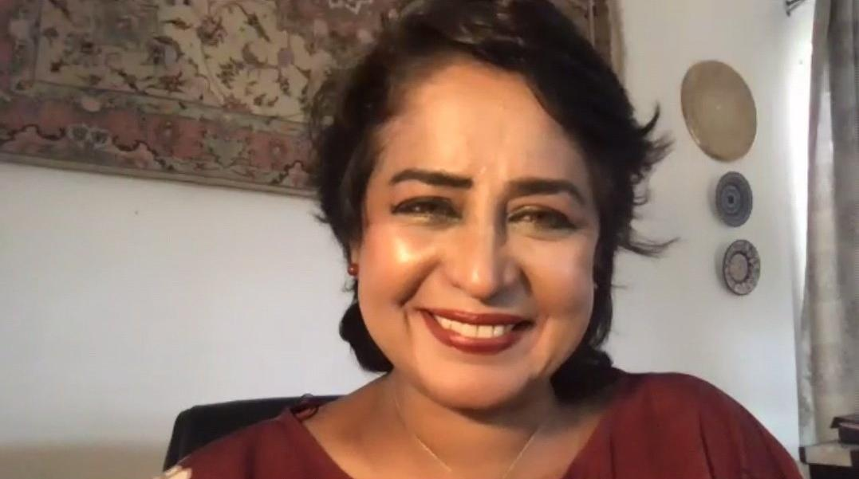
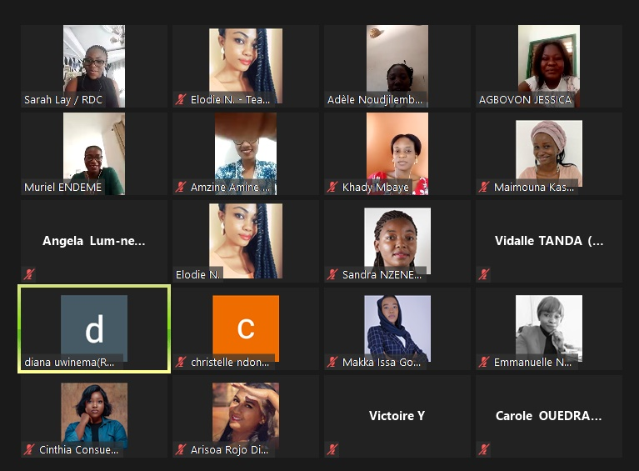
Girls in ITC - “Connected African Girls, Creating Brighter Futures”
H.E Prof. AMEENAH-GURIB FAKIM
Credit Photo: WETECH

Slide 10
Girls in ITC - “Connected African Girls, Creating Brighter Futures”
EXPLORING TRENDS & OPPORTUNITIES
Career orientation
Employment market and needs
Women’s representation
Innovation
Research and Development
Design the future

Slide 11
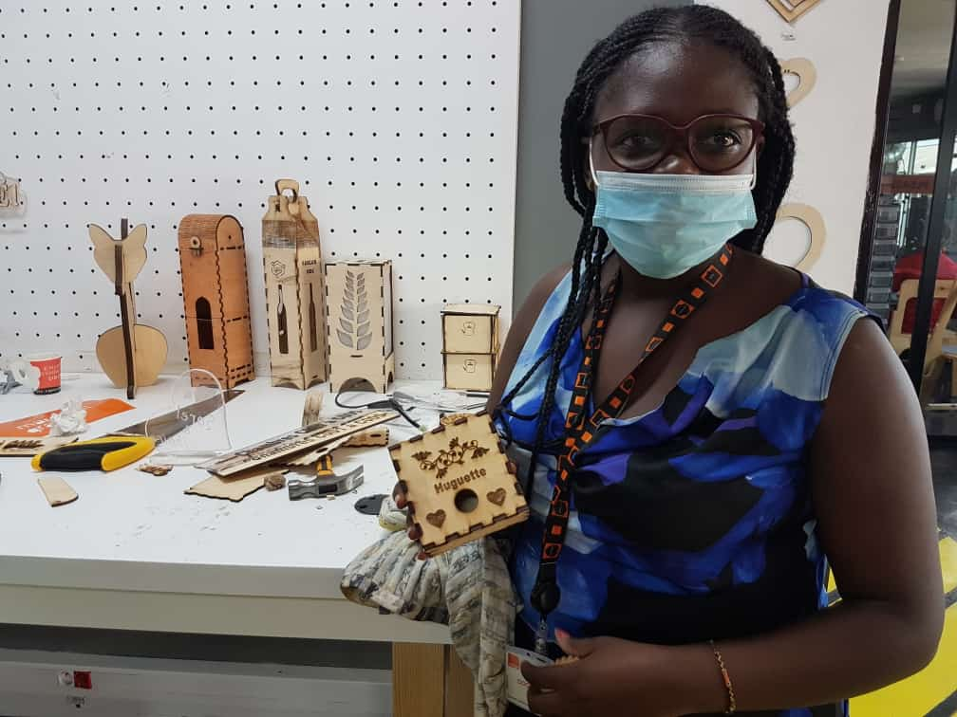
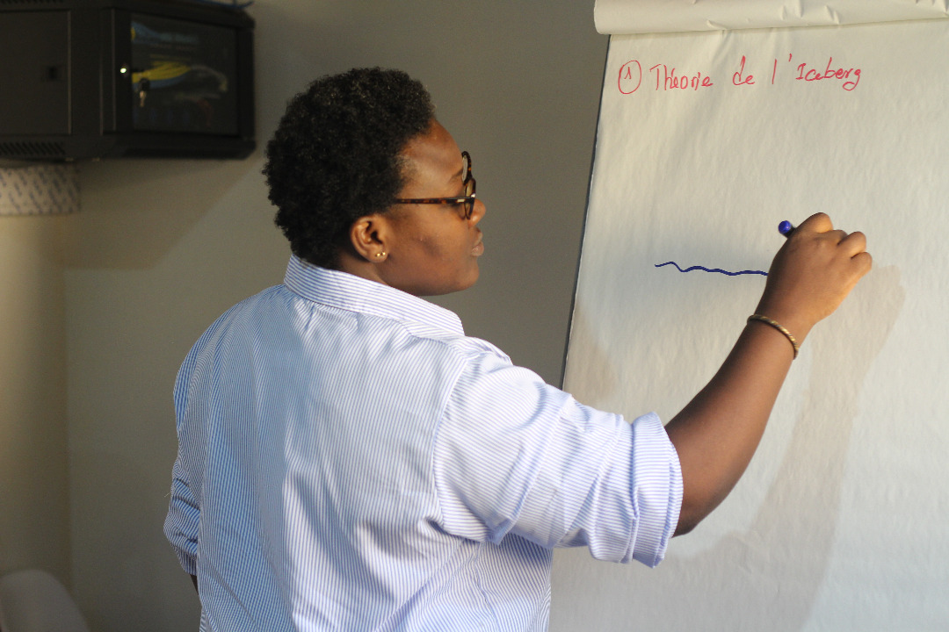
Girls in ITC - “Connected African Girls, Creating Brighter Futures”
Credit Photos: WETECH

Slide 12
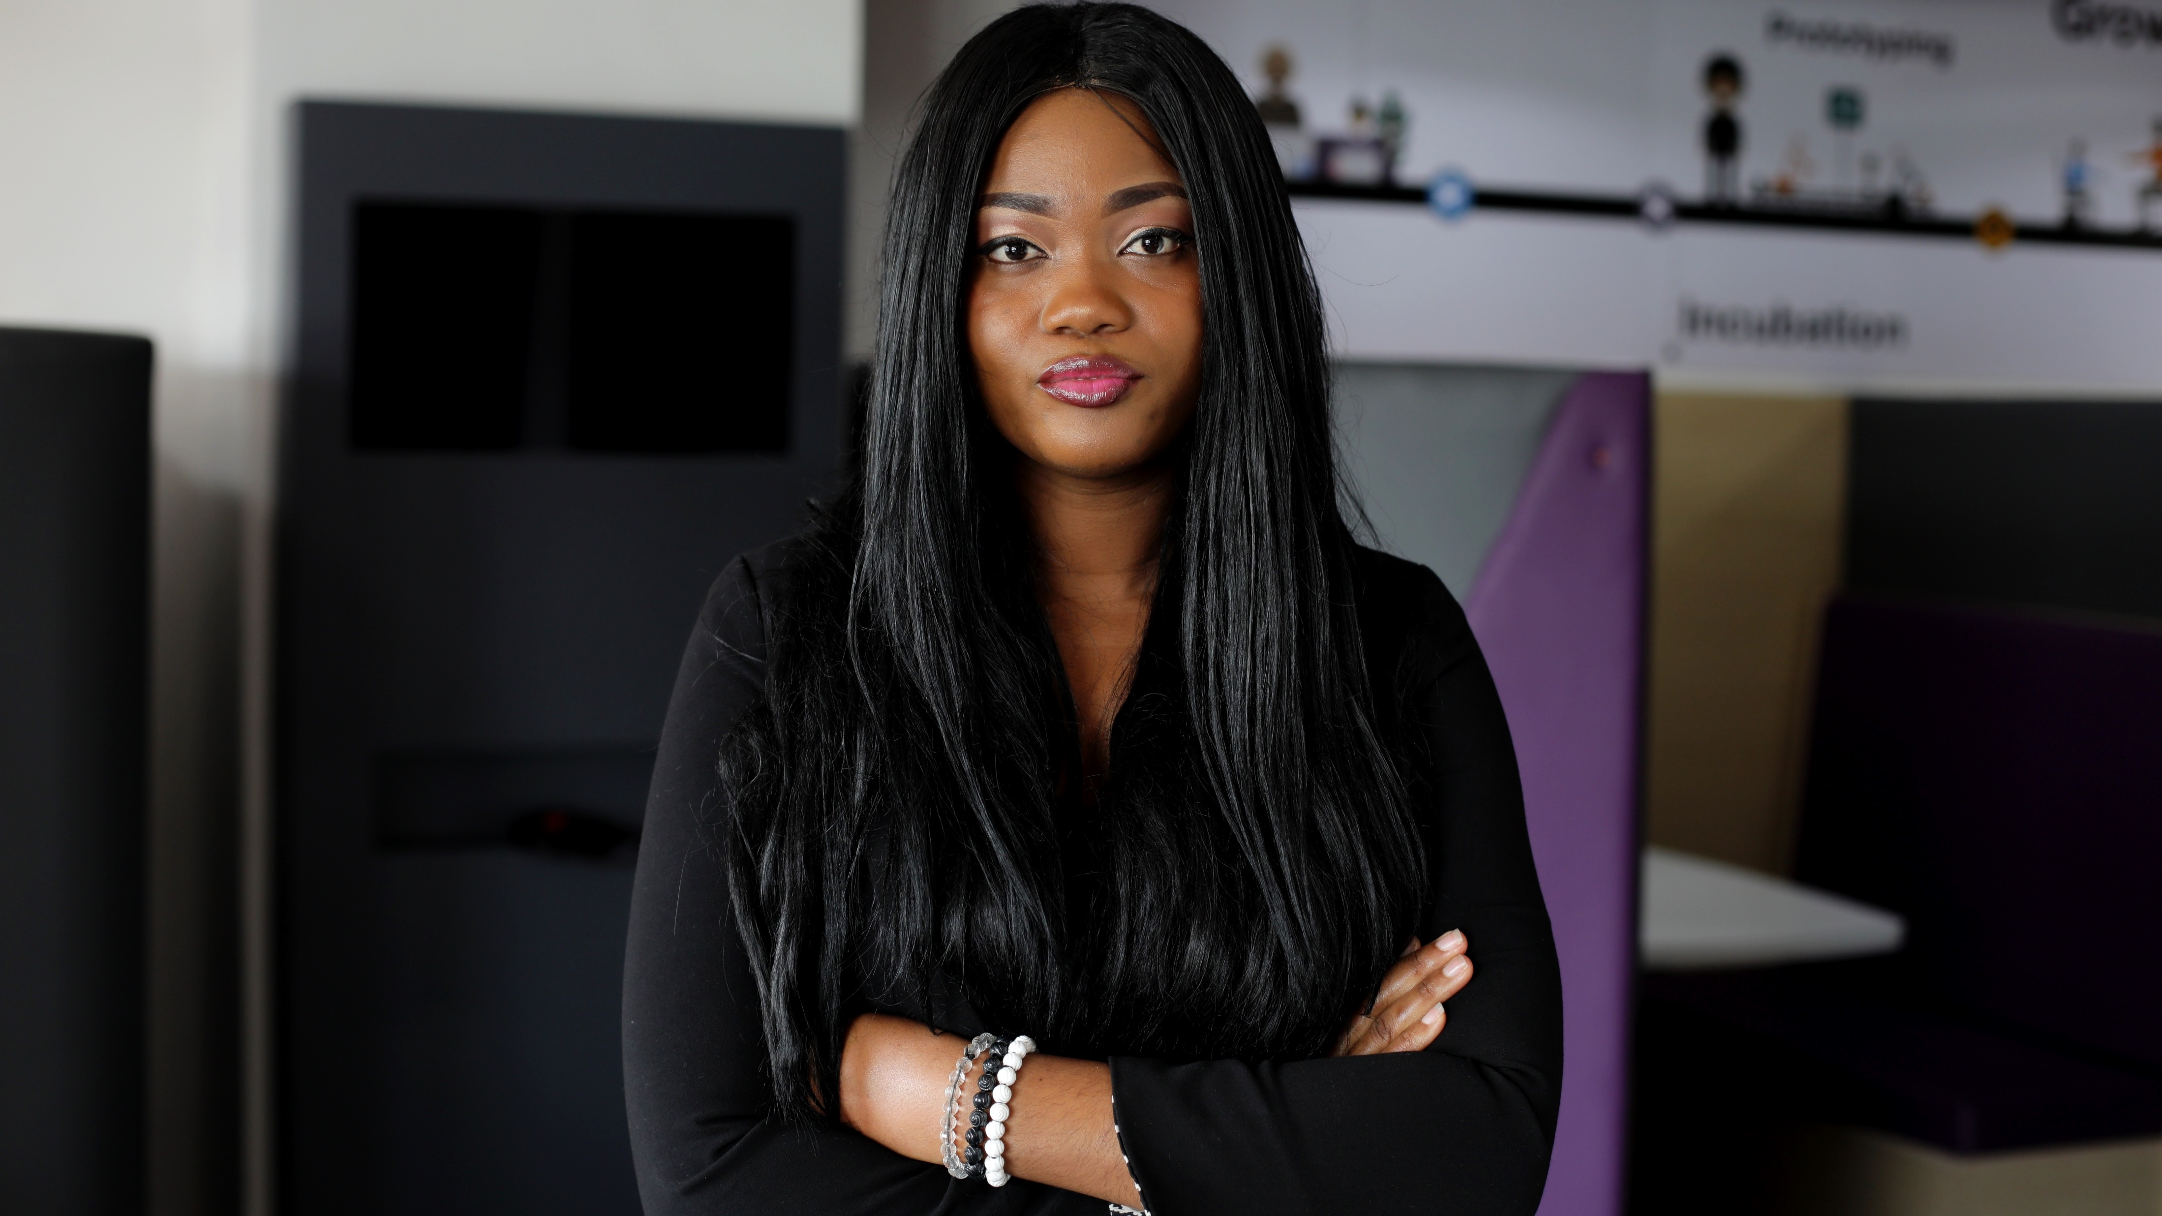
“Dear girls,
Technology gives you a chance to create your own world (E.g.: Be more educated, develop your career, live your passion, start a business, and more).
Make sure you use ICT positively to design your future.”
Crescence Elodie NONGA

Slide 13
Thank you for
your attention
Crescence Elodie NONGA
Blogger
Digital Communication Consultant
Founder of WETECH (Women in Entrepreneurship and Technology) – www.we-tech.org
Founder and Managing Director of EN Group – www.engroup-hub.com
UNCDF Panel Member for CEMAC
TechWomen Fellow
Africa Code Winner
Top African DOERS
Best Social Entrepreneur
Best Role Model
dear@engroup-hub.com

