Slide 1





#GirlsinICT
CYBERSECURITY &
KEEPING SAFE ONLINE
SORENE ASSEFA
@SoreneTweets
@icyberczar
Sorene.Assefa@icyberczar.com
https://chat.whatsapp.com/LDFLoUfcX1mI75rfPZkjA0

Slide 2


TOPICS
ABOUT </SORENE />
How would you define Cybersecurity?
Why do we need more #GirlsinCybersecurity?
Online Safety & Tips
Digital Good Citizenship Pledge
    Video from the Hybrid Continental Coding Camp
#GirlsinICT

Slide 3
CYBERSECURITY ?
Cybersecurity is the collection of tools, policies, security concepts, security safeguards, guidelines, risk management approaches, actions, training, best practices, assurance and technologies that can be used to protect the cyber environment and organization and user’s assets – ITU
CYBERSÉCURITÉ ?
La cybersécurité est l'ensemble des outils, politiques, concepts de sécurité, mesures de protection, approches de gestion des risques, actions, formations, meilleures pratiques, assurances et technologies qui peuvent être utilisés pour protéger le cyber environnement et les biens des organisations et des utilisateurs - UIT
#GirlsinICT
Notes:
ICTs have become an integral part of modern society.

Slide 4

WHY WE NEED MORE #GIRLSINCYBERSECURITY ?
According to Cybersecurity Ventures, there will be up to 3.5 million job openings by 2021.
Meanwhile, women make up only 11% of the Cybersecurity workforce.
POURQUOI AVONS-NOUS BESOIN DE PLUS DE #FILLESDANSLACYBERSÉCURITÉ ?
Selon Cybersecurity Ventures, il y aura jusqu'à 3,5 millions d'offres d'emploi d'ici 2021.
Cependant, les femmes ne représentent que 11 % de la main-d'œuvre du secteur de la cybersécurité.
LACK OF SKILLED CYBERSECURITY PROFESSIONALS
#GirlsinICT
Notes:
ICTs have become an integral part of modern society.

Slide 5
CYBERSECURITY IS
OUR SHARED RESPONSIBILITY
LA CYBERSÉCURITÉ EST
NOTRE RESPONSABILITÉ PARTAGÉE
ONLINE SAFETY- begins with you.
</Yes…/> YOU ☺
LA SÉCURITÉ EN LIGNE - commence par toi
</Oui.../> ☺
#GirlsinICT
Notes:
ICTs have become an integral part of modern society.

Slide 6
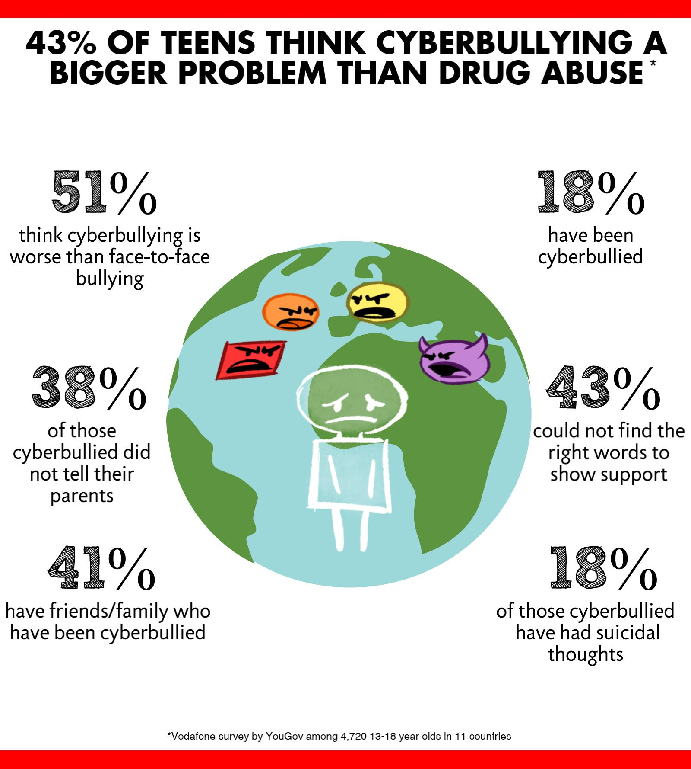

What does Cyberbullying look like?
Bullying defined as:
unwanted, aggressive behaviour among persons that involves a real or perceived power imbalance.
À quoi ressemble la cyberintimidation ?
L'intimidation est définie comme :
les comportements indésirables et agressifs entre personnes qui impliquent un déséquilibre de pouvoir réel ou perçu.
#GirlsinICT
Notes:
ICTs have become an integral part of modern society.

Slide 7
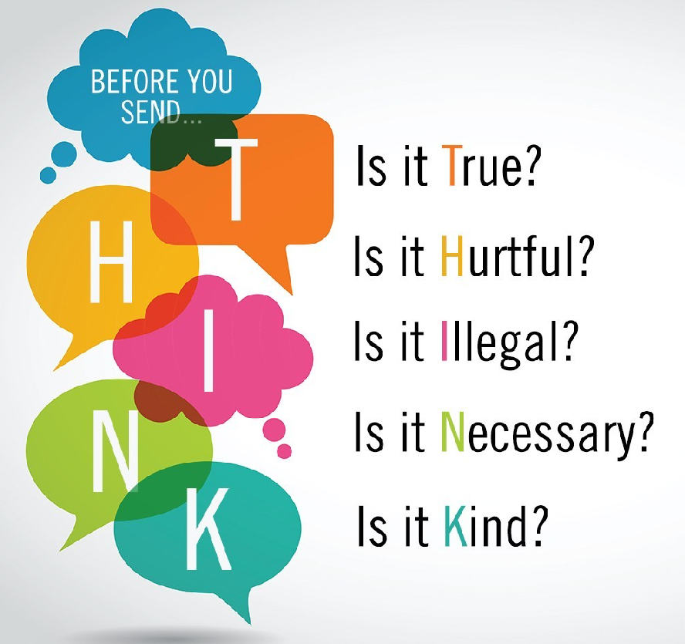

Has anyone experienced Cyberbullying ?
Quelqu'un a-t-il déjà été victime de cyberintimidation ??
COMMON SENSE RULES APPLY ONLINE!
WORST SOCIAL MEDIA SITES FOR BULLYING
#GirlsinICT
Notes:
ICTs have become an integral part of modern society.

Slide 8
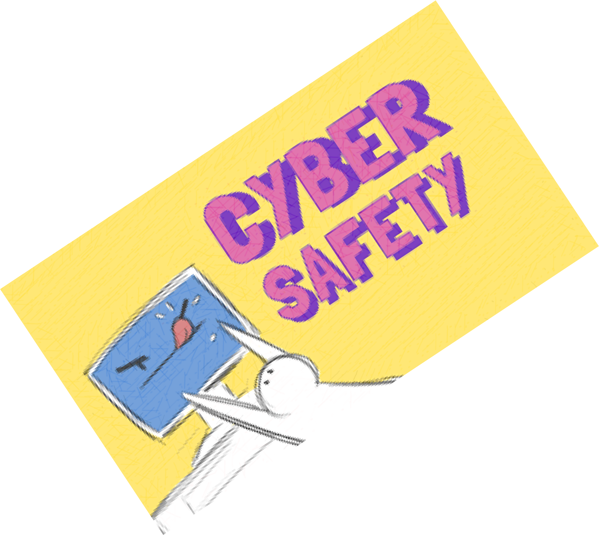
ONLINE SAFETY- TIPS
Golden Rule ! Post only About others as you have them post about you !
Just like you have to look both ways before crossing the street, you have to be aware of Internet safety.
Internet doesn’t forget, what you post can last a lifetime. Share with Care!
CONSEILS DE SÉCURITÉ EN LIGNE
Règle d'or ! Ne postez que sur les autres, car vous les faites poster sur vous !
Tout comme vous devez regarder des deux côtés avant de traverser la rue, vous devez être conscient de la sécurité sur Internet.
Internet n'oublie pas que ce que tu publies peut durer toute une vie. Partagez avec soin !
COMMON SENSE RULES APPLY ONLINE!
#GirlsinICT
Notes:
ICTs have become an integral part of modern society.

Slide 9
CONSEILS DE SÉCURITÉ EN LIGNE…
LES RÈGLES DU BON SENS S'APPLIQUENT EN LIGNE !
Ne parlez pas aux étrangers. Ne communiquez pas avec des inconnus en ligne et n'acceptez jamais de les rencontrer en personne. vous dans un salon de discussion, par courrier électronique ou par SMS.
Les informations personnelles, c'est comme l'argent . Valorisez-le. Protégez-les.
Si l'offre semble trop belle pour être vraie, alors elle l'est probablement. (Attaque de phishing).
ONLINE SAFETY- TIPS…
COMMON SENSE RULES APPLY ONLINE!
Don’t talk to strangers. Don't communicate with strangers online and never agree to meet in person. you in a chat room, through email, or via text messaging.
Personal information is like Money . Value It. Protect It.
If the offer seems too good to be true, then it probably is. (Phishing attack).
#GirlsinICT
Notes:
ICTs have become an integral part of modern society.

Slide 10
CONSEILS DE SÉCURITÉ EN LIGNE…
LES RÈGLES DU BON SENS S'APPLIQUENT EN LIGNE !
7. Keep your applications/ OS Up to date.
Do the necessary back ups.
Get savvy about free Public hotspots.
ONLINE SAFETY- TIPS…
COMMON SENSE RULES APPLY ONLINE!
7. Keep your applications/ OS Up to date.
Do the necessary back ups.
Get savvy about free Public hotspots.
#GirlsinICT
Notes:
ICTs have become an integral part of modern society.

Slide 11
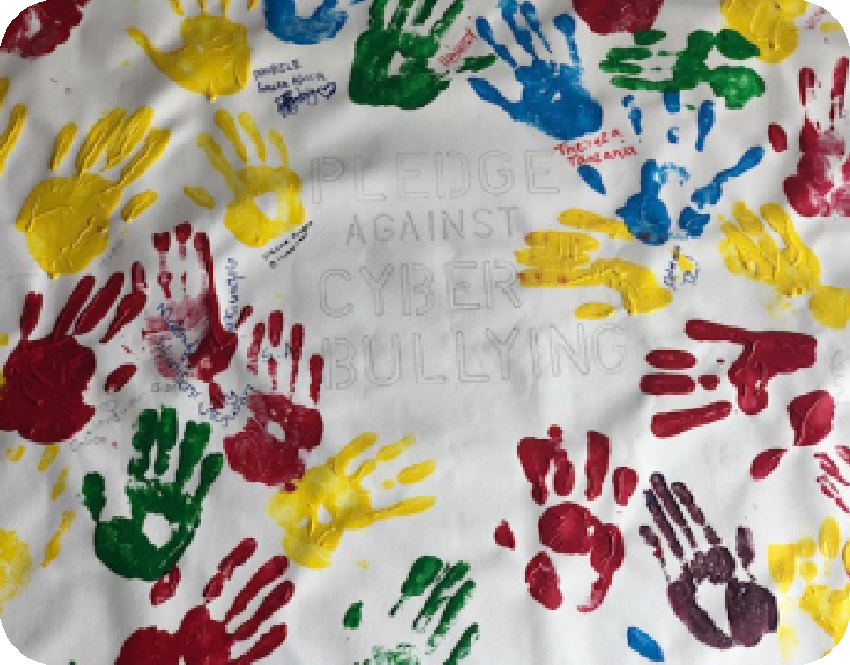

I Pledge…
To take a stand against cyberbullying.
I will not use technology to hurt others.
I will help those who are being cyberbullied.
I will speak out against cyberbullying.
I will protect myself when using technology.
If I encounter a situation that is offensive I will tell my parent, guardian or another trusted adult.
I will use technology responsibly and agree to think before I post.
I will not pass harmful messages, images, or language that is hurtful.l
I will be kind.
CYBERSECURITY IS
OUR SHARED RESPONSIBILITY
&
LET’S BE A GOOD DIGITAL CITIZENS!
#GirlsinICT
Notes:
ICTs have become an integral part of modern society.

