Slide 1
SDGs and Digitalization
Emelang Leteane, Social Affairs Officer and Head of the Sub-Regional Initiatives Cluster

Slide 2
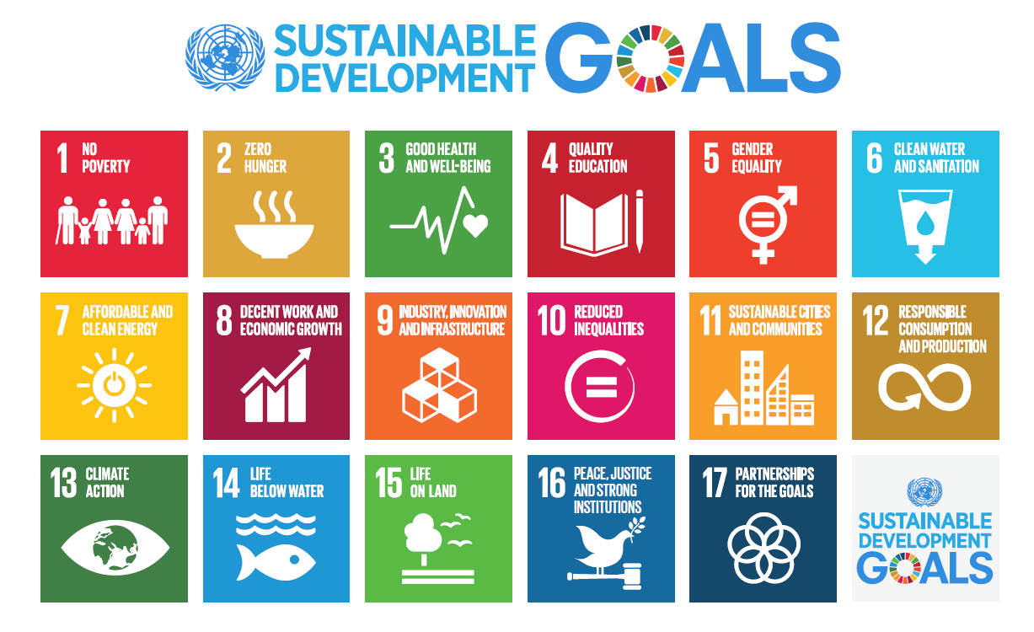
The Goals

Slide 3
Progress is off-track in most SD
Source: The Sustainable Development Goals Centre for Africa and Sustainable Development Solutions Network (2019.

Slide 4






Eastern African countries are making slow progress with many SDGs
SDGs Registering Weakest Performance in all countries except Seychelles
Government Spending on Education and Health
847
3,003
685
But low government spending makes it hard to progress
Source: UNDP

Slide 5
In specifically looking at SDG 1 on no poverty, according to economic analysis, the digitization of economic processes, activities, and value could bring as much as a $4.1 trillion USD increase in GDP among developing countries, using the opportunity of technological leapfrogging to engage quickly and effectively with the digital economy. (Hany Besada)

Slide 6
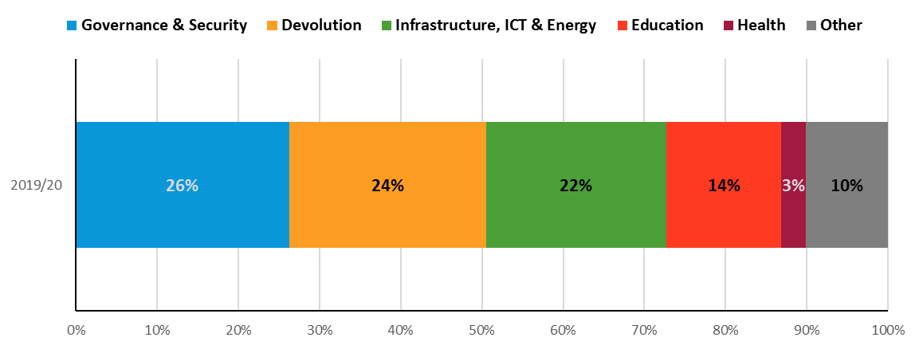
Budgetary allocations often reflect government priorities
Latest Government Budget Sectoral Allocations
Percent of Total Government Spending
Kenya
Will the region meet the SDGs with only this spending?
Financing the SDGs may require innovative strategies
(e.g. PPPs)
Rwanda
Uganda
Source: National sources

Slide 7
ICTs was one of the sectors that remained resilient
7
Source: NISR
Notes:
Prior to the crisis, growth in East Africa was very strong – the highest of all sub-regions on the continent
This year, it is still expected to expand slightly, driven by growth – against all odds – in Ethiopia, Rwanda, South Sudan and Tanzania

Slide 8
Digital Literacy -- UIS
The ability to access, manage, understand, integrate, communicate, valuate and create information safely and appropriately through digital technologies for employment, decent jobs and entrepreneurship. It includes competencies that are variously referred to as computer literacy, ICT literacy, information literacy and media literacy

Slide 9
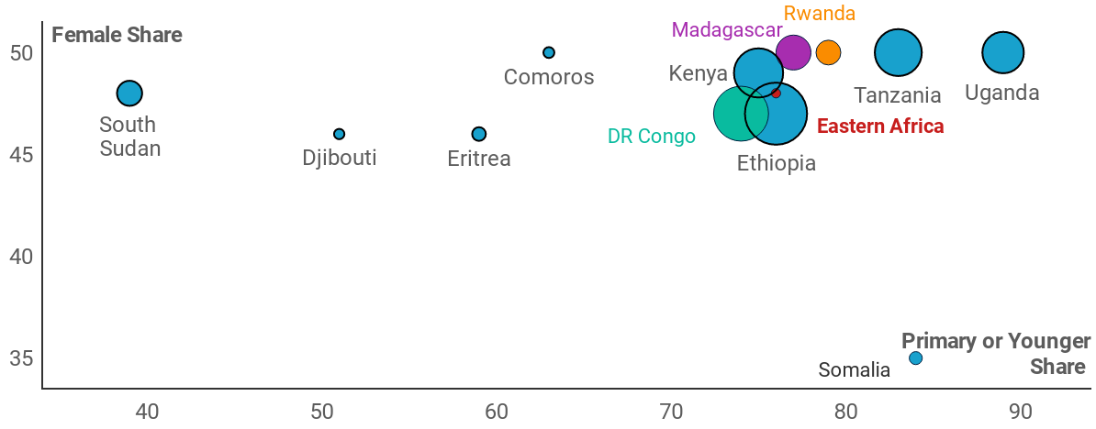

School closures affected 96 million learners in Eastern Africa, BUT, technology plugged some of the gaps through digital platforms
Across all affected learners in Eastern Africa,
49% are female, and
79% are primary school-aged or younger
Share of Female and Young Students Among Total Impacted by School Closures
… slowing progress to SDG4 …
Note: Except for the Eastern Africa point, country bubbles are sized by the total number of students impacted
Source: UNESCO, UNICEF, World Bank

Slide 10

Despite investment in education, skills mismatch still persist
Education is prioritized in the region
On average 15% of government budgets is spent on
Public Education
However there is a high level of skills mismatch. Graduates cannot meet the needs of the job market
COUNTRY | SHARE OF GRADUATES LACKING REQUISITE SKILLS FOR THE JOB MARKET
Uganda | 63%
Tanzania | 61%
Burundi | 55%
Rwanda | 52%
Kenya | 51%
Source: World Bank, IUCEA

Slide 11
Digital divide in COVID times
Digital divide is real.
Country responses to covid– the COVID-19 pandemic also seem to have contributed to narrowing the digital divide. The Global Digital Development policy response notes that all countries in Eastern Africa have expanded digital access between 2020 and 2021. While countries like Kenya and DRC have made digital infrastructure more affordable, other countries have explored e-learning, provision of public health information, digital payments and business continuity;

Slide 12
Conclusion and Recommendations
Fewer girls than boys possess ICT skills. Can we commit to equip girls with the necessary skills?
Home environment is critical
Technology and related skills go together.
It is redundant to have access without the skills and vice-versa
Digital gender divide needs to be addressed as it poses a threat to gender equality and the attainment of SDGs e.g. cyberbullying

Slide 13
Conclusion/ Recommendations continued
Improve access to digital literacy
For digital access to be equitable, there is need to address the digital gender divide
Get involved and encourage more women to be involved in implementation of the SDGs
Continue to call for more investment in addressing the digital divide.

