Slide 1
Reports of the seventh meeting of the Statistical Commission for Africa
and the fifth Conference of Ministers Responsible for Civil Registration and Vital Statistics
Tinfissi Joseph ILBOUDO
Chief Statistical Development, Data Innovation and Outreach Section
African Centre for Statistics
18 March 2021

Slide 2
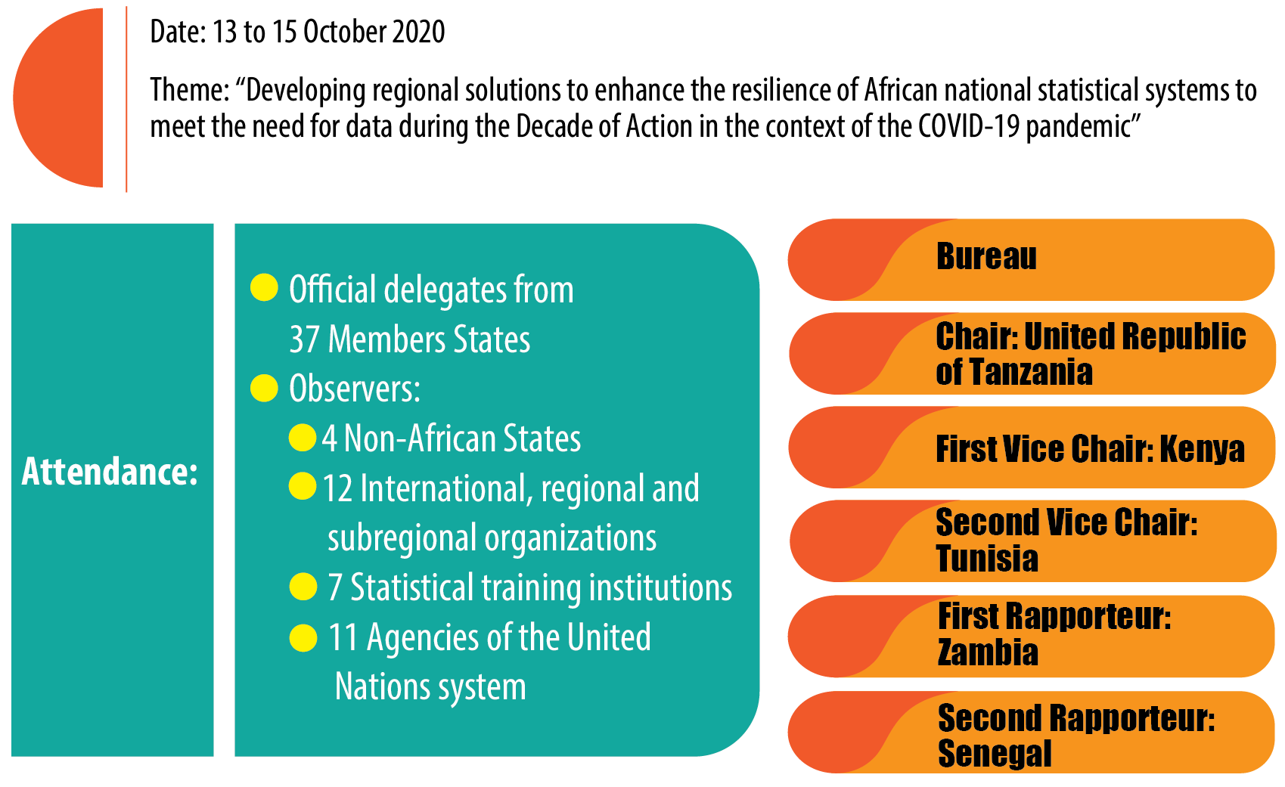
General information – 7th meeting of StatCom

Slide 3
Statutory issues – 7th meeting of StatCom
Objective:
Review current trends and devise innovative statistical solutions to strengthen national statistical systems in Africa in the context of the pandemic
Main issues discussed
  Statistical capacity development in Africa
  Sustainable Development Goal indicators
  2020 round of population and housing censuses
  Civil registration, vital statistics and the United Nations Legal Identity Agenda
  Implementation of the African programme on gender statistics 2017–2021
  2008 System of National Accounts
  Standard guiding principles of the Global Statistical Geospatial Framework for the integration of statistical and geospatial information in Africa
  Private-sector experience with big data
  United Nations global platform and regional hub on big data for official statistics
  Statistical coordination among United Nations agencies
Emerging issues:
Response to the COVID-19 pandemic
Open data
Data science and big data
Urban data

Slide 4
Conclusions - 7th meeting of StatCom
Urgency in the context of the COVID-19 pandemic of transforming statistical production systems in African countries
Continuing efforts and initiatives undertaken to track the achievement of the Sustainable Development Goals at the national, subregional and continental levels and under the impact of the COVID-19 outbreak
Building the capacities of countries in respect of health statistics and mortality surveillance would be critical to improving health services that have been greatly affected during the COVID-19 pandemic

Slide 5
Resolutions – on 7th meeting of StatCom
Endorse the creation of the African group on transformation and modernization of official statistics
Urge partners and governments to endeavour to build strong monitoring systems and health information systems at the national and local levels
Call upon pan-African organizations and partners to work in close collaboration and foster synergies to support African countries
Call upon member States to renew their commitment to the conduct of population and housing censuses during the 2020 round of such censuses
Endorse the report and resolutions of the seventh meeting of the Statistical Commission for Africa, held virtually from 13 to 15 October 2020
Urge that steps be taken to ensure that the Integrated Geospatial Information Framework is incorporated into national development plans
1
2
3
4
5
6
Inception Meting Private Sector for GG and Jobs
UNECA.ORG
Notes:
UIN issued at birth will be critical in linking civil registration records and national ID management system and in the establishment of population registers
Digitization and advances in technology have been essential to the integration of civil registration and identity management systems
Awareness on the importance of identities in people’s daily lives will be the selling point for the UN LIA.. People will need to be identified by their governments.
Population registers will be the ultimate aim of a well-functioning system that will provide real time population estimates.
Coordination: Because of the fragmented nature of CR, VS and ID systems, there is need for strong coordination mechanisms at ministerial, management and technical levels.

Slide 6




Objectives of the Second Ministerial Conference on CRVS
Segments
  Meeting of Experts on 15-16 October 2019
  Ministerial meeting on 17-18 October 2019
Representations
  31 Ministers and Deputy Ministers
  53 African Member States
    750 national Experts
  18 Development partners
    350 international experts
  22 Media Houses
Bureau
  Chair: Zambia — Southern Africa
  First Vice-Chair: Kenya — East Africa
  Second Vice-Chair: Chad — Central Africa
  Third Vice-Chair: Sierra Leone — West Africa
  Rapporteur: Mauritania — North Africa
Civil registration as the foundation for legal identity systems
CRVS and Identity management for durable solutions for refugees, internally displaced persons and returnees
Foundations for digital transformation
Civil registration as the foundation for legal identity systems
Innovative civil registration and vital statistics systems: foundation for legal identity management

Slide 7
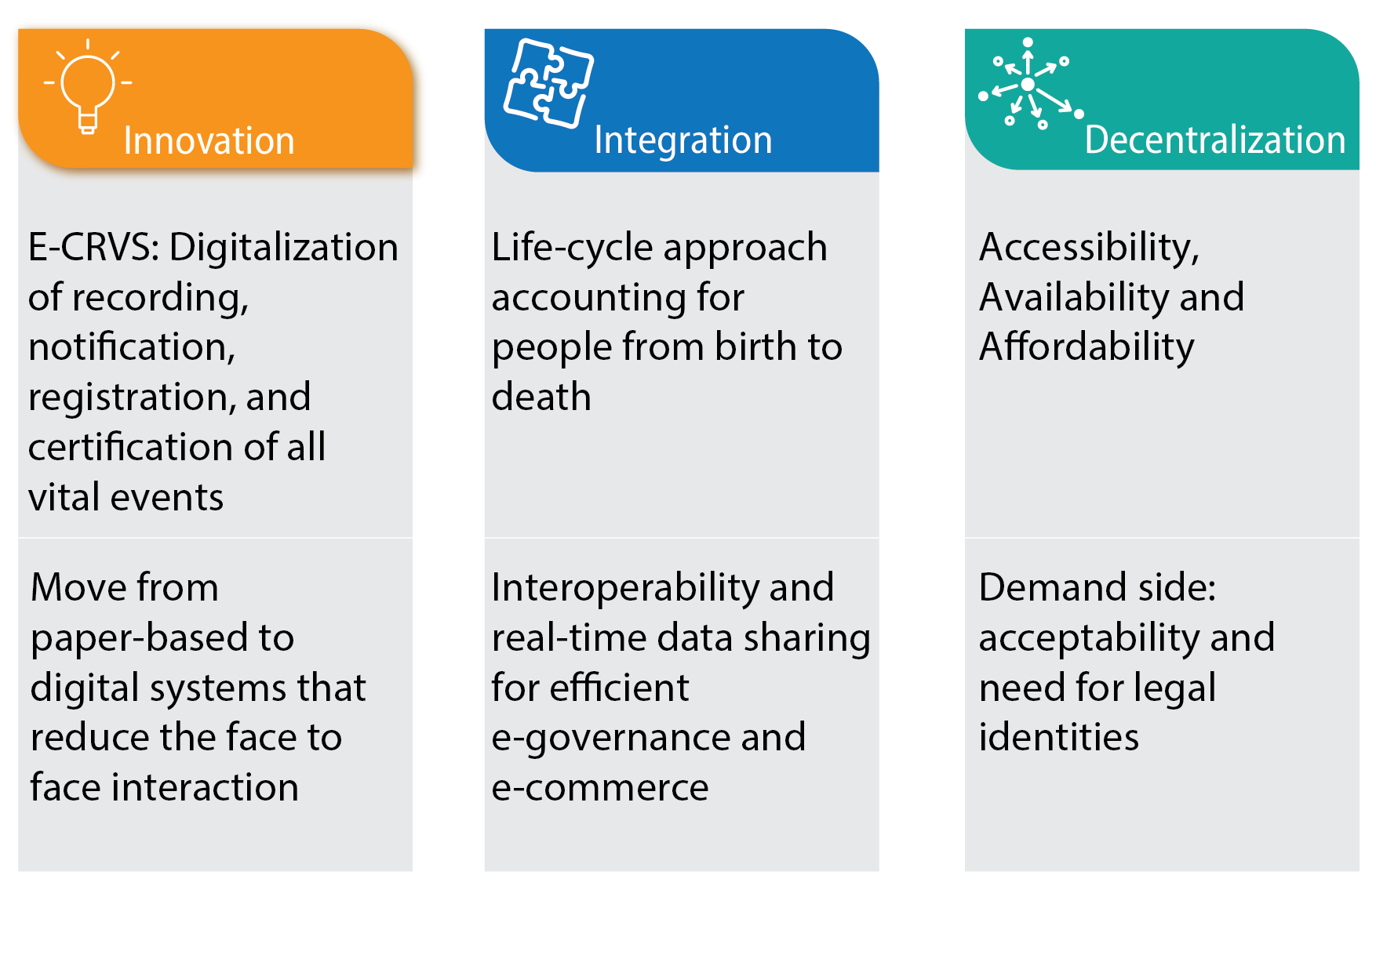
Pillars for Transformation - CRVS

Slide 8
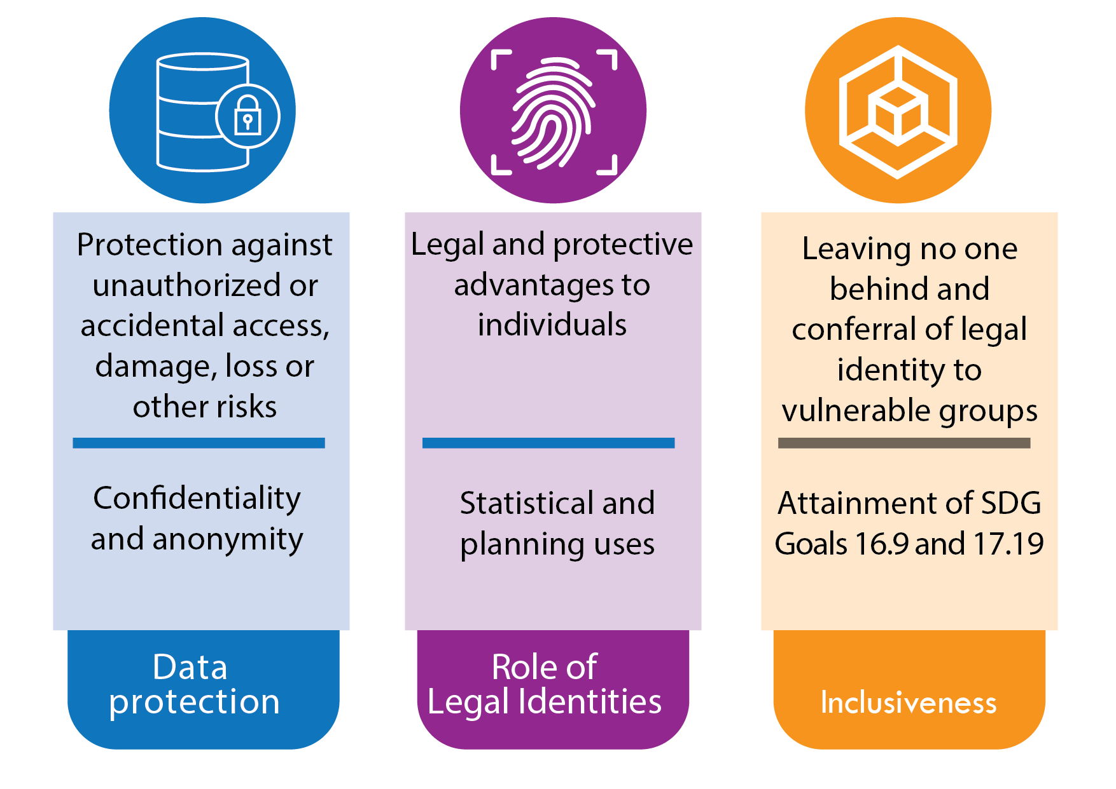
Security and Public Confidence in Systems - CRVS

Slide 9
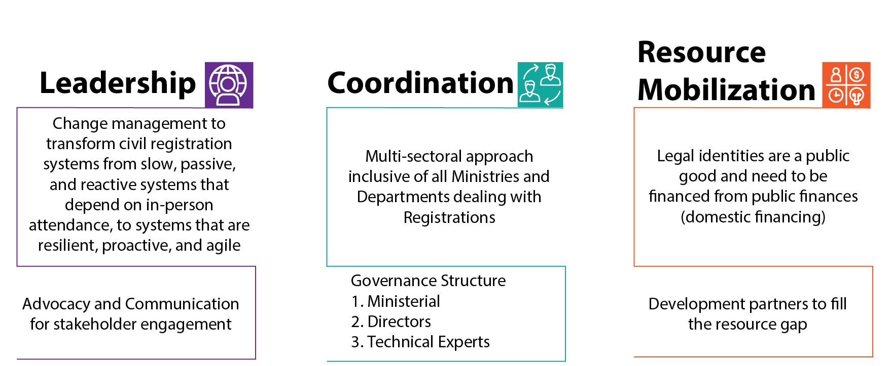
Role of Ministers - CRVS

Slide 10
Resolutions - CRVS
Strong political will and leadership by Ministers for Member to increase investments in modernized and digitization CRVS systems
Adopt laws and policies that strengthen existing institutions to provide legal documents to refugees, stateless persons and displaced persons
Adhere to the principles of civil registration: continuous, permanent, compulsory, universal and confidential
Collaboration of the development partners to provide support for the life-cycle model of registration
Establish integrated and interoperable CRVS systems to bring efficiency in the provision of services across different government functions as well as private sectors
Member States are encouraged to put in place data protection legislations to avoid manipulation and fraud
Request Ministers of Finance to provide adequate funding to the established of universal, modernized and digitalized CRVS and Identity Management systems
1
2
3
4
5
6
7
Inception Meting Private Sector for GG and Jobs
UNECA.ORG
Notes:
UIN issued at birth will be critical in linking civil registration records and national ID management system and in the establishment of population registers
Digitization and advances in technology have been essential to the integration of civil registration and identity management systems
Awareness on the importance of identities in people’s daily lives will be the selling point for the UN LIA.. People will need to be identified by their governments.
Population registers will be the ultimate aim of a well-functioning system that will provide real time population estimates.
Coordination: Because of the fragmented nature of CR, VS and ID systems, there is need for strong coordination mechanisms at ministerial, management and technical levels.

Slide 11
THANK YOU!
Follow the conversation: #COM2021
More: www.uneca.org/cfm2021

