Slide 1

Report on IDEP work
(E/ECA/COE/39/13*)
Karima Bounemra Ben Soltane
Director, IDEP
18 March 2021

Slide 2


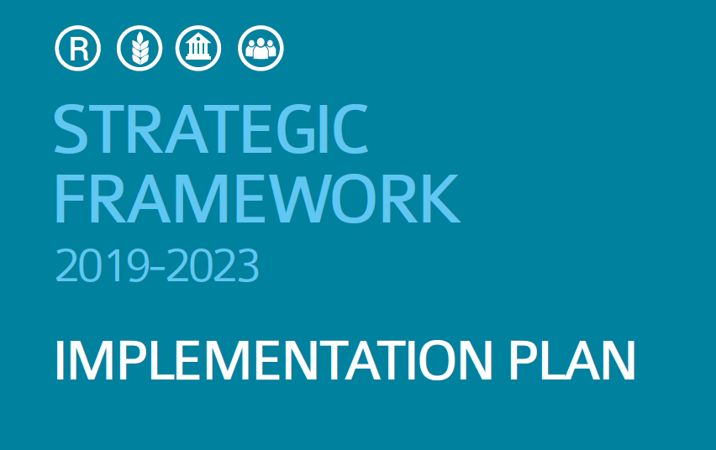
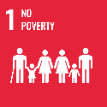



IDEP 2019 - 2020 Activities
Transformation
Operation
Knowledge generation
& dissemination
Implementation
of 2019-2023 Strategic Plan
Training
Research
& Knowledge Management
African Institute for Economic Development and Planning

Slide 3



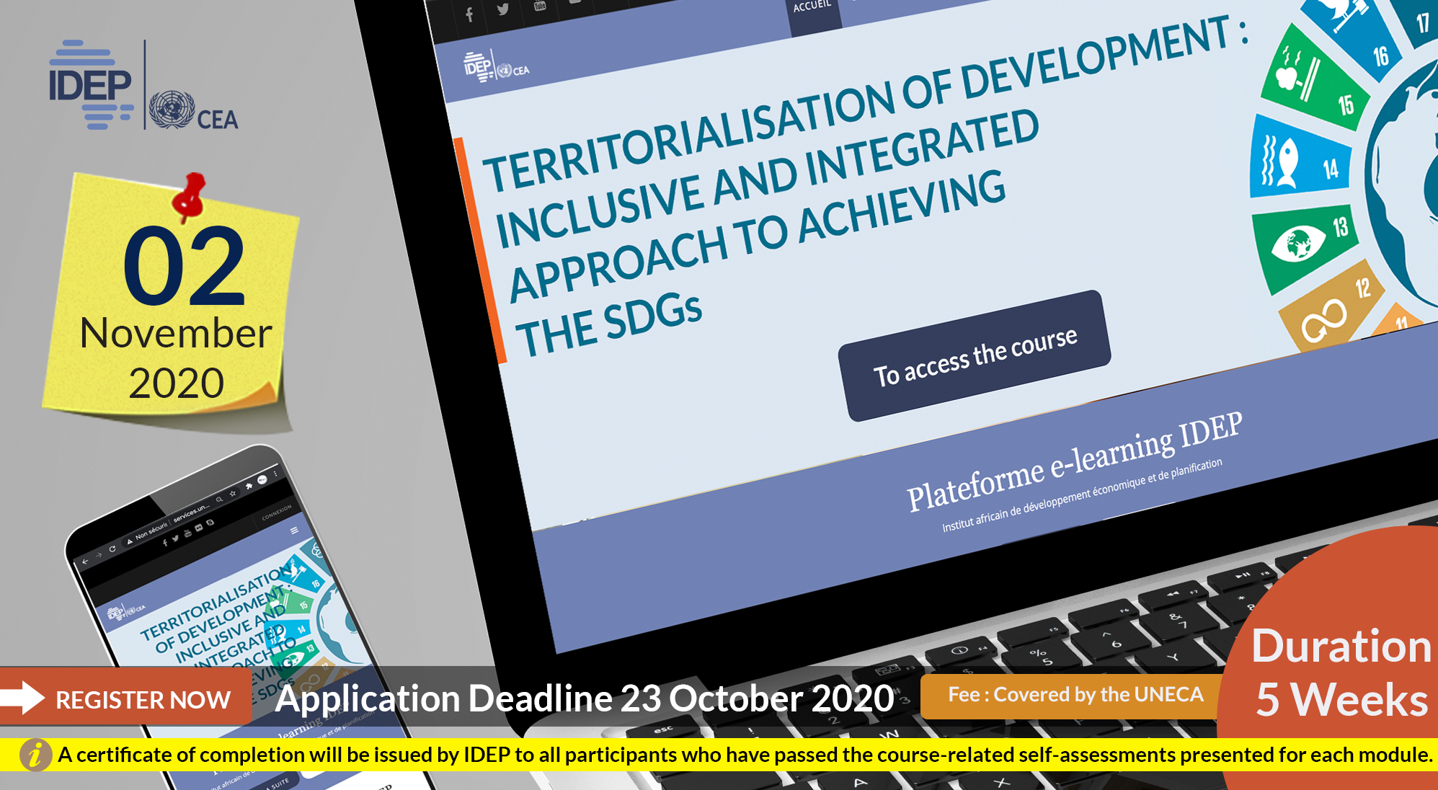
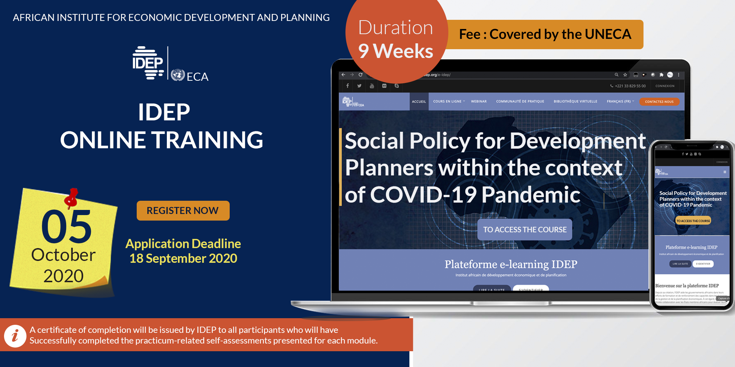
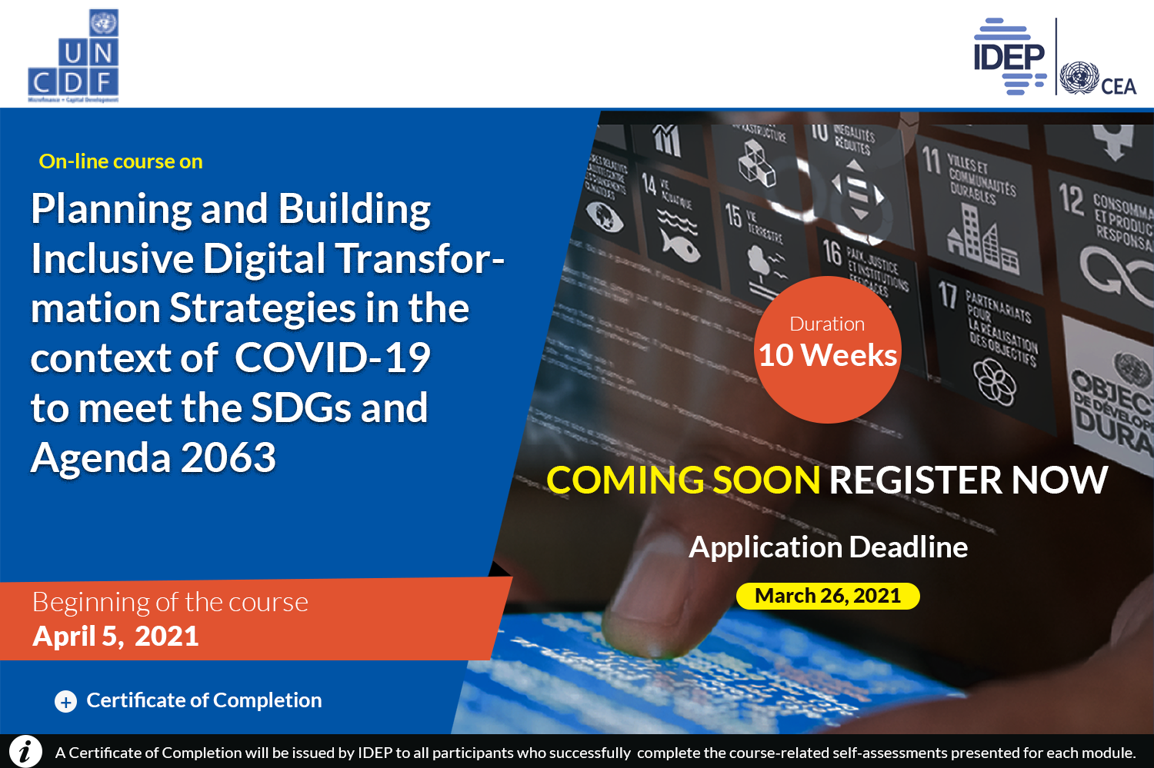

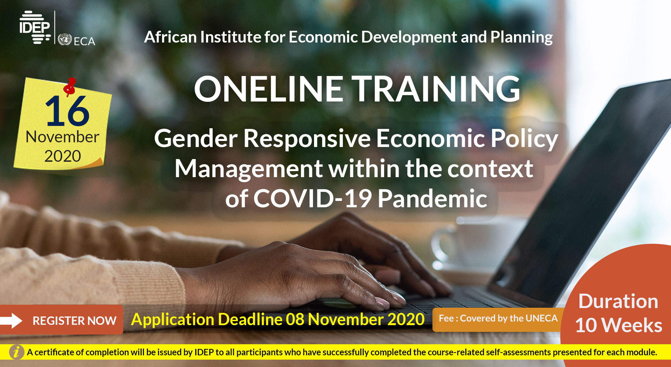
Training Activities
51 courses organized
19 on-site (2019)
32 digital learning (2019 – 2020)
4th & 5th cohorts of IDEP-UJ Masters’ - ‘Industrial Policy’
Increased number of public officials trained
1081 in 2019 - 2033 in 2020
Increased number of women trained
257 in 2019 - 484 in 2020
Impact assessment
Close to 70% response rate
80,64% trainees attested that they used acquired knowledge and skills for effective public policies, planning and implementation
28 JUILLET 2020
Modélisation macroéconomique pour la planification du développement durable

Slide 4





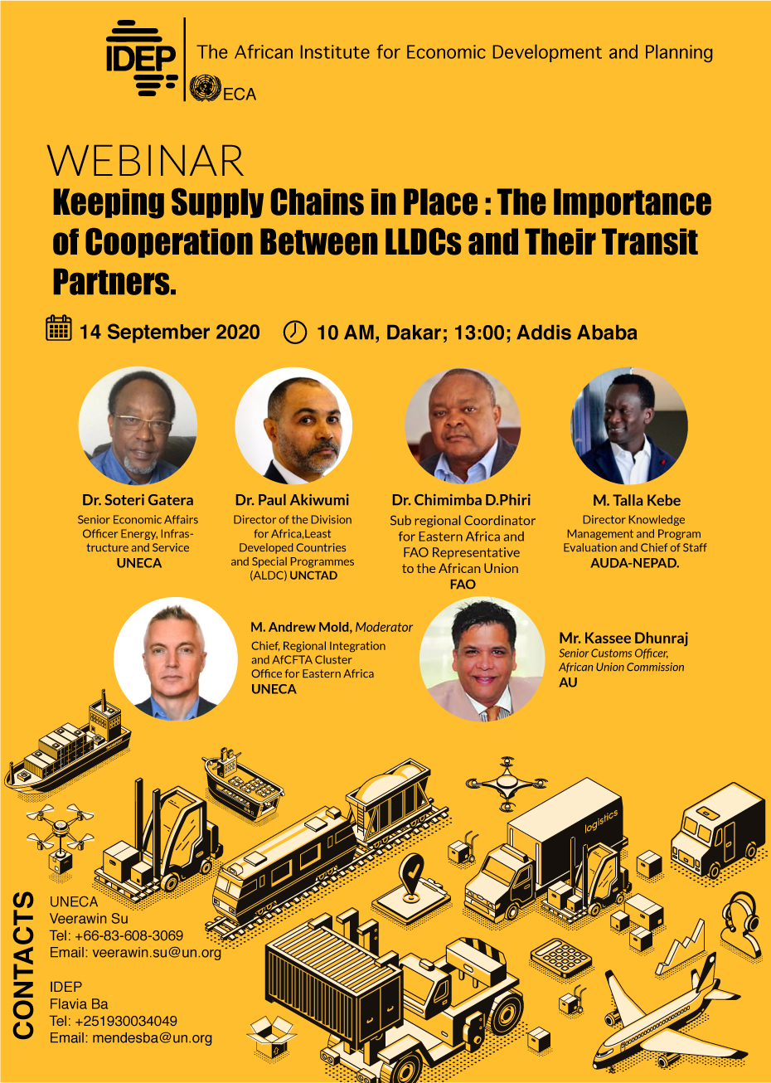
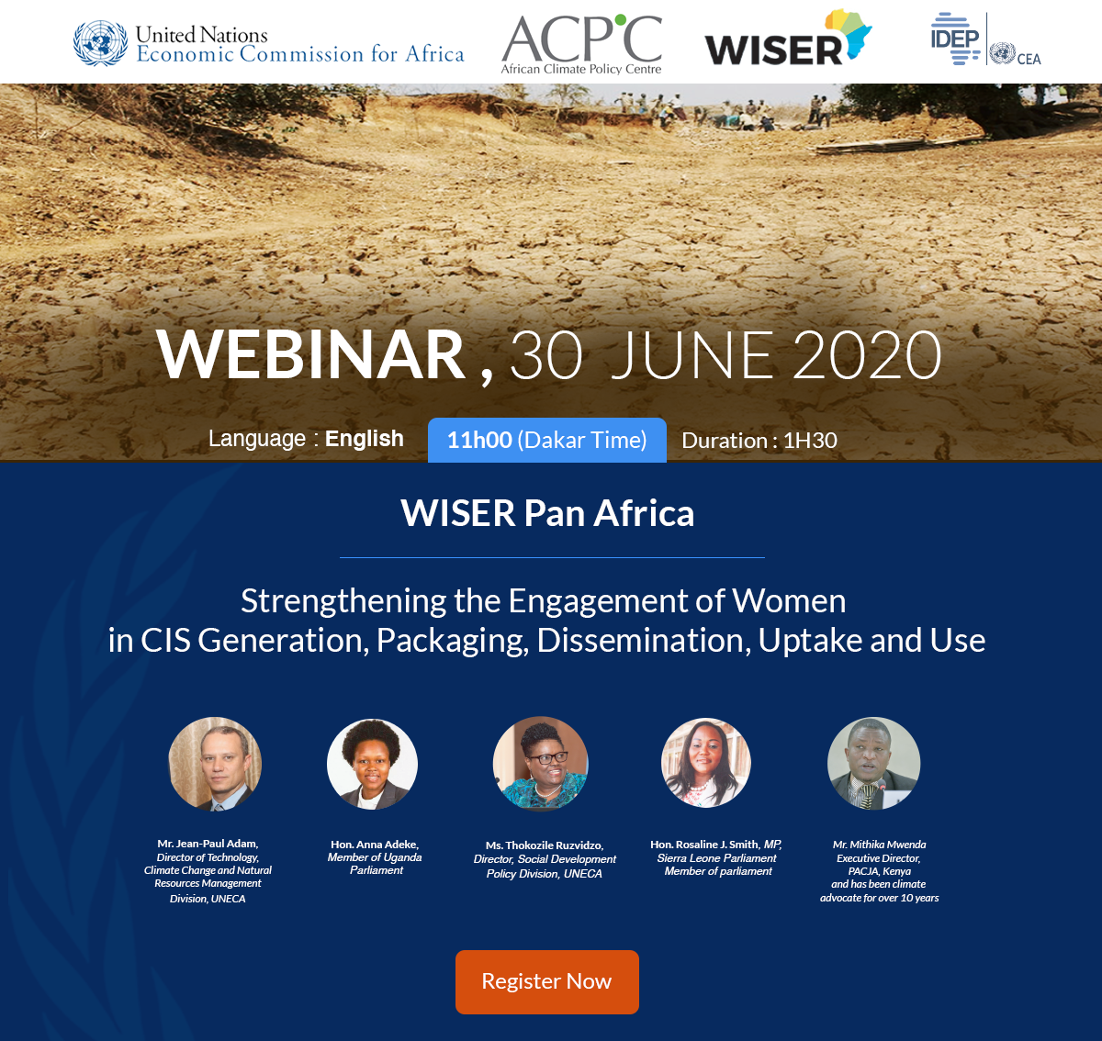

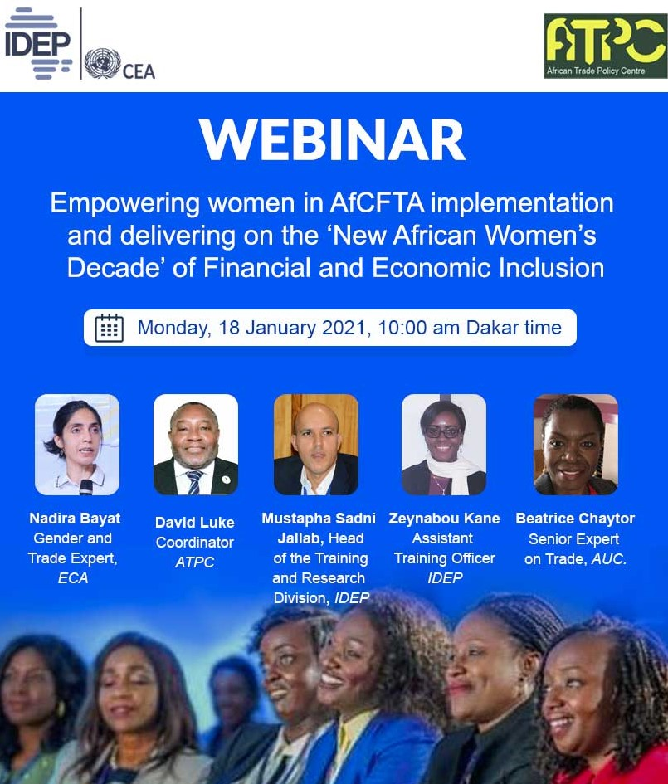
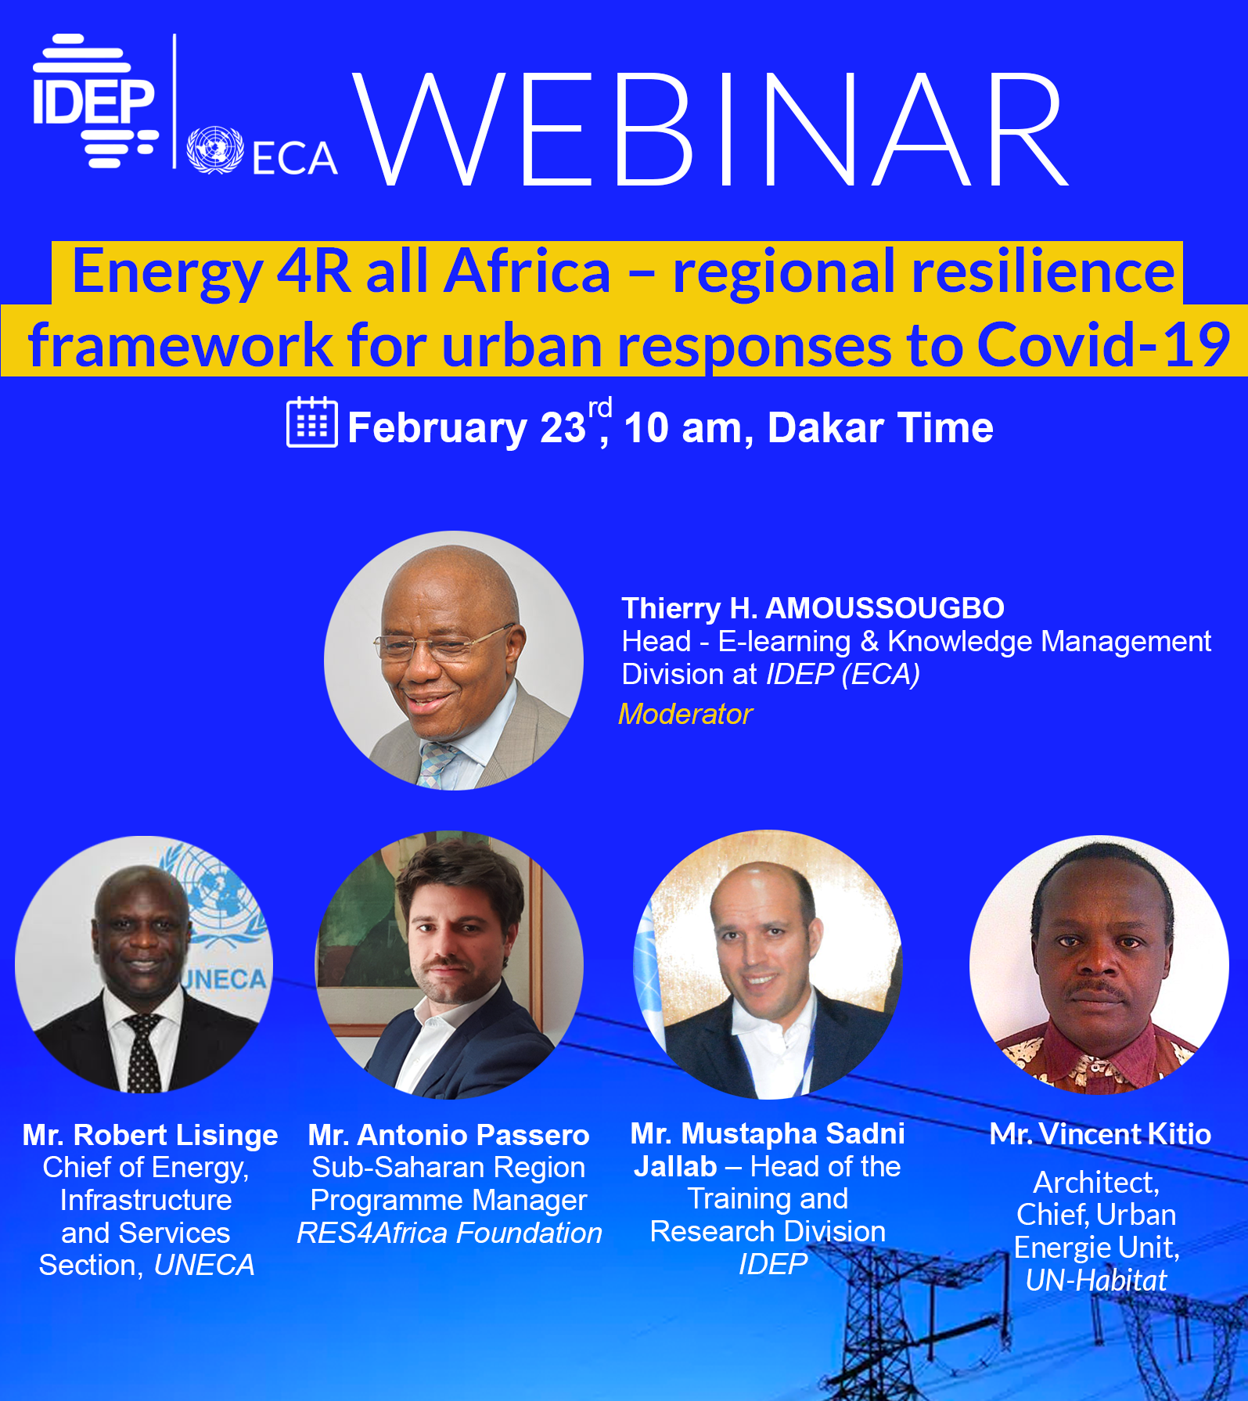


Knowledge Generation (research)
Research programme ( ) > Debt, taxation & F4D: immediate responses to global emergencies & efficient planning
Fellowship programme + UNV
20+ IDSs & High Level Policy Dialogues
Production of Working Papers & Policy Briefs
Communities of Practice
Main areas of focus: AfCFTA, COVID-19, SDGs, Planning
Increased participation: close to 900 participants (553 women)
from 47 countries

Slide 5

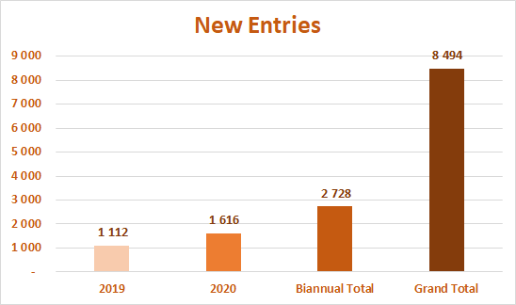
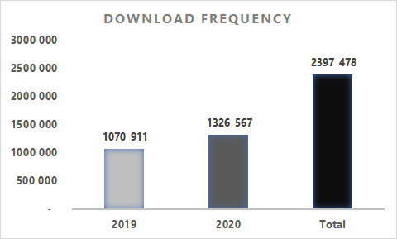
Knowledge Dissemination
Library
21 bibliographies & webographies provided to trainees & participants of the webinars
On-line only in 2020
Communities of Practice

Slide 6
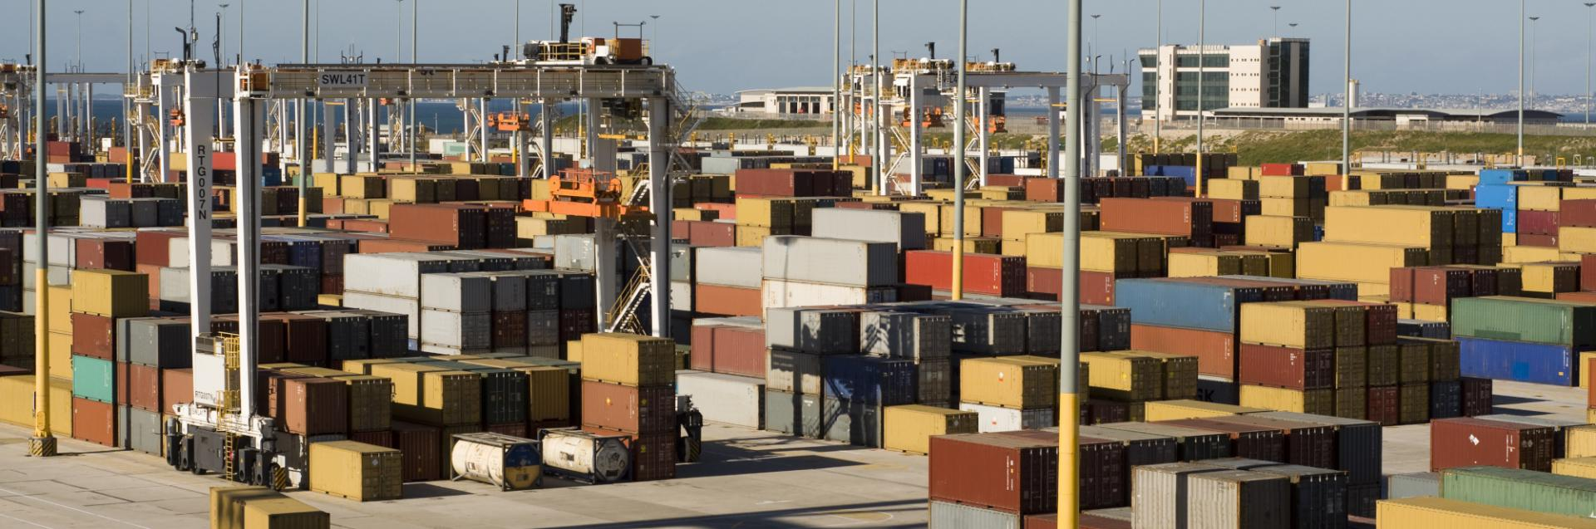

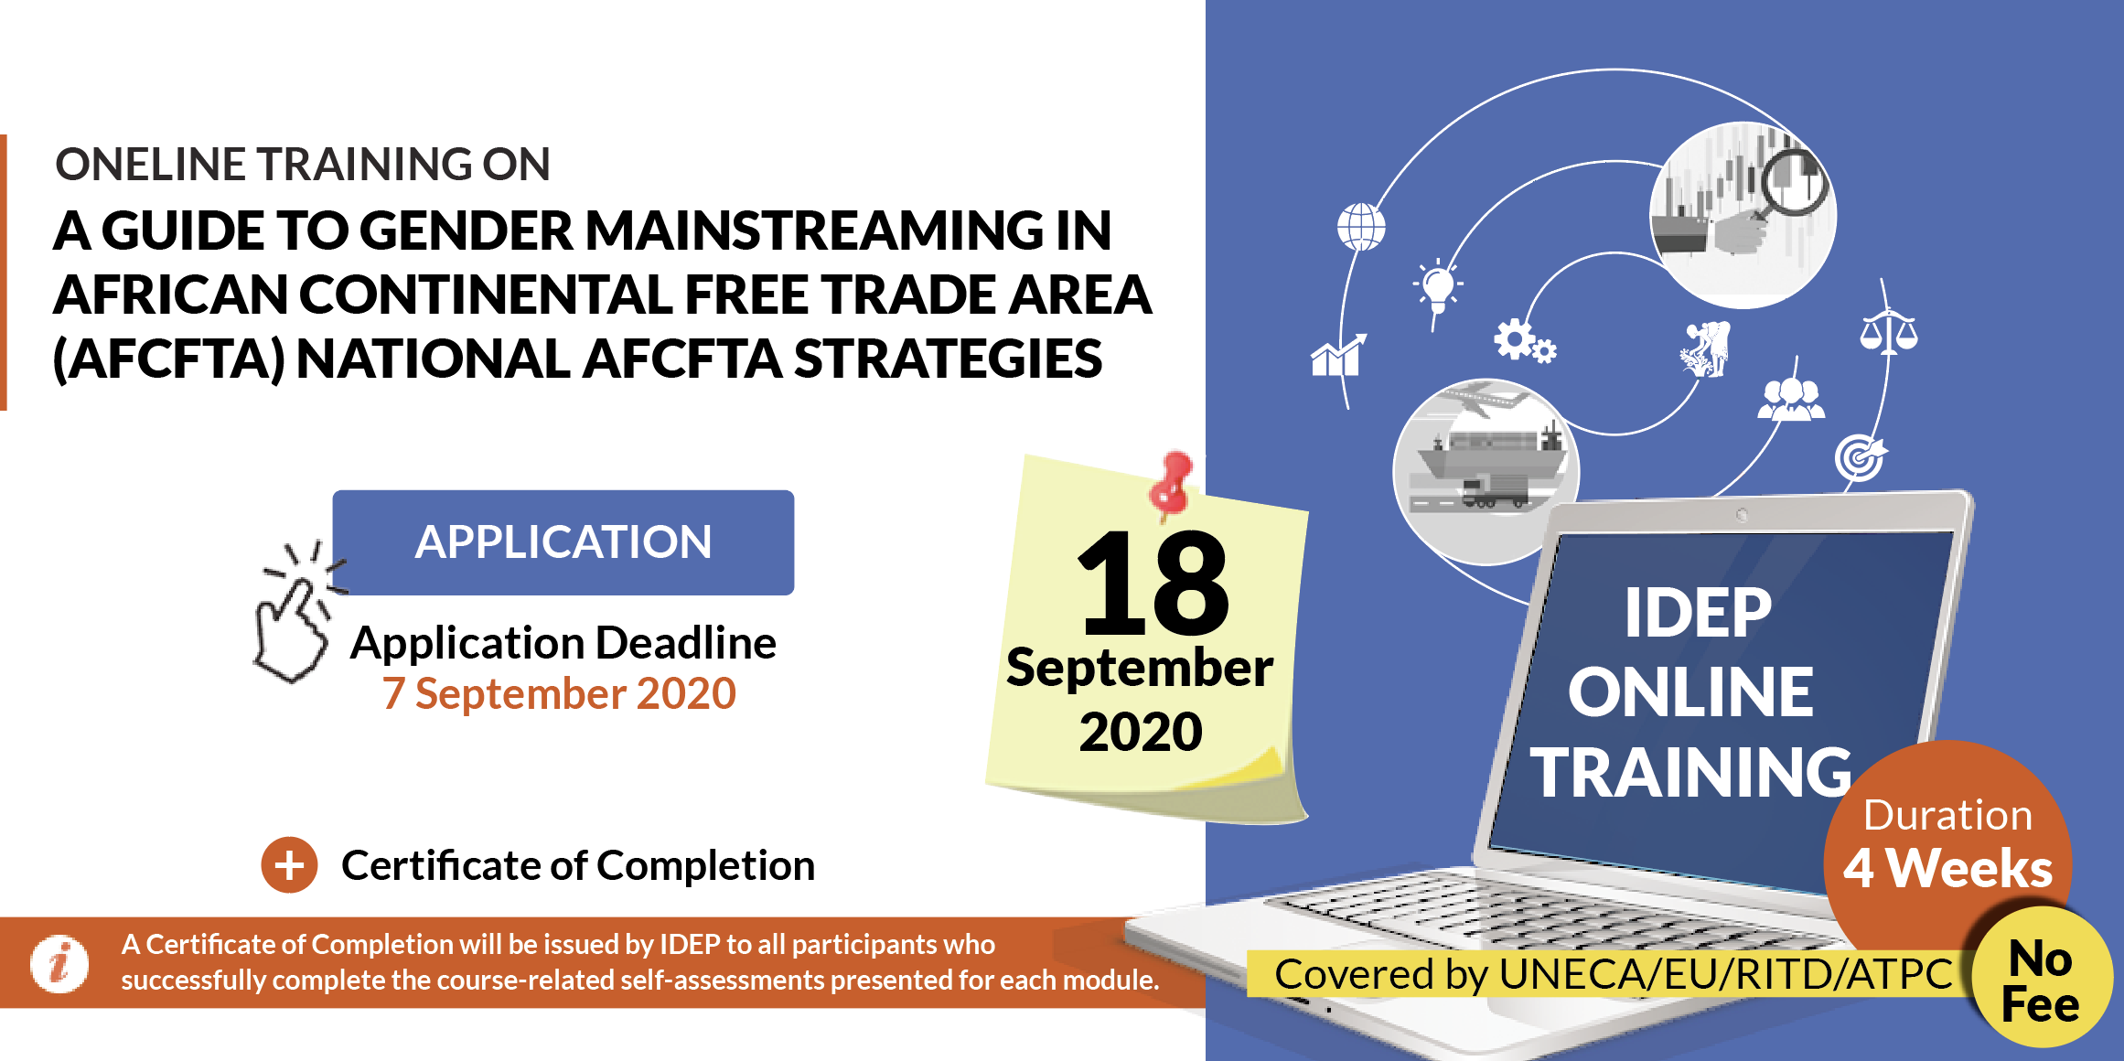
2020 Most Significant Result
Capacity development for AfCFTA
All African countries
Special attention to Countries of Focus
Trainings & Webinars
Research Papers
National and Regional perspectives
Trade modelling, gender & trade, AfCFTA for the media, e-commerce, enterpreneurship …
736 officials trained
M&E programme 123 testimonies
Focus on the AfCFTA
Where
What
How
Outcome

Slide 7

Partnership
  International & regional
  Academia
AUC, AUDA–NEPAD, RECs
DFID, GI-Hub, GIST, IDB, IEA, IFPRI, INTAN-Malaysia, IRENA, OIF, OSIWA, SEforAll, SIDA, World Bank
U. of Johannesburg
U. of Turku, U. of Edinburgh
CREG and U. Gaston-Berger, UCAD
Polytechnique Dakar
CODESRIA, CSIR
RCOs, RDs, UNOHRLLS, UNCDF, UNSDS, UNDP, IAEA, UN-DESA, IOM, UNESCO, ITU, UNV, FAO, UNCTAD, OSAA, UNDESA
+ ECA divisions and SROs – in the context of Joint Delivery
  ECA

Slide 8
IDEP Governance
58th Meeting of IDEP Governing Council, 10 December 2020, virtual
Renewal of IDEP Governing Council Membership (3years term)
Senegal (host country) and AUC (permanent member) to update the name of their representative
Sub Region | Proposed Members |  |  | Potential Alternate
Central Africa | Equatorial Guinea (*) | CAR |  | Sao Tome
East Africa | Rwanda | Ethiopia |  | Djibouti | Madagascar
North Africa | Sudan(*) | Mauritania |  | Libya
Southern Africa | Botswana | Mozambique |  | Namibia | DRC
West Africa | Guinea(*) | Ghana(*)
Selection Criteria
Eligibility: non participation for the last 10 years
Language balance
Minimum of continuity >> 4 countries remain
(*) to serve for another term

Slide 9

Income 2017–2020
Uneven level of income
Support of Member States is increasing, but …
Outcome of IDEP 58th GC Meeting
Increase & diversify partnerships (funding & technical)
Cost-sharing with partners
Advocate for regular payment of contributions by Member States
Continue recovery of contribution arrears
Resubmit request to increase the UN Grant as per GC reiterated recommendation & CoM2018 resolution (2600 KUSD)
More systematic support from ECA

Slide 10
Member States Contributions
 | Country | Annual assessed contribution | Amount paid in 2019 |  |  | Total amount paid in 2019
 |  |  | Annual contribution paid | Arrears paid | Advance payment
 |  |  | Annual contribution paid | Arrears paid | Advance payment
1 | Benin | 15 | 15,000 | 5,599 | - | 20,599
2 | Burkina Faso | 15 | 15,000 | - | - | 15,000
3 | Central African Rep. | 15 | 15,000 | 1,761 | - | 16,761
4 | Congo | 15 | - | - | 15,000 | 15,000
5 | Cote D'Ivoire | 32 | 22,703 | - | 9,297 | 32,000
6 | Egypt | 80 | 80,000 | 160,000 | - | 240,000
7 | Guinea | 20 | 20,000 | 100,000 | - | 120,000
8 | Kenya | 32 | - | - | 32,000 | 32,000
9 | Lesotho | 15 | 15,000 | - | - | 15,000
10 | Madagascar | 20 | 20,000 | 3,490 | - | 23,490
11 | Mali | 15 | 15,000 | 50,014 | - | 65,014
12 | Mauritania | 10 | 10,000 | 10,000 | - | 20,000
13 | Namibia | 24 | 24,000 | - | - | 24,000
14 | Nigeria | 80 | 80,000 | 370,331 | - | 450,331
15 | Rwanda | 15 | 15,000 | 45,000 | - | 60,000
16 | Senegal | 24 | 24,000 | 48,398 | - | 72,398
17 | Seychelles | 10 | 10,000 | 20,000 | - | 30,000
18 | Sierra Leone | 20 | 20,000 | - | - | 20,000
19 | South Africa | 80 | 80,000 | - | - | 80,000
20 | Togo | 15 | 15,000 | - | - | 15,000
21 | Tunisia | 24 | 24,000 | 7,220 | - | 31,220
22 | Uganda | 24 | 24,000 | 44,971 | - | 68,971
23 | Zimbabwe | 40 | 40,000 | 80,000 | - | 120,000
 | Total | 640 | 583,703 | 946,783 | 56,297 | 1,586,783
 | Countries | Annual Assessed Contribution 2020 US$ | 2020 Contribution | Arrears Paid | Total Amount Paid in 2020
1 | BURKINA FASO | 15,000 | 15,000 | - | 15,000
2 | EGYPT | 80,000 | 80,000 | - | 80,000
3 | GAMBIA | 10,000 | 10,000 | 85,582 | 95,582
4 | GHANA | 32,000 | 32,000 | 35,462 | 67,462
5 | LIBYA | 80,000 | 80,000 | 74,561 | 154,561
6 | MOROCCO | 32,000 | 32,000 | 210,557 | 242,557
7 | SOUTH AFRICA | 80,000 | 80,000 | 80,000 | 160,000
8 | SWAZILAND | 20,000 | 20,000 | 8,770 | 28,770
 | TOTAL : | 349,000 | 349,000 | 494,931 | 843,931

Slide 11


Prospects for 2021
Relevance, effectiveness and agility to support building forward better
and - with focus on youth related issues
On-Line training
UN Reform >> IDEP regional asset
Joint activities: partnership & cost sharing
Lusophone countries
Mobilisation of financial resources,
Renewal of the membership of GC & TAC

Slide 12
THANK YOU!
Follow the conversation: #COM2021
More: www.uneca.org/cfm2021

