Slide 1
53rd Session of the Committee of Finance Ministers: Opening Statement
Vera Songwe
United Nations Under-Secretary-General and Executive Secretary
[22nd March 2020]

Slide 2
Outline
The triple crisis
The immediate response
The Green Recovery
The Reset required

Slide 3
THE TRIPLE CRISIS
CLIMATE
COVID19
ECONOMY
2-5% of GDP loss for African countries annually by 2030
Up to 9% lost in climate related natural disasters in 2019
By 8th March 2021, over 3.97 million cases, affected and 106k deaths
Most African countries are projected to lose 2-5% GDP to climate change by 2030 in conservative estimates.
GDP growth is estimated to have dropped from 3.3 percent in 2019 to -2.6 percent in 2020, and is projected to be 3.7 percent in 2021

Slide 4
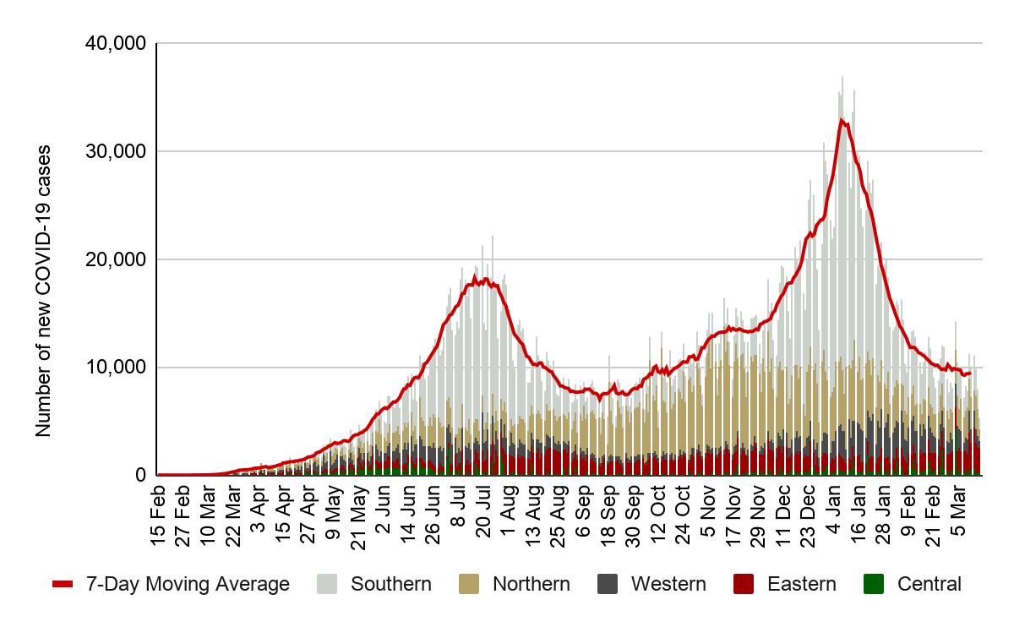
COVID-19 Situation in Africa
New COVID-19 cases* reported in Africa daily by AU Region from 15 Feb 20 – 16 Mar 21
>4M
>107K
>3.5M
cases
CFR: 2.7%
deaths
90%
recoveries
COVID-19 vaccine doses administered per 100 people, Mar 19
Key: Country reporting COVID-19 cases
No Report
1-10k
>10K-100K
Key: Country reporting COVID-19 cases
>100k - 500k
> 500k
1
2
1
No Report
1
2
4
1
1
1-10k
3
>10K-100K
>100k - 500k
> 500k
51
*Africa numbers are taken from official RCC and Member State reports.
Safeguarding Africa’s Health | www.africacdc.org
Notes:
Coming to the epidemiological situation in Africa, all 55 AU have been affected however we do not have current information for one MS. 45 MS have reported 100,000 cases or less. The epi chart is showing the number of new cases (y axis) reported by day (x Axis). The red line is the 7 day moving average which gives an indication of the trend of new cases. The new cases being reported from across the continent has continued to decline this past week. Cumulatively over 3.9 million cases have been reported, over 105K deaths (CFR 2.7%). Of the cases reported, 89% have recovered.

Slide 5
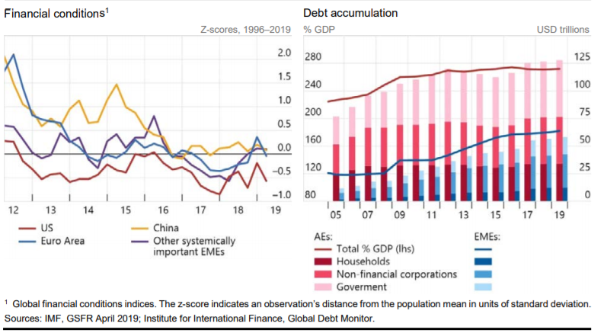
Lower for Longer and Global Debt Accumulation

Slide 6
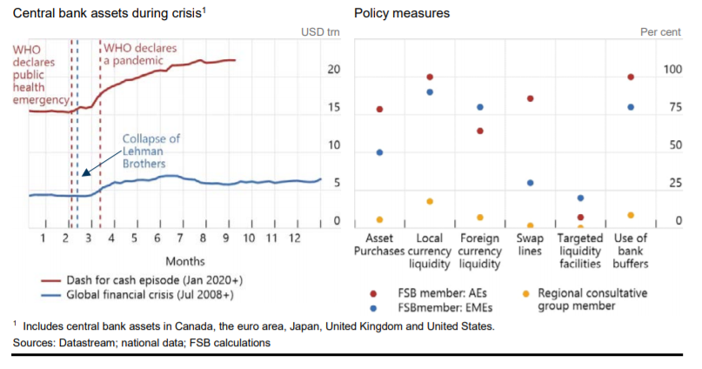
Liquidity: 7 trillion increase in G7 Central Bank Assets

Slide 7
A 100B USD Stimulus could have averted recession in 2020

Slide 8
Economic activity has been brought to a near-stand still
FDI Flows to Africa (in billion dollars)
billion
billion
Source: UNCTAD.
*Annual figures are estimated based on available partial-year data, in most cases up to the third quarter of 2020. The proportion of inflows from these economies in total inflows to their respective region in 2019 is used to extrapolate 2020 regional and global data.
Note: The data will be updated in WIR21.
Source: IMF, WEO, October 2020,
Note: Projections start after 2019
Source: IMF, WEO, October 2020,
Note: Projections start after 2019

Slide 9
Impact on Poverty in Africa
ECA estimates that between 49 million–161 million Africans have fallen into poverty due to COVID-19, with an estimated 100 million as the most likely scenario
Pre-crisis
Post-Crisis
Source: Based on data from the Background paper on Sustainable Development presented at the ARFSD, 2021
Note: Using the growth elasticity of poverty change approach, and with economic growth contractions of 1.8–5.4 % in 2020

Slide 10
Poverty and Vulnerability in Africa
Poverty in Africa is both extensive and deep. More than 1 billion people (or more than 80% of the total population) have a mean consumption of less than $5.50/day (PPP). Two-thirds of them live in countries with mean consumption of less than $1.90/day.
Not extreme poor but Vulnerable to falling into poverty
Not extreme poor but Vulnerable to falling into poverty
Extreme poor and Vulnerable to staying in poverty (<$1.90)
Extreme poor and Vulnerable to staying in poverty (<$1.9)
Source: ECA calculations using consumption data from Povcalnet

Slide 11
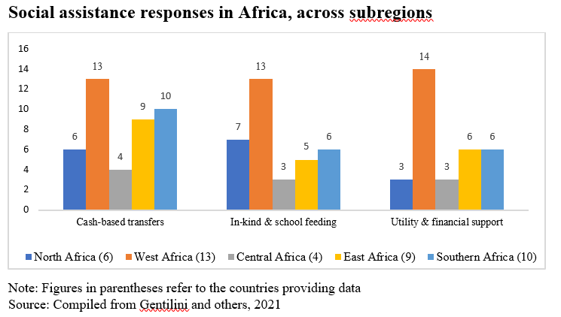
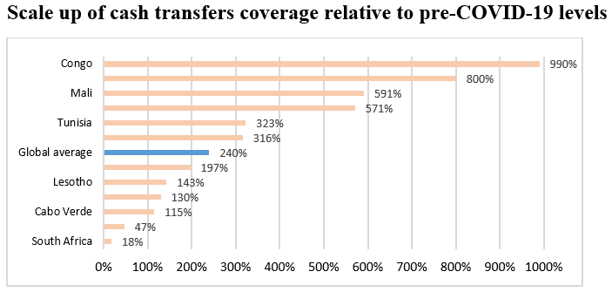
Social Assistance Spending in Africa is Far Less That of Other Regions
Globally, social assistance spending ranges from $6.1 billion in Africa to $290 billion in North America.
On per-capita basis, the 30 countries in Africa, for which data is available, spend only USD 10 per capita on social protection, against USD 361 per capita in East Asia and the Pacific and USD 442 per capita in North America.

Slide 12



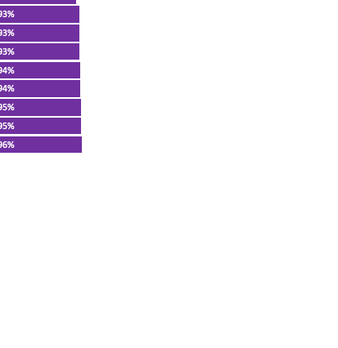
Impact on Learning and Skills: COVID-19 inflicted education losses for children in Africa have been significant – FUTURE IS AT RISK
Children engaged in any learning/education activities since school closures
(% of households with school-age children who attended school before the pandemic)
On average, only about half of households with children in Africa who attended school before the pandemic have engaged in any educational activities in the months following school closures
Source: WBG, COVID-19 High-Frequency Monitoring Dashboard, 2020

Slide 13
Another opportunity for liquidity SDRs SDR500bn (in SDR bn)
In a new allocation of SDR500bn, the G7 group will receive 10-times the amount of SDRs that will go to Africa
SDR Allocations based on existing quota
Source: IMF, February 2021

Slide 14
The Liquidity and Sustainability facility – an opportunity to be transformational
Private Sector Investor
Posts eligible bonds
Commercial Bank (Facility Administrator)
Provides financing to Commercial Bank
Posts collateral to Facility
Investor uses financing to purchase additional debt either on the primary or secondary markets.
* Credit risk to remain with the private sector investor
Financing “Facility” for Vulnerable Countries
Countries provide
interest-bearing
SDR deposits
Market
If needed, Sovereign (eg, Central Bank/DFI) provides first loss guarantee

Slide 15
LIQUIDITY AND SUSTAINABILITY FACILITY:
Comprehensive Package for Building Forward Together
Sound financial markets in Africa is a well-functioning debt market, including government and corporate bonds
AFRICA NEEDS ITS OWN FINANCIAL INSTITUTION
There are opportunities for deepening capital markets, crowding-in private capital and leveraging climate financing on the continent
AFRICA’S GREEN STIMULUS
Acting swiftly to prevent a ‘lost decade’
USD 345 billion gap (IMF)
Finance for energy and resilient infrastructure. Crowding in private sector
DEBT SUSTAINABILITY:
Debt for climate/ debt for nature swaps.
SDG LINKED BONDS:
ADVANCING GENDER EQUALITY AND WOMEN EMPOWERMENT
The implementation of the African Continental Free Trade Area (AfCFTA) also provides great opportunities for African capital markets to expand
PUBLIC FINANCE MANAGEMENT:
Green and Blue Bonds, with partial guarantees and enhancements for affordability
Domestic Resource mobilization, combatting illicit financial flows

Slide 16
THANK YOU!
Follow the conversation: #COM2021
More: www.uneca.org/cfm2021

