Slide 1
Highlights of ECA’s key achievements
Report of the Executive Secretary on the activities of ECA
(April 2021 to March 2022)
Said Adejumobi
Director, Strategic Planning, Oversight and Results Division (SPORD)
12 May 2022

Slide 2
Responding to new and emerging challenges
Despite the continued challenges of Covid-19 in 2021, ECA re-purposed itself and intensified efforts to better support its member-states and deliver on its programme of work around the key strategic directions:
  knowledge-generation to support effective policy making in Africa
  formulation of macro-economic policies and economic diversification
  innovative financing models
  support for regional and transboundary issues, and
  advancing of the continent’s position at the global level
Tangible successes and impacts have contributed to a consolidation of ECA’s position at the forefront of positively influencing decision-making and promoting economic resilience on the continent.

Slide 3
Supporting resilient recovery from the pandemic
Financing response to Covid-19
African countries benefit from the Debt Service Suspension initiative, with potential savings of over US$30 billion.
Release of Special Drawing Rights, resulting in resulting in up to USD 33 billion in additional liquidity for countries.
Launch of the Liquidity and Sustainability Facility
Support to recovery
Technical and global leadership for the negotiation and acquisition of 35% of the vaccines needed for Africa. Over 120 million vaccines made available to countries through the African Union Vaccine Acquisition Trust.
Data for results and impact
Launch of the Africa UN Data for Development Platform
Africa Data Leadership Initiative
Africa’s voice at the global level
African Common Position at the United Nations Food System Summit.
Establishment of high level group on the reform of the global financial architecture
Consensus on financing asks for recovery from Covid-19

Slide 4
Supporting AfCFTA implementation
National AfCFTA implementation strategies developed in 7 countries
Key performance indicators for the implementation of the Yamoussoukro Decision
42 countries ratified AfCFTA
AfCFTA country business index developed in 5 countries
Launch of the Centre of Entrepreneurship in Africa

Slide 5
Strengthening policy formulation and implementation
2021 Economic Report on Africa
Framework to strengthen national taxation policies
01
05
Addressing poverty and vulnerability
02
African Economic Conference, 2021
06
ECA Young Economist Network
Financing Africa’s post COVID-19 development
Migration statistics and skills recognition
03
Integrated planning and reporting toolkits
07
Adopted and mainstreamed in 4 countries
Six-country pilot studies ongoing
Africa Gender Index report and
cost of achieving the SDGs
04
E-census support
08
Kenya, Ghana, Zambia, Togo, Seychelles, Somalia, Mauritius, Namibia, Botswana, Rwanda and Sierra, Zimbabwe, Tanzania, Cote d’Ivoire, Liberia and Senegal
Support to five countries in assessing the cost of achieving Sustainable Development Goal 5

Slide 6
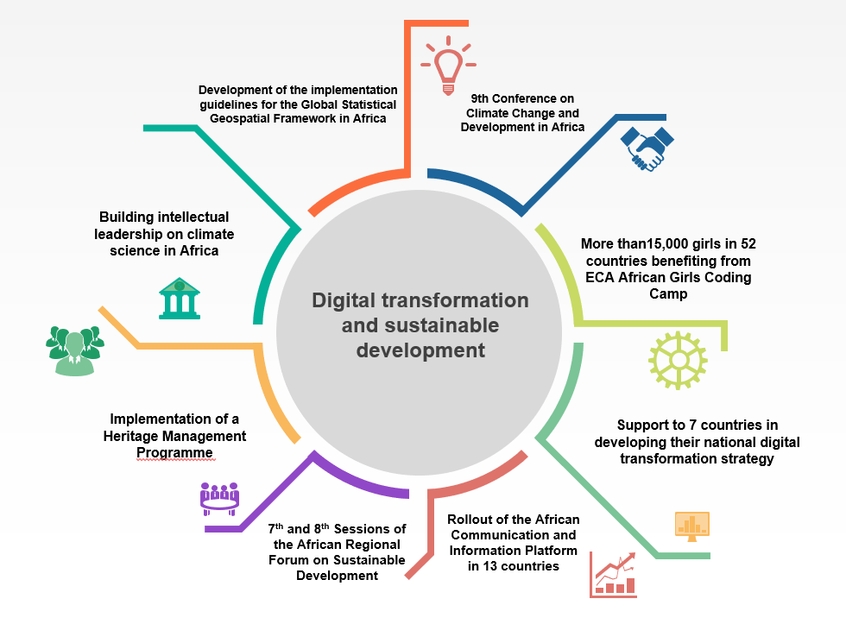
Digital transformation and sustainable development

Slide 7

Capacity building and partnerships
Curbing illicit flows
Working with UNCTAD and UNODC to assist 12 pilot countries to measure and track illicit financial flows, prevent IFFs and on asset recovery initiative
01
Capacity building & partnerships
Support to Least Developed Countries
02
Working with UN system to raise global awareness, mobilize international support and resources in favour of the least developed countries
03
Supporting African Union 2021 theme of the year
Leading the implementation of the heritage management programme to contribute to cultural and creative industries as a lever for sustainable development

Slide 8
Implementation of the regional reforms and operational modalities
Implementation of regional reforms and working with resident coordinators (RC)
Co-vice chair of the Regional Collaborative Platform for Africa
ECA strategy for enhanced collaboration with RCs and UNCTs
Operational modalities for enhanced delivery
Strengthened accountability systems
Emergency preparedness and business continuity activities
COVID-19 response and vaccination work in Ethiopia
Gender dimension at ECA
Environmental management system

Slide 9
THANK YOU!
Follow the conversation: #COM2022
More: www.uneca.org/cfm2022

