Slide 1
ECA Strategic Framework, Medium-Term Programme Framework (2022-25), and 2023 Proposed Programme Plan
Daya Bragante
Chief, Corporate Policy and Planning Section (CPPS), SPORD
11 May 2022

Slide 2

Contextualization
MEDIUM-TERM PROGRAMME FRAMEWORK (2022-2025)
ECA
STRATEGIC FRAMEWORK
2023 PROPOSED PROGRAMME PLAN

Slide 3






ECA Strategic Framework
Synergies
Our Common Agenda
2030& 2063 Agendas
Adopted in 2018 (51st session of COM)
To promote inclusive and sustainable development to accelerate the economic diversication and structural transformation of Africa, anchored in a renewed social contract, and to promote the accelerated achievement of the 2030 Agenda for Sustainable
Development and Agenda 2063: The Africa We Want in line with the SG Report on Our Common Agenda
OBJECTIVE
Programme of work of 13 SPs anchored into the Proposed Programme Plan
13 SUBPROGRAMMES
THINK TANK
1. Build
2. Formulate
3. Design
4. Integrate
5. Advocate for a Common position for Africa
CONVENING
5STRATEGIC DIRECTIONS
OPERATIONAL

Slide 4
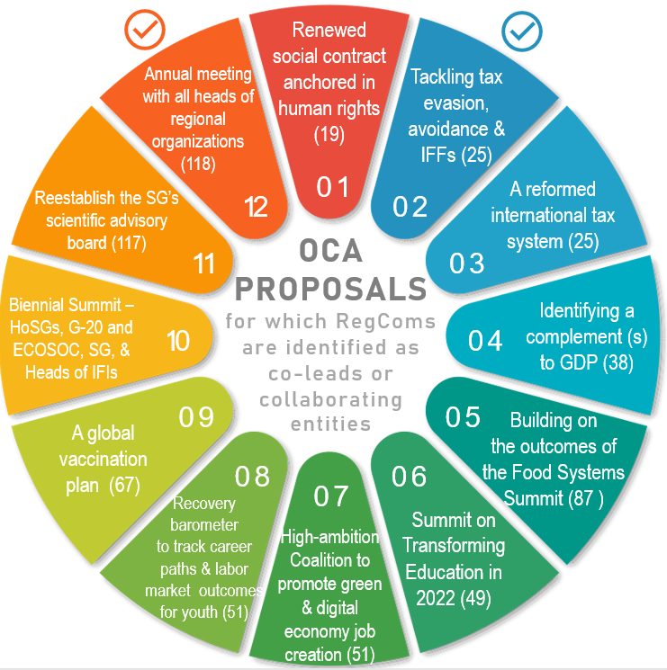
Implementing “Our Common Agenda”
UN Development System, through the Regional Collaborative Platform, is already working together across pillars which can deliver on the OCA: Deliberate action needed to mainstream OCA in flagship initiatives (e.g. AfCFTA)

Slide 5
Medium-Term Programme Framework (2022-2025) - MTPF
  ECA requested to develop the MTPF (Resolution 964 (LII) -E/ECA/CM/52/2, annex)
  Unifying framework for UNECA’s various strategic initiatives
  Brings together the thematic areas of UNECA work
  Provides single, forward-looking planning instrument covering several budget cycles
  Serves as clear and coherent communication tool showing UNECA contribution to African development, especially in context of Agenda 2063 and 2030 Agenda, Our Common Agenda
  Reference document for UNECA programming from 2022 – 2025

Slide 6
MTPF Five Transformations
Improved skills and employment possibilities
Equal access to opportunity
Sustained social investment
Safe, orderly migration
An Africa that invests in human potential
Promoting peaceful development
Addressing the continent’s debt
Promoting macroeconomic stability
Developing fiscal space
Developing effective decision-making capacity
Integration through trade (incl. support to AfCFTA)
Infrastructure for greater integration
Harmonization of policy frameworks for greater integration
An Africa of stable and effective institutions
An integrated Africa
Increasing productivity
Investment in sustainable resource use
Investing in climate action
Connected urban development
An Africa of sustainable, productive industries and economies
An innovative, connected Africa
Digital transformation
Fostering entrepreneurship and business development
Promotion of science and innovation

Slide 7
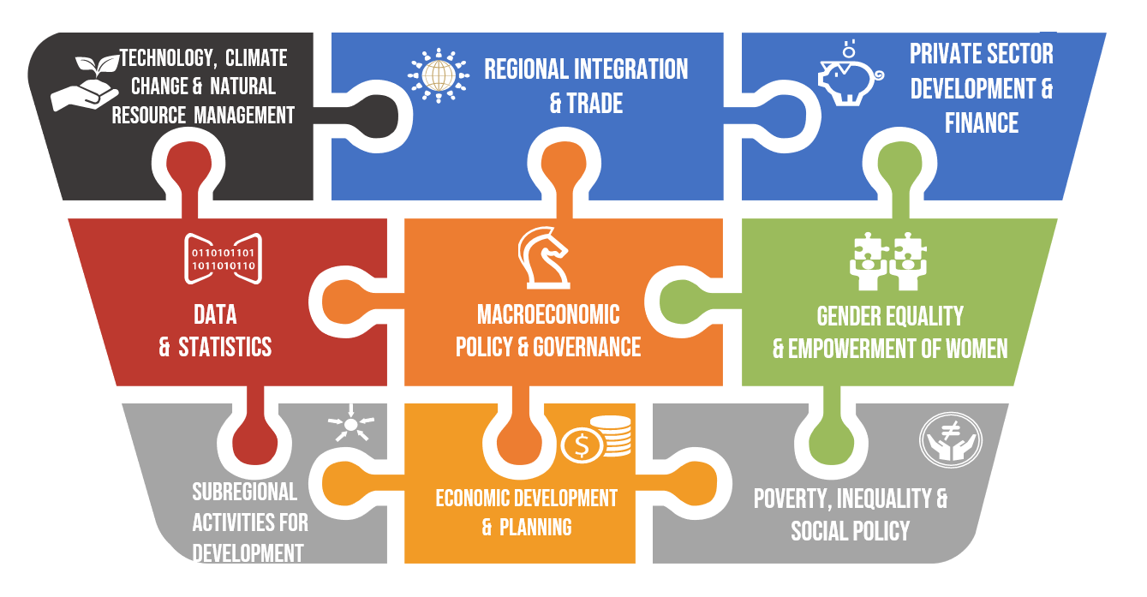
2023 Proposed Programme Plan
Thematic Cluster 1 :Trade & Regional Integration
Thematic Cluster 2: Macroeconomic Policy for Sustainable and Inclusive Development
Thematic Cluster 3: Poverty, gender and social policy
Thematic Cluster 4: Private sector, innovative finance and infrastructure development
Thematic Cluster 5: Data, statistics and digital transformation
Thematic Cluster 6: Climate change and green economy

Slide 8
2023 Proposed Programme Plan – Key Strategic Priorities
SP 1- Macroeconomic policy & governance
Development of macro-modelling tools, tracking of 2030 & 2063 agendas
SP 6 – Gender equality and women’s empowerment
Policy research, mainstreaming within ECA programmes, progress (Beijing Declaration and Platform for Action, the African Gender & Development Index, the African Gender Index)
SP 2 –Regional integration and trade
AfCFTA and training for negotiators
SP 3 – Private sector development &finance
Domestic resources mobilization, PPPs
SP 4- Data and Statistics
Support national statistical systems, Capacity-building of 2030 & 2063 Agendas
SP 7- C1 Subregional activities in Northern Africa
Research & workshops on employment creation through SMEs, migration data, workers’ skills
SP 5 –Climate change, environment and natural resources management
Digital transformation in Africa, ARFSD, VNRs, VLRs, mining strategies, Blue economy, climate resilience & disaster vulnerability
SP 7- C2 Subregional activities in Western Africa
Demographic dividends & regional integration, strategic partnership with ECOWAS -first five-year strategic plan (Vision 2050 & national plans)

Slide 9
2023 Proposed Programme Plan – Key Strategic Priorities
SP 7- C3 Subregional activities in Central Africa
Economic diversification strategies, training on IPRT, national AfCFTA strategies into bankable projects, support the harmonization of trade instruments in ECCAS an CEMAC
SP 8 – Economic development and planning
Face-to-face and online training on development, planning, promote peer learning, foster knowledge generation
SP 7- C4 Subregional activities in Eastern Africa
AfCFTA and regional value chains , blue economy, urban tourism & tourism satellite accounts
SP 9- Poverty, inequality and social policy
Support national policies, develop analytical knowledge and provide technical assistance on various frameworks, regional policy learning on urban job creation and urbanization dynamics
SP 7- C5 Subregional activities in Southern Africa
Support to SADC, COMESA, countries on inclusive industrialization & regional integration, AfCFTA, assist micro, SMEs

Slide 10
THANK YOU!
Follow the conversation: #COM2022
More: www.uneca.org/cfm2022

