Slide 1
Progress report on the Transformation and Modernization of National Statistical Systems in Africa (E/ECA/COE/40/12) Oliver Chinganya
Director, African Centre for Statistics 12th May 2022

Slide 2
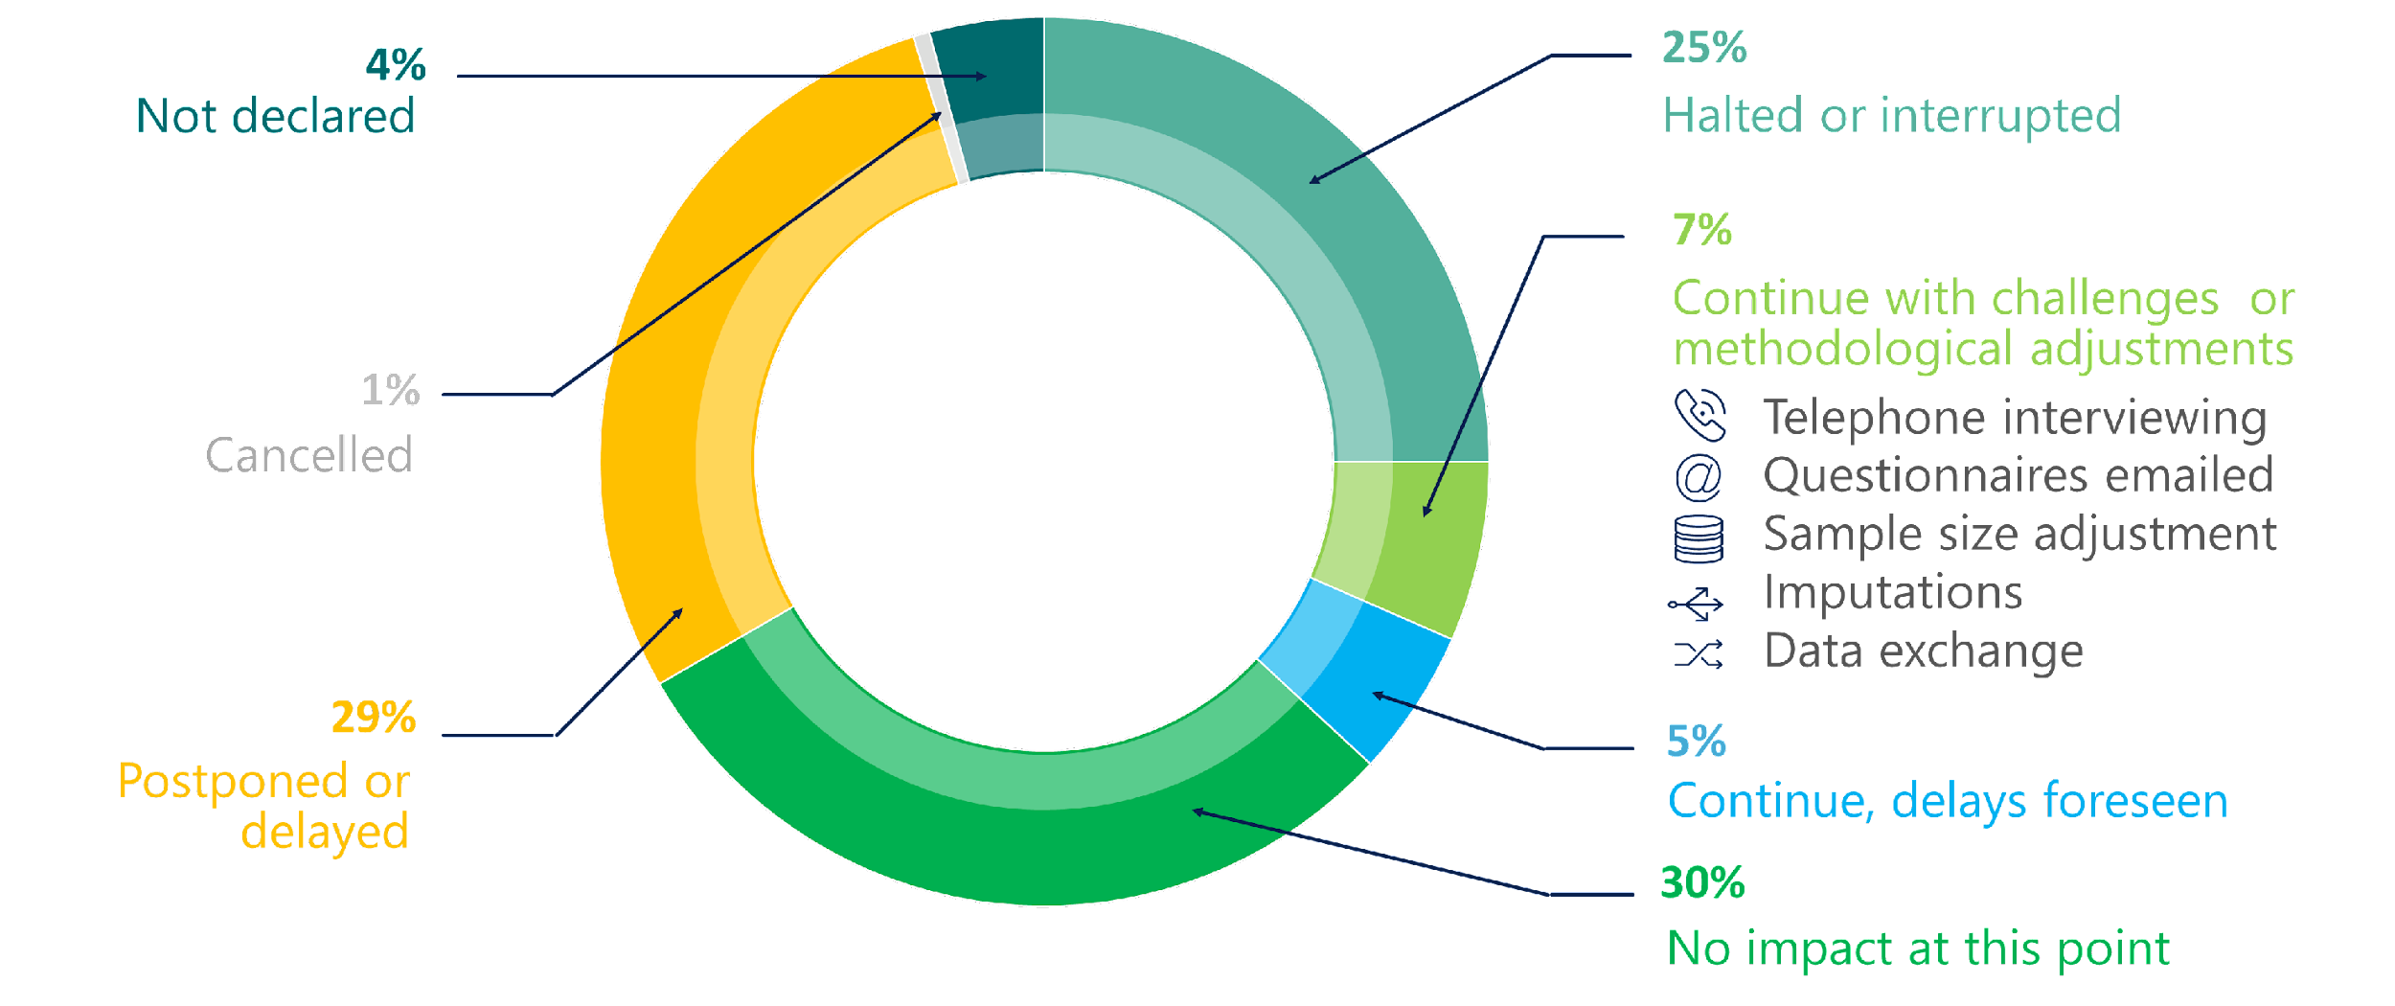
Why.… transforming and modernizing NSSs
Data demand by:
Agenda 2030
Agenda 2063
Sub regional agendas
NDP
Sub-NDP
AfCFTA
Supply:
Producers of official statistics
Gap to fill
COVID19 impact on surveys in Africa, Mid-April 2020

Slide 3
Institutional and operational setting
The African Group on Transformation and Modernization of NSS
Objective
Strategically guide and coordinate the work on transformation and modernization of national statistical systems in Africa
Members
Central Africa: Cameroon and Equatorial Guinea
East Africa: Rwanda and Kenya
North Africa: Morocco and Egypt
Southern Africa: Zambia and South Africa
West Africa: Niger and Nigeria.
Three technical teams
Image: Courtesy of Statistics Norway
Digitalization and integration of data science initiatives
Survey methodology
Coordination of the national statistical system and statistical legislation (including administrative data systems and other sources)

Slide 4
Progress and ongoing initiatives
Critical outputs
Other outputs and innovation
Assessment of NSSs in Africa in the three main ares
Comprehensive report on the transformation and modernization of NSS in Africa
Guidelines on user engagement in official Statistics
Data science campus
Modernization of administrative data
Alternative data collection (CPI)
Integration of geospatial information and statistics
Digital Census
AGTM Secretariat
In progress
Road map for transforming and modernizing NSSs in Africa
Instititionnal
Modernization of statistical legislation
Leadership programme in Statistics
NSDSs

Slide 5
THANK YOU!
Follow the conversation: #COM2022
More: www.uneca.org/cfm2022

