Slide 1
Subregional Policy dialogue on CoM22 Theme: the uptake
Mr. Jean Luc Mastaki Namegabe
Officer-in-Charge, Subregional Office – Central Africa
11 May 2022

Slide 2
Table of content
Objectives and ambitions of the discussion series and policy dialogues.
A financing landscape facing many challenges.
Five sub-regional offices: key messages from the policy dialogues
Harnessing opportunities arising from the SDRs.
Mobilizing Climate Financing : which technical Support ?
Making an optimal use of the abundant “old money”.
Structural transformation and market integration for a resilient Africa.

Slide 3
Objectives and ambitions of the discussion series and policy dialogues
Discuss the theme of the CoM2022 and socialize the Issues Paper at subregional level.
Understand subregional financing landscape, challenges and opportunities for financing recovery.
Identify measures to crowd-in private sector financing, utilize SDRs, mobilize climate financing.
Enable stakeholders to go to CoM2022 with a fresh assessment of the financing issue
Multi-stakeholder’s engagement : public and private sectors, academia, CSOs, media, UNCTs.

Slide 4
Dates, participants and nature of sessions per subregion
A Physical session, Douala, 17 March 2022.
A Virtual meeting on financing economic diversification, 27 April 2022.
A physical dialogue with the West African Economic Journalists Network, Lomé, 15 – 16 February 2022.
A virtual dialogue on 19 April 2022 with high-level panel of experts.
Webinars on Digital finance in post pandemic recovery, 14 April 2022 and on Improving access to finance for SMEs in North Africa, 19 April 2022.
Physical session on the sidelines of SADC National Planning Entities’ meeting, 8 April 2022.
Virtual Dialogue on Financing Africa’s Recovery, 20 April 2022.
Webinar on 28 - 29 March 2022. Engaging the private sector on 31 March 2022 during the EATIW. Private sector dialogue with the EABC, 6 April 2022.

Slide 5
A financing landscape facing many challenges
Huge SDG financing needs and post-pandemic gaps widening.
Public debt evolving towards commercial borrowing.
Rising debt crisis exacerbated by pandemic.
Ukraine Crisis to worsen fiscal challenges might lead to debt burden.
Low DRM capacity, underdeveloped capital markets and limited external financing.
Private sector credit to GDP ratio is quite low.
High interest rates and risk profiles, lack of trade finance instruments, high default rates.

Slide 6
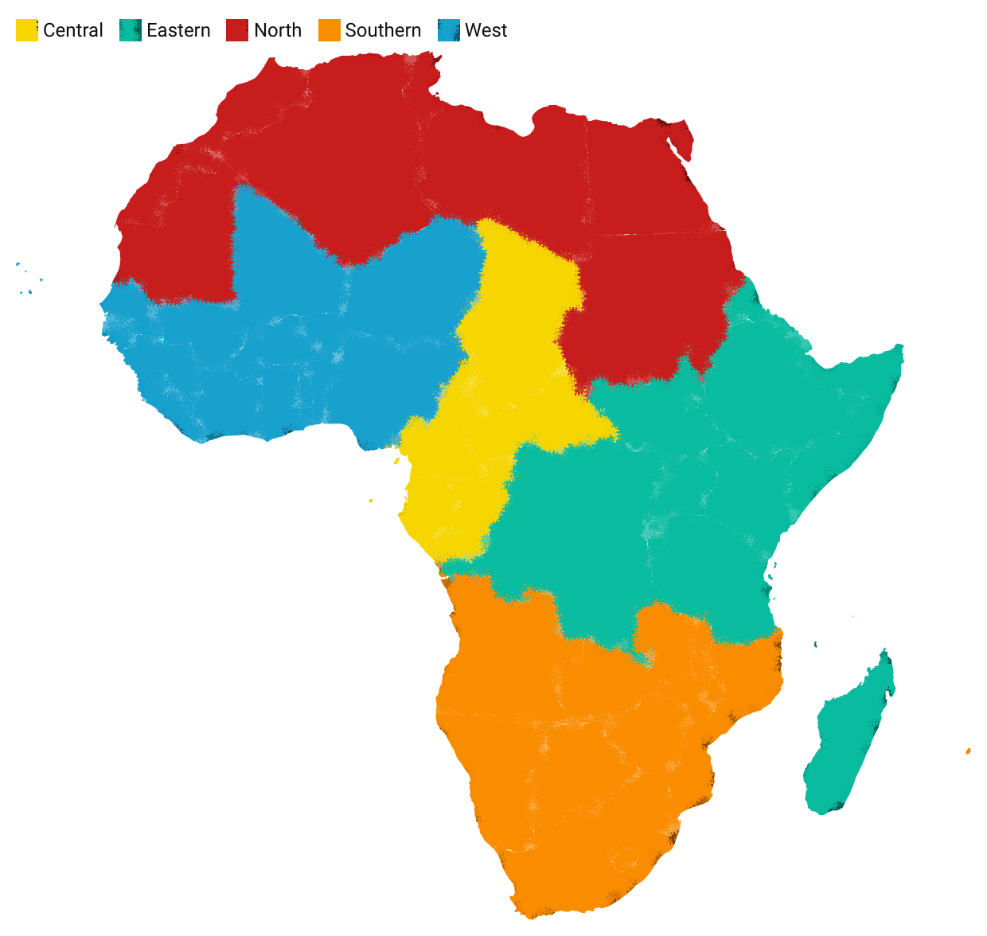

Five sub-regional offices: key messages from the policy dialogues
NORTH AFRICA
EASTERN AFRICA
Harnessing digital finance and support to SMEs and youth employment.
Mobilizing innovative financing, digital instruments, deepening financial markets and private sector involvement in support of the AfCFTA.
WEST AFRICA
Mobilizing global partnership for sustainable development and special needs of the Sahel.
SOUTHERN AFRICA
CENTRAL AFRICA
Accessing affordable financing for SMEs, mobilizing SDRs and financing regional value chains towards Inclusive Industrialization.
Harnessing natural capital and green financing towards expanding fiscal space for economic diversification

Slide 7
Harnessing opportunities arising from the SDRs
The IMF SDRs when properly managed and deployed will positively impact on long term economic growth and resilience.
SDRs are meant to provide short term liquidity and are not suitable for equity financing for Africa’s long-term needs. SDRs should be readily available to lenders on short notice.
Encourage developed countries to lend their SDRs to African countries or to African development financial institutions.
Predominant African young population requires huge investments in health, education. Need ways to channel some of these SDRs toward these ends.

Slide 8
Mobilizing Climate Financing : which technical Support ?
Improve awareness raising on climate change and financing; build capacity to tap into available mechanisms e.g., climate financing, carbon credits, carbon markets.
Identify creative ways to deploy part of SDRs resources for adaptation and mitigation measures.
Support the rising awareness on the benefits of engaging in green and circular economy.
Define forms of taxes on key processes and activities with negative climate change impacts.
Climate financing may not be directly monetarized. Countries to take the route of demonetarizing resource mobilization.
Need for an African declaration with an agreed upon dedicated percentage of national budgets for climate change financing.

Slide 9
Making an optimal use of the abundant “old money”
Use the windfall to settle costly public debts. Mineral commodity price boom to repair damaged fiscal situations as part of efforts to attract FDIs and stabilize macroeconomic environments.
Prudent use of available funds, encourage pension and insurance funds to invest locally.
Address illicit financial flows stemming from poor governance leading to tax evasion and fiscal leakages.
Increase budgetary effectiveness, more transparency and efficient allocations. A more appropriate and equitable tax policy towards broadening the tax base.
Discourage from providing generous tax exemptions, promote tax policies encouraging formalization of SMEs.

Slide 10
New grounds and niches for recovery financing
African countries should go into the digital space and mobilize domestic resources from e-commerce.
Build sovereign wealth funds and harness financial benefits related to the natural capital.
Reduce on inefficiencies in govt expenditure, plug the financial holes, reinforce the scope of DRM.
Need to tap into existing opportunities on climate change e.g. debt for nature swaps.
Use of SDRs as additional resources to address developmental needs of Africa.
Bring subregional perspective to the bigger financing questions to shape policies.

Slide 11
Structural transformation and market integration for a resilient Africa
Promote inclusive industrialization, modern services development and economic diversification for resilience.
Fasten continental integration to promote resilience drawing lessons from the two recent crises.
Promote financing for regional value chains systems to take advantage of the AfCFTA.
Strengthen regional payment systems towards promoting intra-Africa trade.
Explore and leverage on digital finance and economy to drive trade and investment.
Reinforce internal capacity to prepare SMEs to benefit from trading under the AfCFTA.

Slide 12
THANK YOU!
Follow the conversation: #COM2022
More: www.uneca.org/cfm2022

